Slide 1
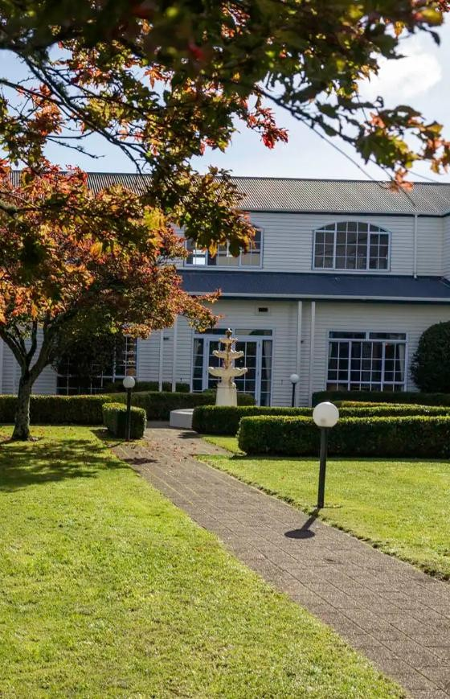


Wairakei Resort Taupō
Now Managed by Accor
Delivering more than a venue – it’s a destination.

Slide 2
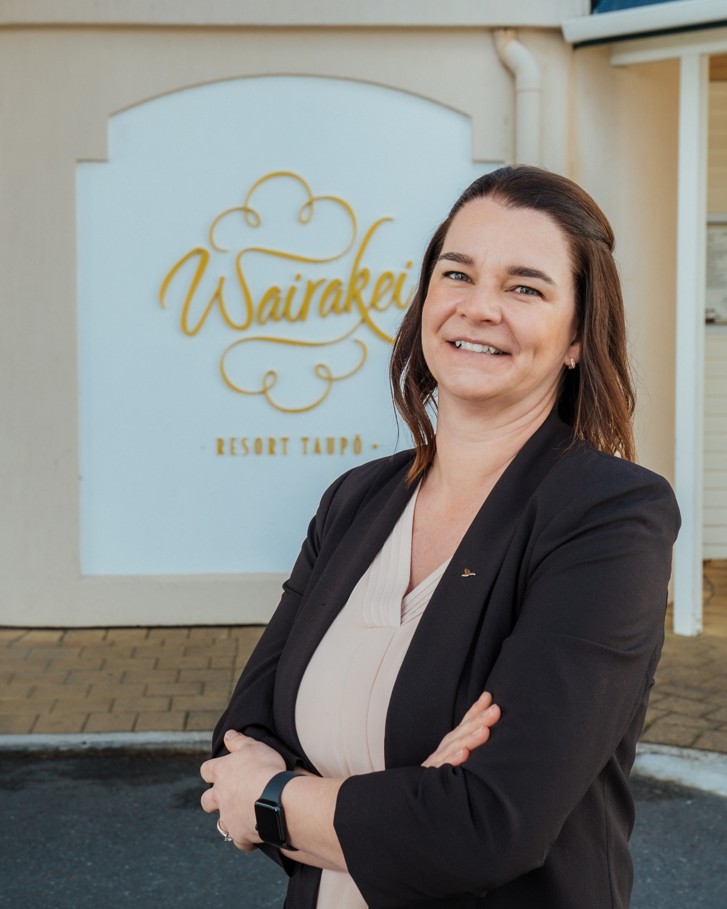
Message from the General Manager:
Wairakei Resort Taupō holds a special place in the hearts of both locals and travelers. This unique destination offers everything families, couples, groups, and business guests need for a complete getaway. With 187 guest rooms, nine conference venues, two hot pools, two spas, a tennis court, gym, sauna, nine-hole golf course, squash court, and a full sports oval, visitors can create their own style of holiday and lasting memories.
I am honoured to have stepped into the role of General Manager this year and look forward to working with our talented team to elevate the resort’s experience under the Accor banner.
Jade Bolstad.

Slide 3
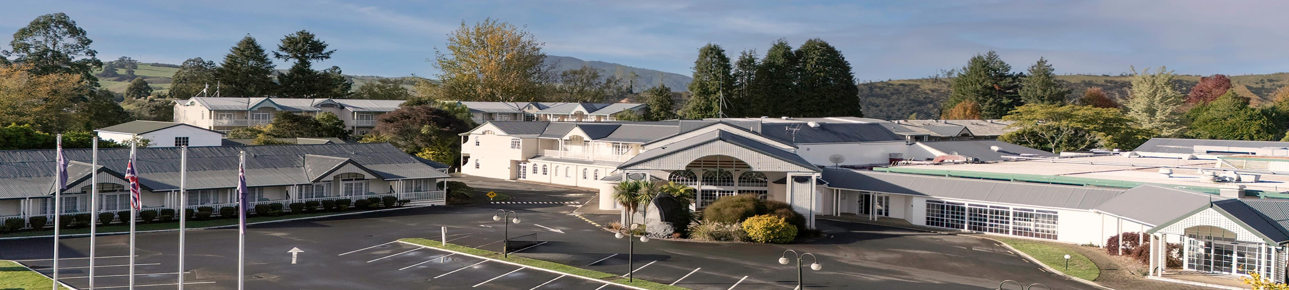
Wairakei Resort Taupō
Wairakei Resort Taupō is a landmark property set within the Wairakei Geothermal Valley, offering a blend of historic character and cosycomfort since its
origins in 1886.
Located approximately halfway between Auckland and Wellington, Wairakei Resort Taupō is easily accessible by road – just 3.5 hours from Auckland and
4.5 hours from Wellington – or via regular domestic flights into Taupō airport (20 minutes drive from the resort). All international arrivals transiting in
Auckland or Wellington.
As the largest accommodation and events facility within the Taupō region, the resort offers a peaceful and spacious environment ideal for all travelers including residential conferences, romantic getaways, family holidays, or group retreats.

Slide 4
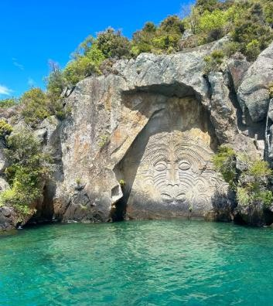
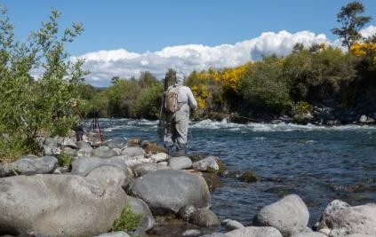
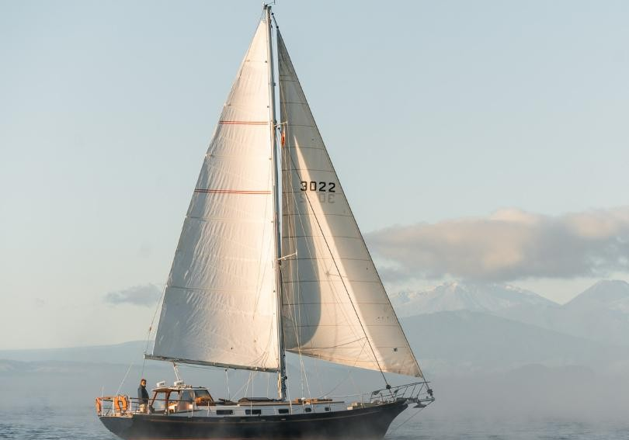
Great Lake Taupō & Mighty
Waikato River
Whether enjoyed for its serenity or sport, Lake Taupō and the Waikato River are central to the visitor experience. Both offer a diverse range of activities suitable for all ages and seasons, and embody geological, cultural, and recreational richness of the Taupō region.
Lake Taupō (5km from Resort)
New Zealand’s largest freshwater lake, formed by a massive volcanic eruption over 26,000 years ago. Ideal for boating,
kayaking, fishing, swimming, sailing, and scenic cruises.
Waikato River
Originating from Lake Taupō, the countries longest river is perfect for kayaking, jet boating, and riverside walks.
Great Lake Trail
A scenic multi-use trail that loops around Lake Taupō for cycling and walking, offering spectacular lake views.
Fishing & Fly Fishing
The lake and surrounding rivers are internationally recognized for trout fishing, particularly fly fishing, drawing anglers world-wide.

Slide 5
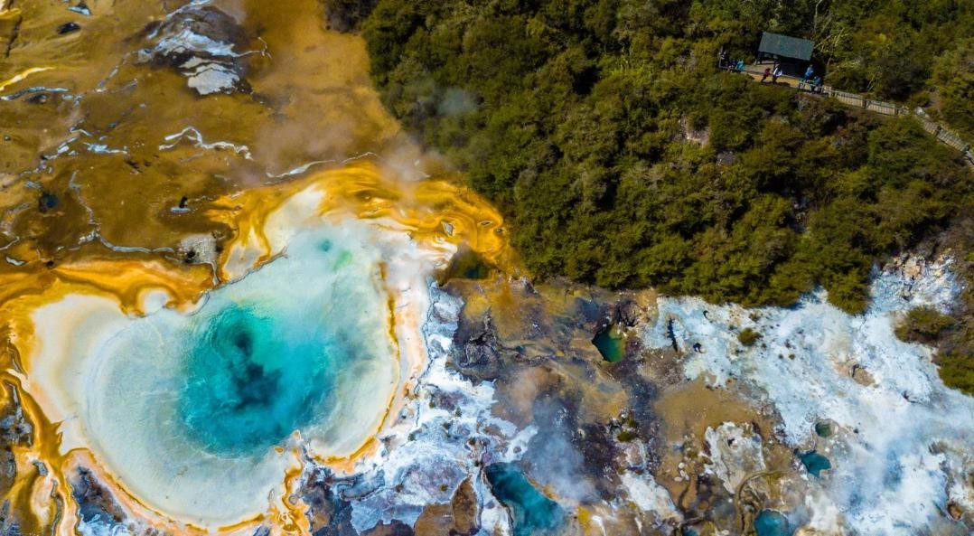
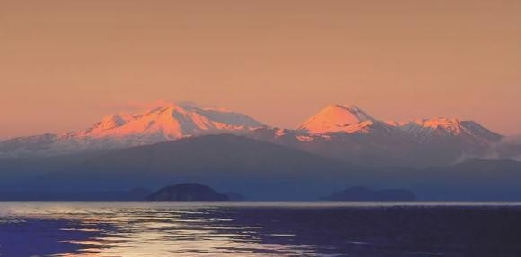
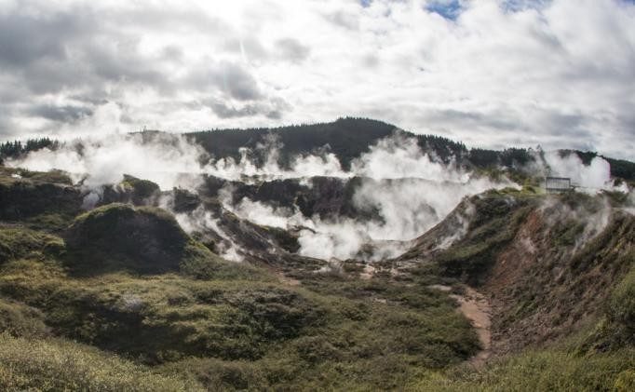
Natural Landscapes & Geothermal Wonders
The Taupō region is renowned for its diverse and dramatic natural landscapes, shaped by
thousands of years of volcanic activity.
The ever-evolving environment features steaming valleys, mud pools, mineral rich hot springs, and striking volcanic terrain – making the area a hub for eco-tourism, nature-based exploration, and geothermal experiences.
Key geothermal highlights of the region includes:
Wairakei Terraces & Thermal Valley (500m from Resort)
Combining Māori culture with natural geothermal wonders, the terraces offer therapeutic hot pools and guided tours highlighting the geothermal and cultural history of the area.
Craters of the Moon (3.5km from Resort)
Just a few minutes from the resort, this accessible geothermal walkway allows visitors to get up and close to steaming vents, mud pools, and craters formed by underground activity.
Orakei Korako – The Hidden Valley (30km from Resort)
Featuring brightly colored silica terraces, geysers, steaming caves, and hot springs.

Slide 6
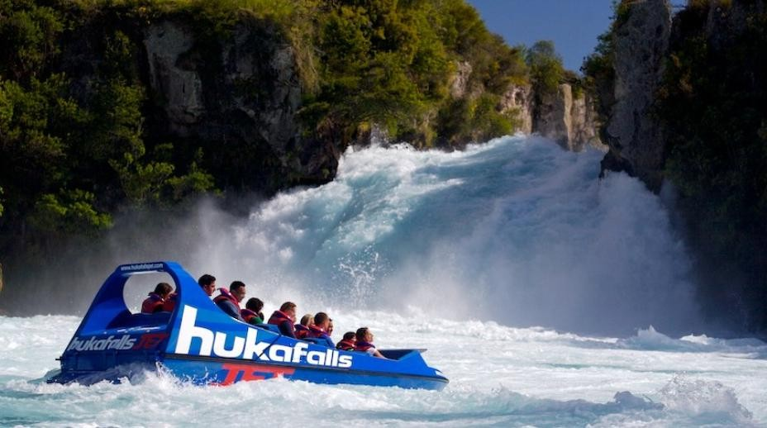
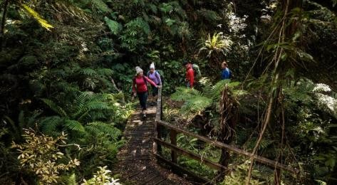
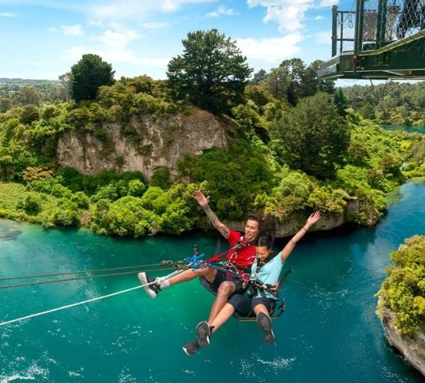
Local Attractions & Activities
Wairakei Resort Taupō’s central location provides easy access to a wide range of exciting local attractions and activities. From iconic natural landmarks and thrilling adventure experiences, to world-class golf, there is something to suit every interest. These nearby experiences complement the resort, offering a perfect balance of relaxation and adventure. To list a few:
Huka Falls (3km from Resort)
New Zealand’s most popular natural attraction, featuring a powerful waterfall.
Wairakei International Golf Course (1km from Resort)
A world class golf course set within a wildlife sanctuary.
Huka Prawn Park (2km from Resort)
A family attraction where visitors can catch, cook and eat their own freshwater prawns.
Taupō Bungy & Swing (8.5km from Resort)
Offering adrenaline pumping jumps in spectacular natural settings.
Huka Honey Hive (2km from Resort)
An interactive experience showcasing New Zealand’s famous Manuka Honey production.
Skydiving – Lake Taupō (18km from Resort)
Freefall with panoramic views of Lake Taupō and mountains. Mountain Biking – Great Lake Trail (10km from Resort) Offering retail, dining and lakefront attractions.
Caving & Bushwalks
Explore limestone caves or venture on forest walks in the region's conservation areas.

Slide 7
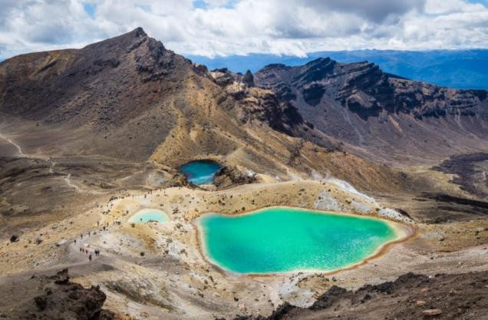
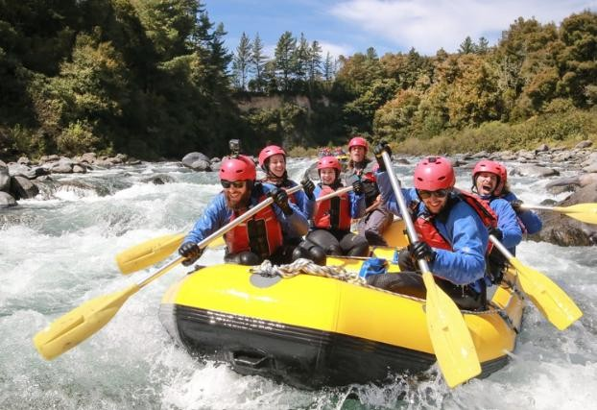
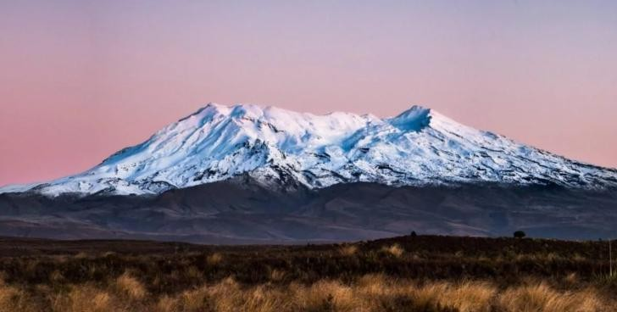
The Wider Taupō Region
Attractions & Activities
The broader region around Taupō is renowned for outdoor adventures and stunning wilderness landscapes. A small collective includes:
Tongariro National Park (100km from Resort / 1.5 hours)
An UNESCO Dual World Heritage Area known for its volcanic peaks, native alpine flora, and the iconic Tongariro Alpine Crossing – considered one of the worlds
best one-day hikes.
White-Water Rafting – Tongariro River (60km from Resort / 50 minutes)
Rafting experiences through scenic gorges and rapids.
Whakapapa (100km from Resort / 1.5 hours)
Located on Mount Ruapehu, Whakapapa is a famous ski field in New Zealand. Offering skiing, snowboarding, sledding and scenic chairlifts.

Slide 8
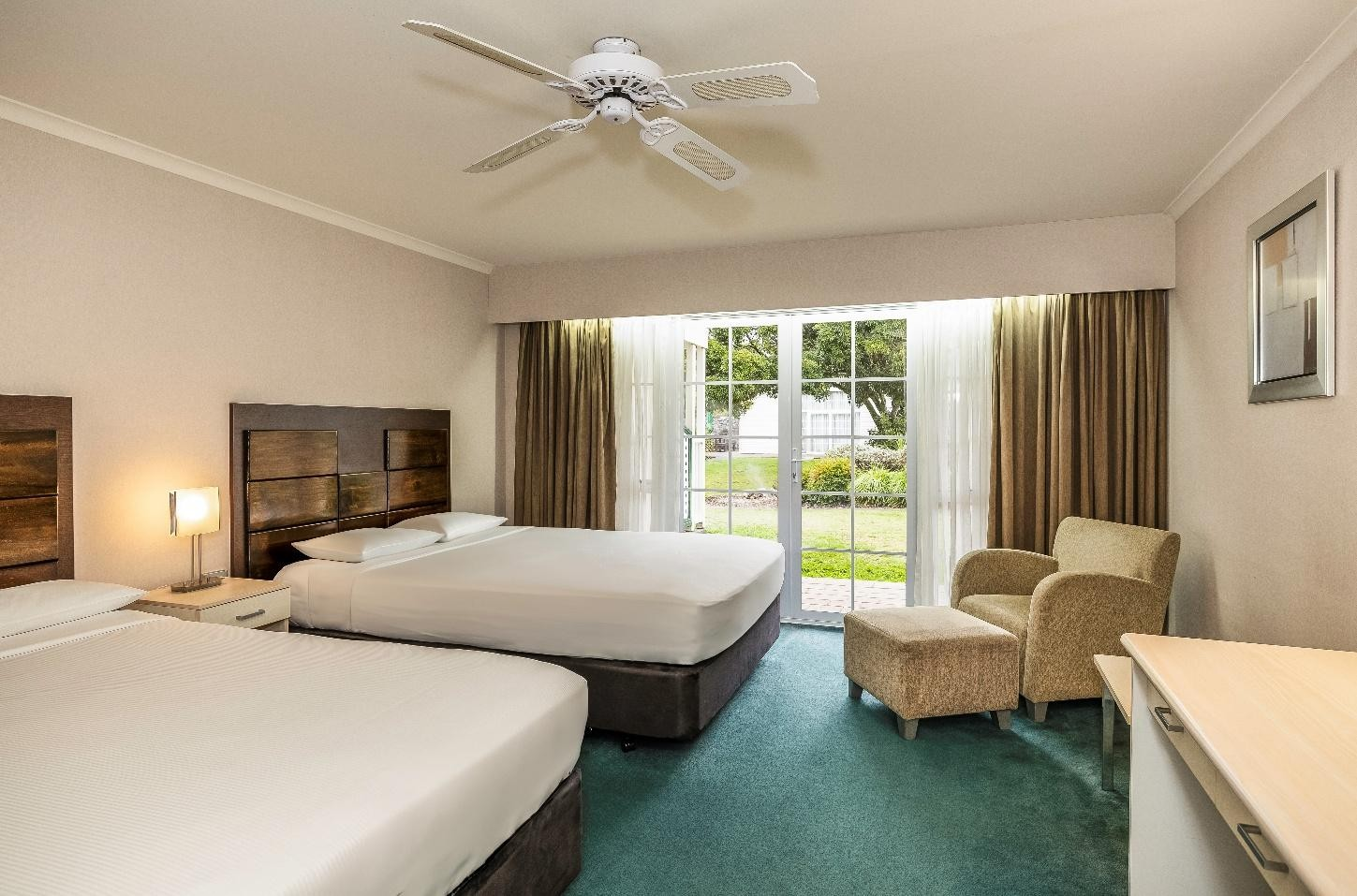
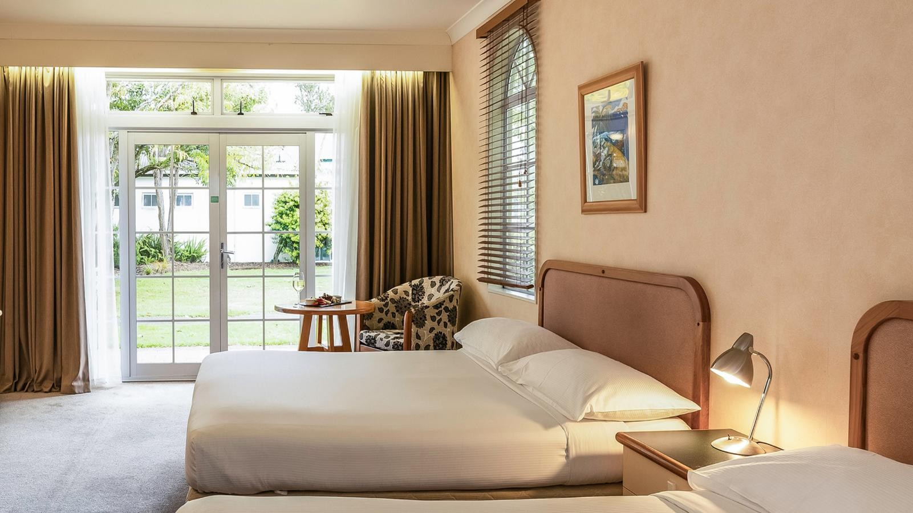
Resort Accommodation 187 Keys
Spacious suites, and family villas, all with en-suites and geothermal heating. From twin rooms for up to 4, to king-bed suites and fully equipped villas, there’s comfort for everyone. Options to choose from:
Standard King Room
Waiora Superior King Room
Huka Standard Twin Room
Tauhara Superior King Room
Tauhara Superior Twin Room
Executive Villa
Superior Twin Room
Junior Suite
Executive Junior Suite
Family Villa
Rangatira Suite
20 rooms
40 rooms
34 rooms
15 rooms
33 rooms
15 rooms
6 rooms
2 rooms
6 rooms
15 rooms
1 room

Slide 9
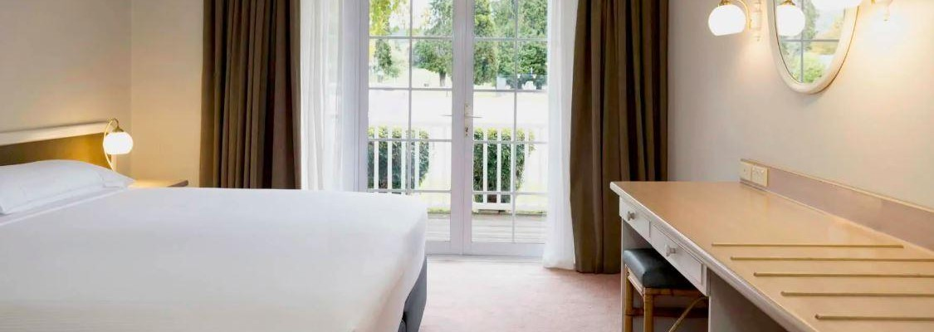
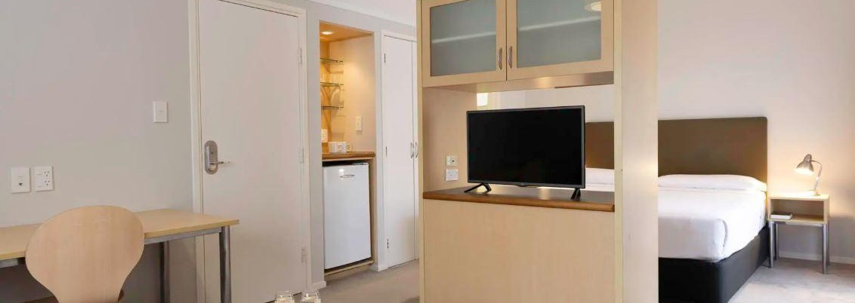
Standard King Room
KGC
20 rooms
Maximum 2 Guests
One king bed
King beds can be split into two single beds
Shower over bath
Tea and coffee making facilities
Eight rooms interconnect with each other (two rooms max to interconnect)
Space for one rollaway
Wall heater
Executive Villa
VEC
15 rooms
Maximum 2 Guests
One king bed
Beds cannot split
Walk in showers
Tea and coffee making facilities
All rooms interconnect to Family Villa X 15
Space for one rollaway bed
Wall heater

Slide 10
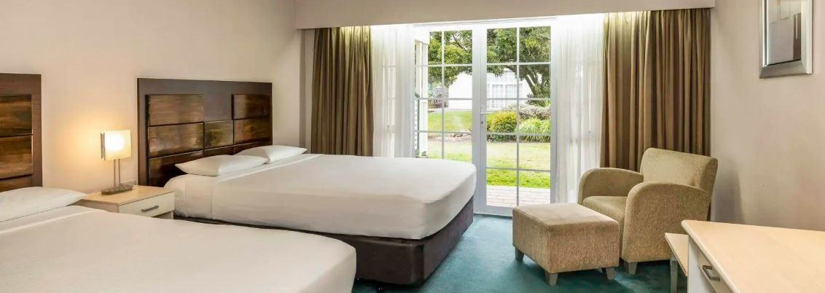
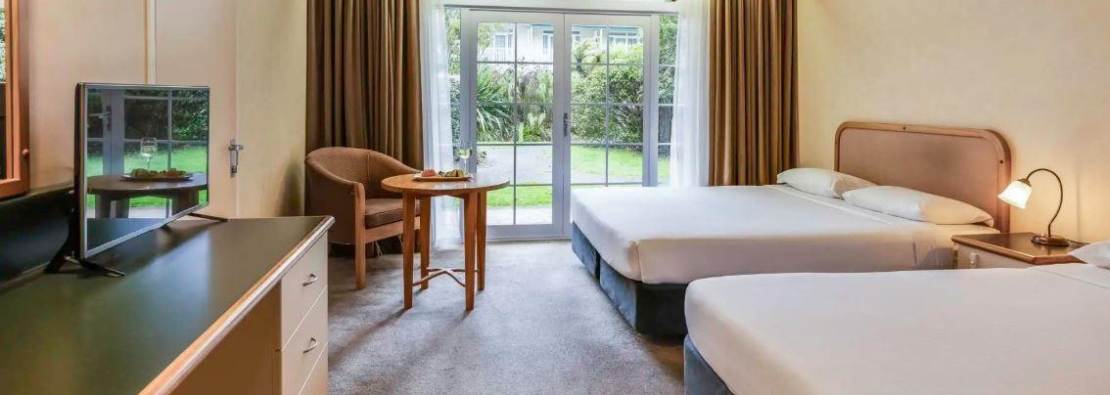
Huka Standard Twin Room
Q2C
34 rooms
Maximum 4 guests
Two queen beds
Beds cannot be split
Shower over bath
Tea and coffee making facilities
Eight rooms interconnect with each other (two rooms max to interconnect)
Space for one rollaway
Wall heater and rollaway
Wall heater
Tauhara Superior Twin Room
TWBBC
33 rooms
Maximum 4 Guests
Two queen beds
Beds cannot be split
Shower over bath
Tea and coffee making facilities
Fifteen rooms interconnect to the Tauhara King room
Space for one rollaway bed or one porta cot
Full air conditioning

Slide 11
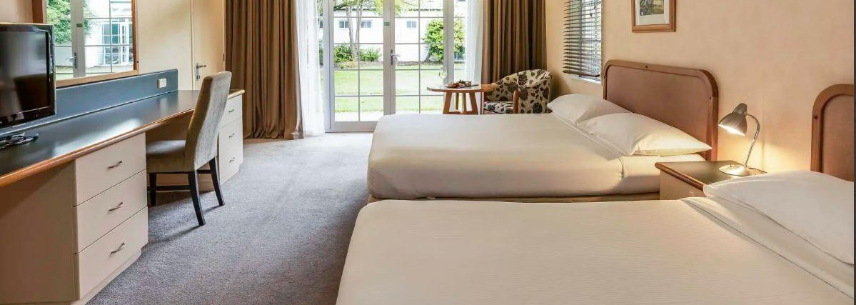
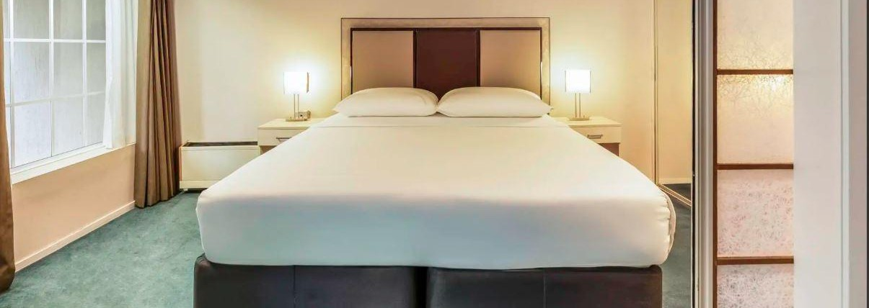
Superior Twin Room
TWB
6 rooms
Maximum 4 Guests
Two double beds
Beds cannot split
Shower over bath
Tea and coffee making facilities
All rooms interconnect to an EKS
Space for one rollaway bed or one porta cot
Full air conditioning
Junior Suite
SKD
2 rooms
Maximum 2 Guests
One king bed, separate lounge
Beds cannot split
Separate shower and bath in the ensuite
Tea and coffee making facilities
Rooms do not interconnect
Rollaway beds
Wall heater

Slide 12
Family Villa
V1A
15 rooms
Maximum 4 Guests
One king bed, separate lounge with one single bed and one
roll-out bed
Beds cannot be split
Shower over bath, laundry facilities
Tea and coffee making facilities, small kitchenette with microwave and stove top
All rooms interconnect to a STU
Space for one rollaway bed
Wall heater
Executive Junior Suite
SKDA
6 rooms
Maximum 2 Guests
One king bed, separate lounge
Beds cannot be split
Separate shower and spa bath in the ensuite
Tea and coffee making facilities
All rooms interconnect to a Superior Twin X 6
Rollaway beds
Air conditioner

Slide 13
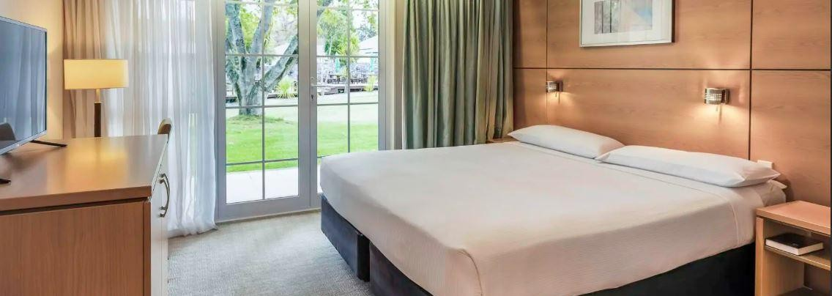
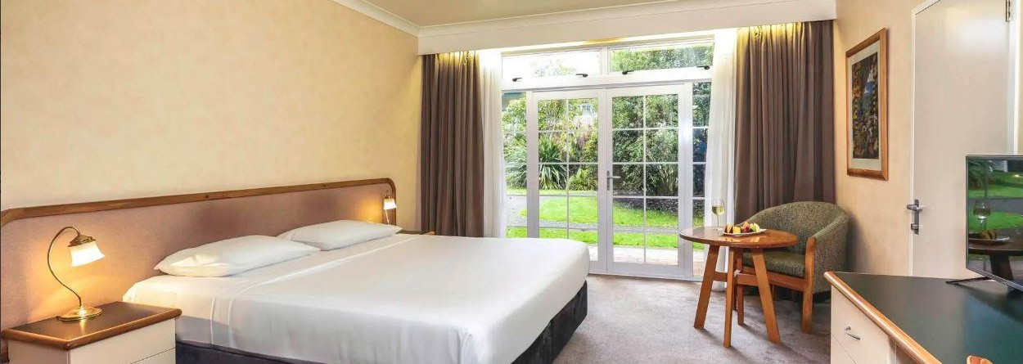
Waiora Superior King Rooms
KBG
40 rooms
Maximum 2 Guests
One king bed
King beds can split into two single beds
Walk-in shower or shower over bath
Tea and coffee making facilities
Fourteen rooms interconnect with each other (two rooms max to interconnect)
No space for one rollaway
Full air conditioning
Tauhara Superior King Room
KGBBC
15 rooms
Maximum 2 Guests
All beds can be split into two single beds
Beds cannot be split
Shower over bath // four rooms have paraplegic
Tea and coffee making facilities
All rooms interconnect to a Tauhara Twin
Space for one rollaway bed
Full air conditioning

Slide 14
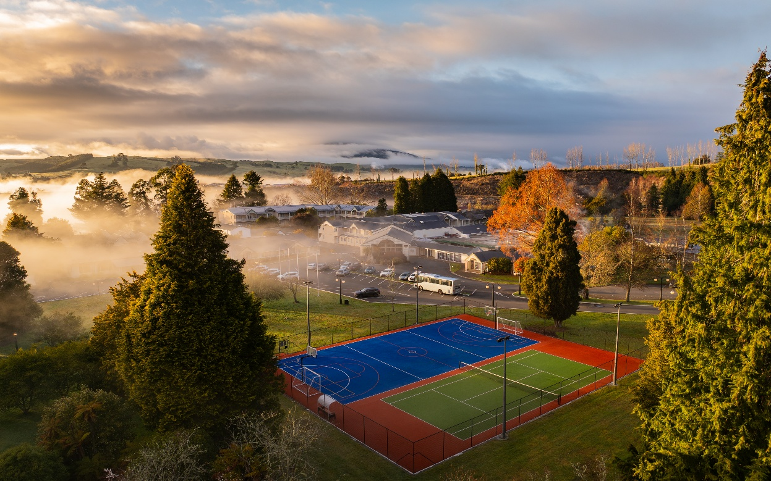
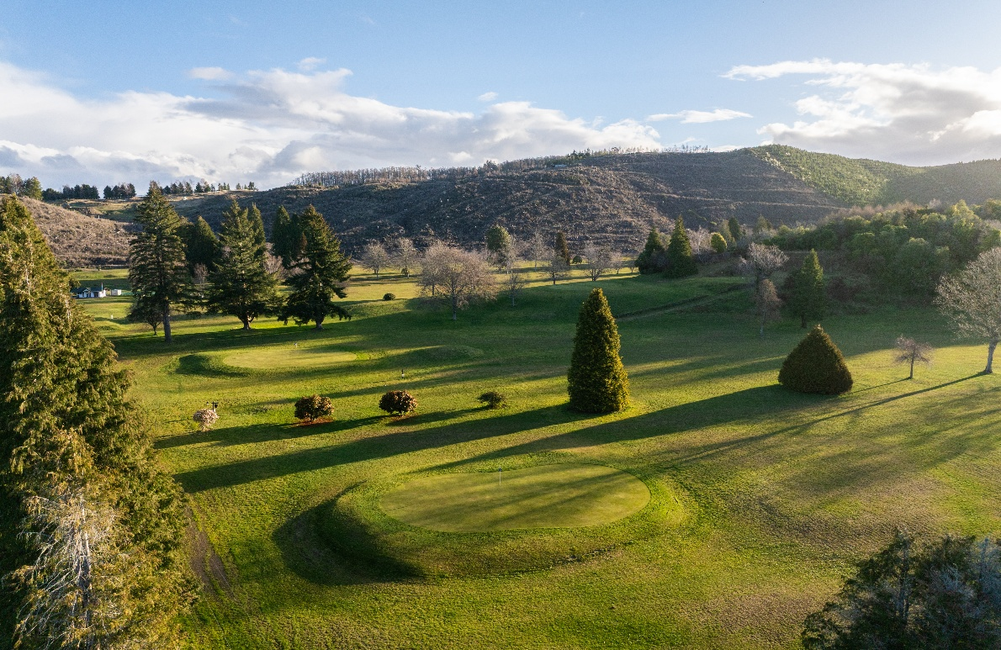
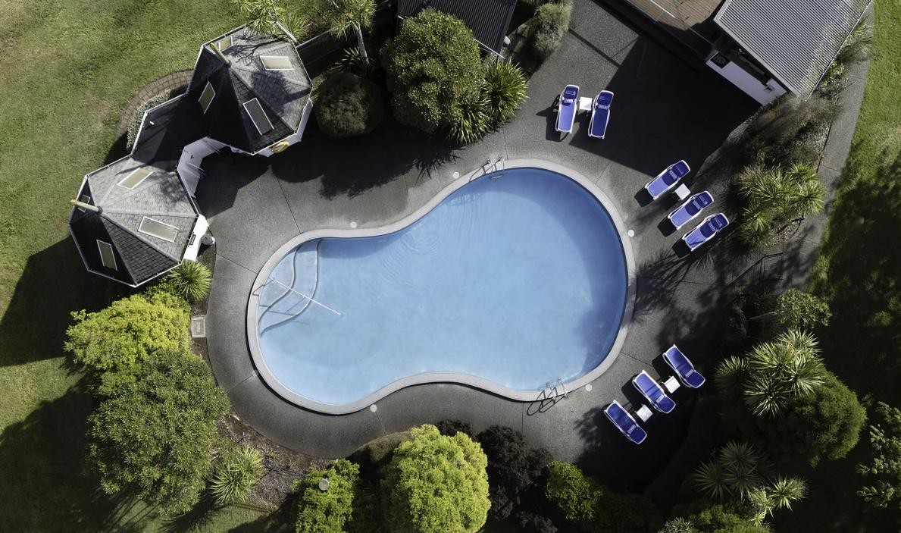
Wairakei Resort Taupō Services
Wairakei Resort Taupō offers a wide range of on-site services and facilities designed to deliver a complete guest experience.
The resort is well equipped for recreation and relaxation, with a 9-hole golf course, two outdoor swimming pools, spa pools, a sauna, a fitness centre, tennis court, and multipurpose courts (soccer, basketball, netball). Families are well catered for, with a dedicated children's playground and spacious outdoor areas for safe, active play. Guests can also enjoy access to scenic walking tracks directly from the resort.
Additional guest services include 24-hour reception, complimentary Wifi, ample free parking, laundry services, and assistance with booking local activities and tours.

Slide 15

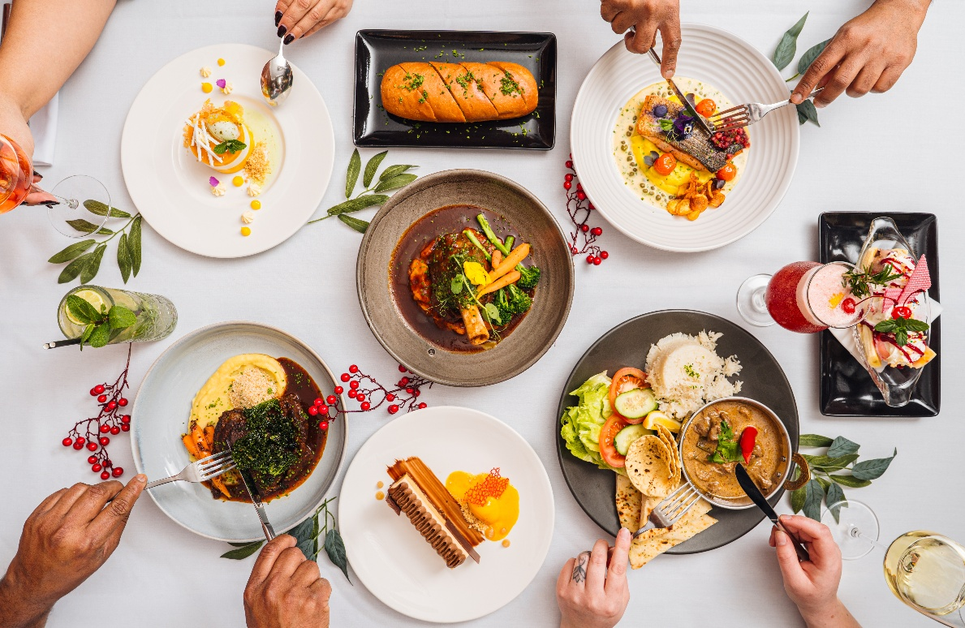
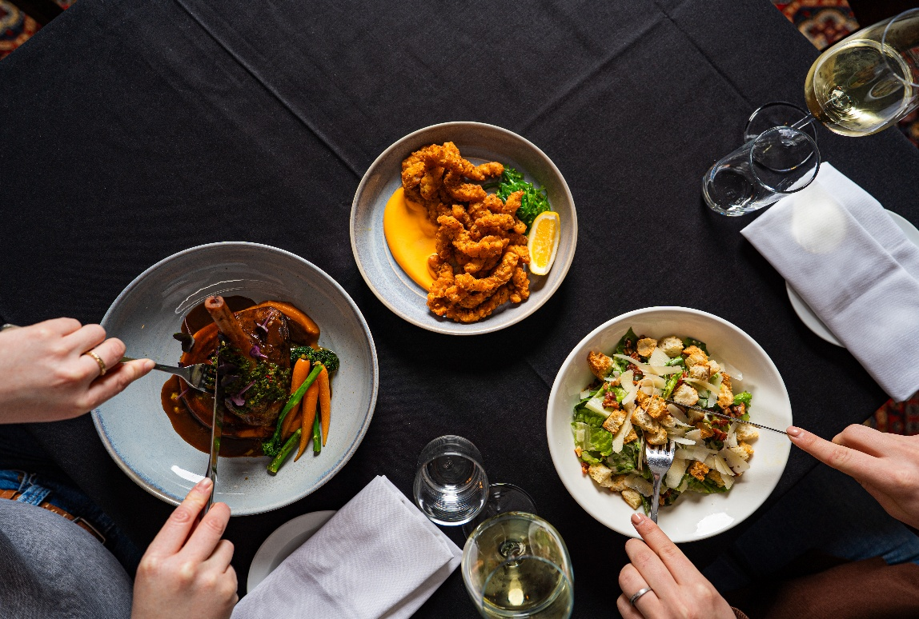
Wairakei Resort Taupo Dining
Wairakei Resort Taupō offers a variety of delicious dining options serving the best of local and New Zealand cuisine.
Dining options include the Pavillion Restaurant, serving full cooked buffet breakfast and The Geyser Bar, for lunch and dinner; a cosy and inviting space to enjoy a selection of wine, beer and cocktails. Custom catering can be arranged for groups, weddings, and conferences.
Operating Hours: -
Breakfast:
6:30 AM – 10:00 AM, full buffet breakfast
The Geyser House Bar:
Lunch: 11:30 AM – 5:00 PM
Dinner: From 5:00 PM – late

Slide 16
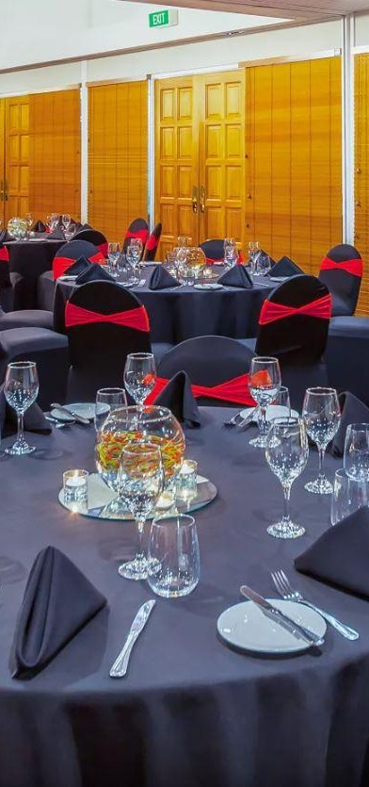
Conference & Events
As the largest conference and event venue in the Taupō region, Wairakei Resort offers a comprehensive and flexible environment for hosting events ranging from intimate meetings to large-scale conferences, exhibitions, and celebrations.
The property features a variety of dedicated event spaces, accommodating up to 750 delegates across multiple rooms. Configurable layouts support everything from boardroom meetings and training sessions to gala dinners, trade shows and weddings.
Supported by experienced in-house events team, Wairakei Resort provides end-to-end service including event planning, audio
visual equipment, tailored catering packages, breakout spaces, and onsite accommodation for seamless multi-day programs.
The resort also has its very own nightclub, with DJ stand, wooden dance floor and disco ball!

Slide 17









Ca p a c i t y Ch a r t
Room name
Area m2
Capacity
Shape Banquet Cocktail Theatre
Classroom
Boardroom
Cabaret
Karapiti & Waikato & _{722 m2} | 750 | - | 500 | 650 | 700 | 700 - -
Karapiti & Waikato _{550 m2} | 650 | 90 | 400 | - | 600 | 300 ₋ ₋
Karapiti Room 275m2 | 250 | 45 | 200 | 150 | 250 | 150 75 -
Waikato Room 275m2 | 250 | 45 | 200 | 150 | 250 | 150 | 75 | -
Graham Rooms I & II ^{172m2} | 130 | 40 | 130 | 100 | 130 | 100 | 55 | -
Heritage Room 141m2 | 120 | 35 | 120 | - | 90 | 60 | 45 | -
Graham Rooms I 100m2 | 80 | 25 | 80 | 60 | 80 | 50 | 30 | -
Graham Rooms II 72m2 | 50 | 20 | 50 | 40 | 50 | 30 | 25 -
Night Club 60m2 | 80 | 30 | 64 | 80 | 80 | 54 | 30 -
Graham Rooms I & II
Rooms
Boardroom
35m2
20
12
20
-
20
15
16
-
Bayview Room
21m2
-
-
-
-
-
-
9
-
The South Lawn
2625m2
1000
-
-
-
-
-
-
-

Slide 18
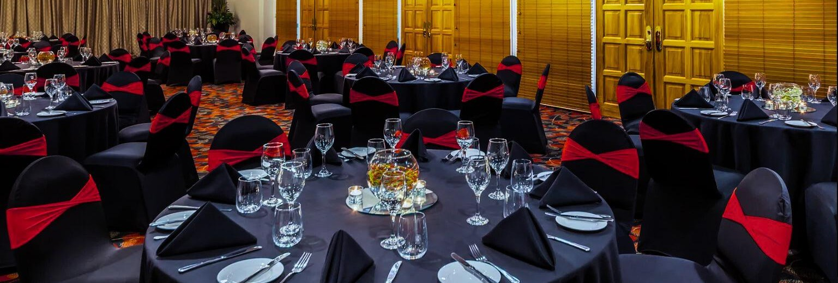
Graham Rooms I & II

Slide 19
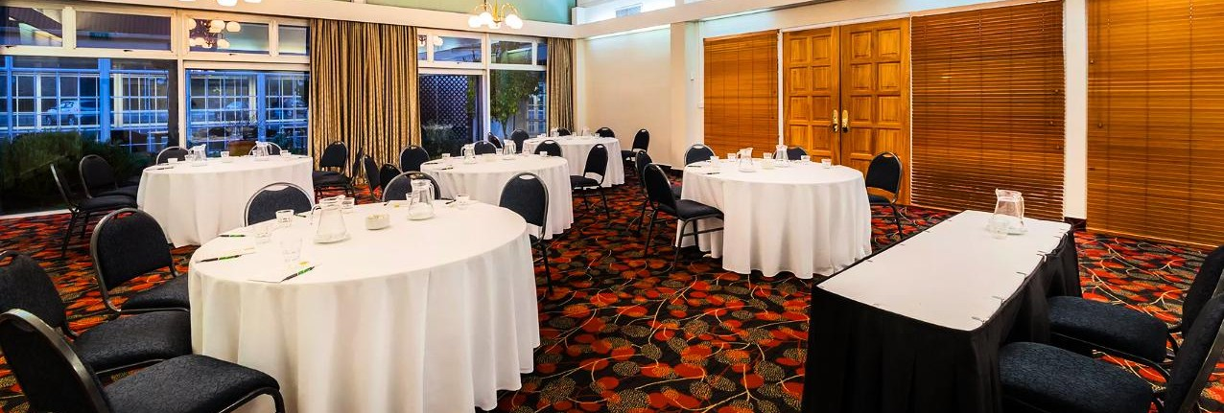
Graham Room I

Slide 20
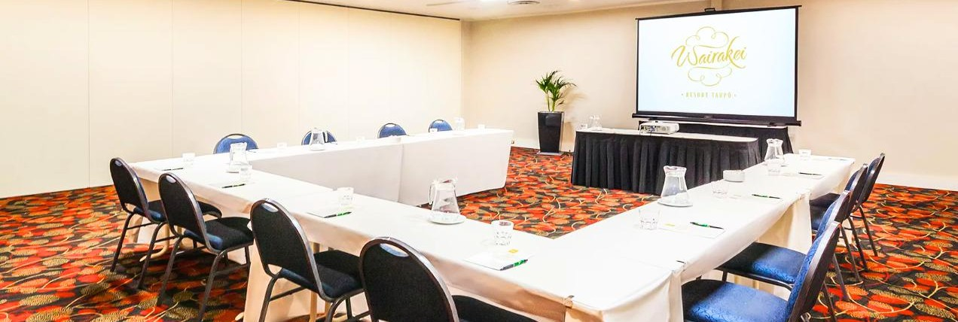
Graham Room II

Slide 21
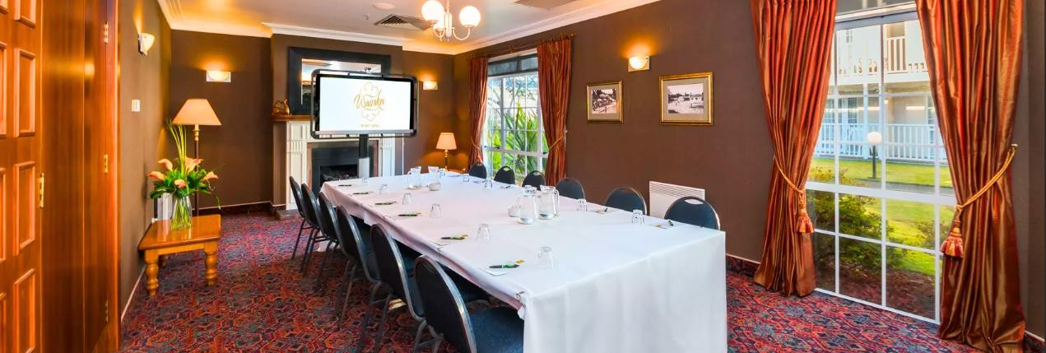
Boardroom

Slide 22
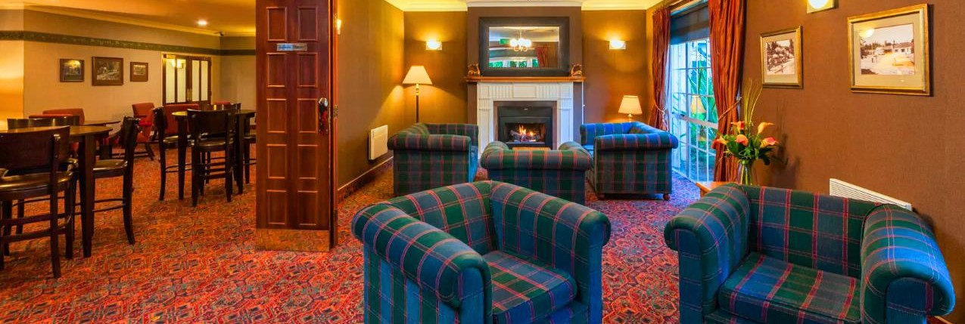
Boardroom Lounge

Slide 23
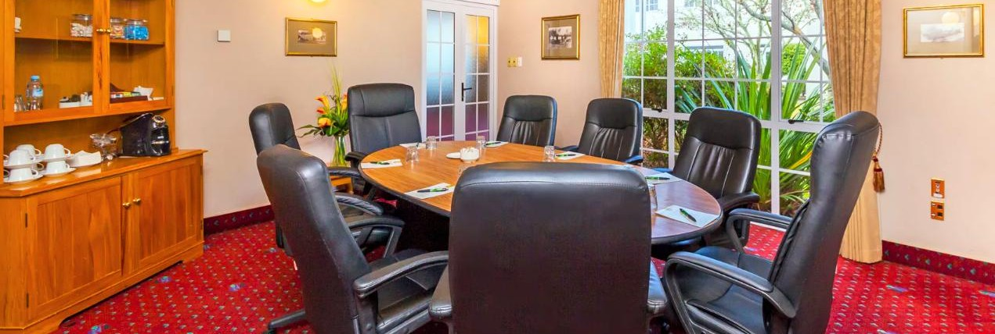
Bayview Room

Slide 24
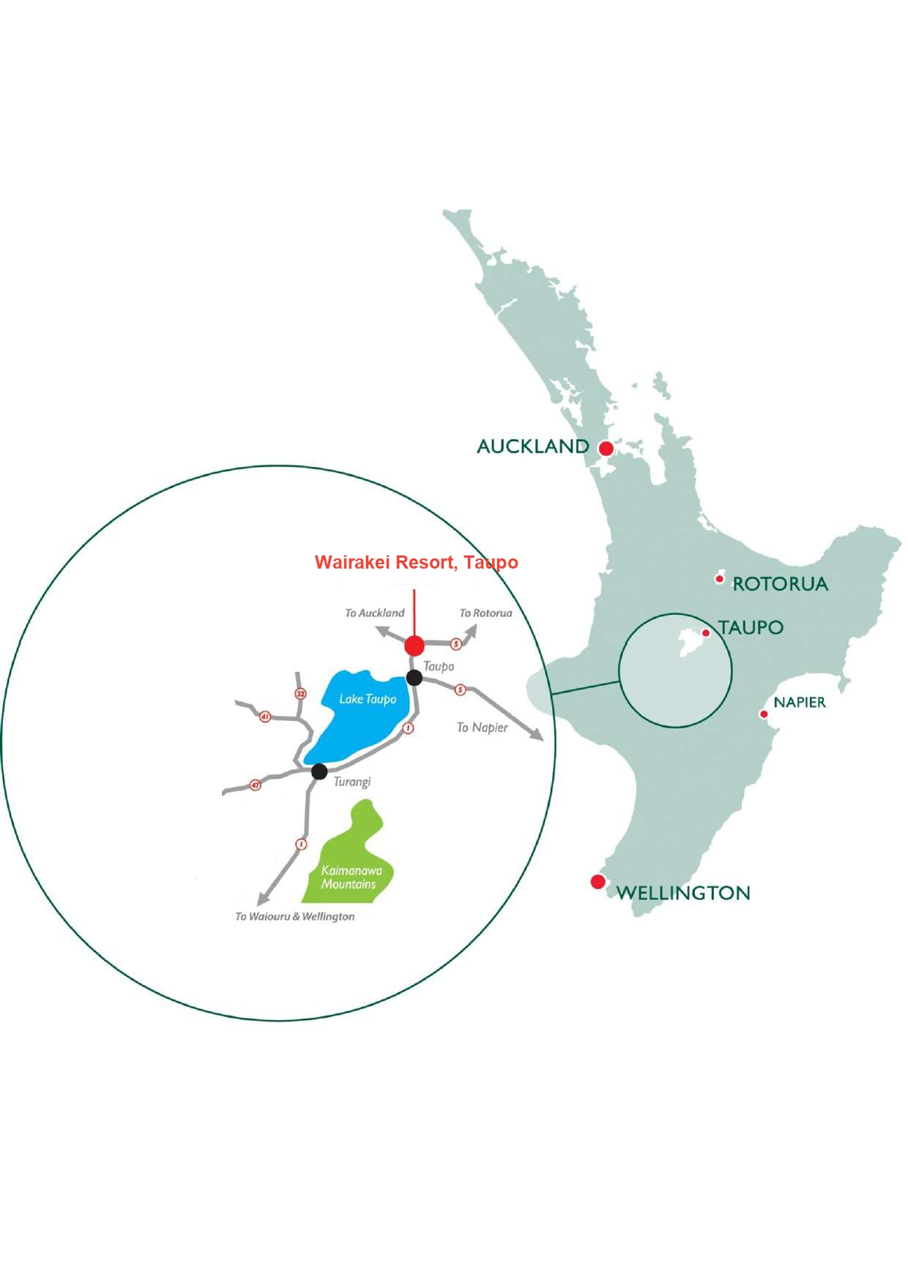
WHERE TO FIND US & CONTACT DETAILS:
Address: 640 Wairakei Drive, Taupō 3384, New Zealand.
Region: North Island, near Lake Taupō
Phone Number: +64 7 374 9004
Email: reservations@wairakei.co.nz
Website: www.wairakei.co.nz

