Slide 1

Accommodation Name
USPs (up to 5)
  Working Farm
  Views to Ocean and Mountains
  Architectural design
  Wellness resources
  Fine dining
00 rooms:
00 x room type #1
00 x room type #2
00 x room type #3
00 x room type #4
00 x room type #5
Additional information:
Restaurant & bar,
Gym
Outdoor heated Mineral pool
Spa, Sauna
Conference spaces
Pictures to go on this side of the slide.
Up to 4 photos max
Contact details:
Trade: First name + last name
email address
Res.: email address
+64 phone number
Qualmark logo to go here
(remove if not applicable)
operator logo to go here
(remove if not applicable)

Slide 2
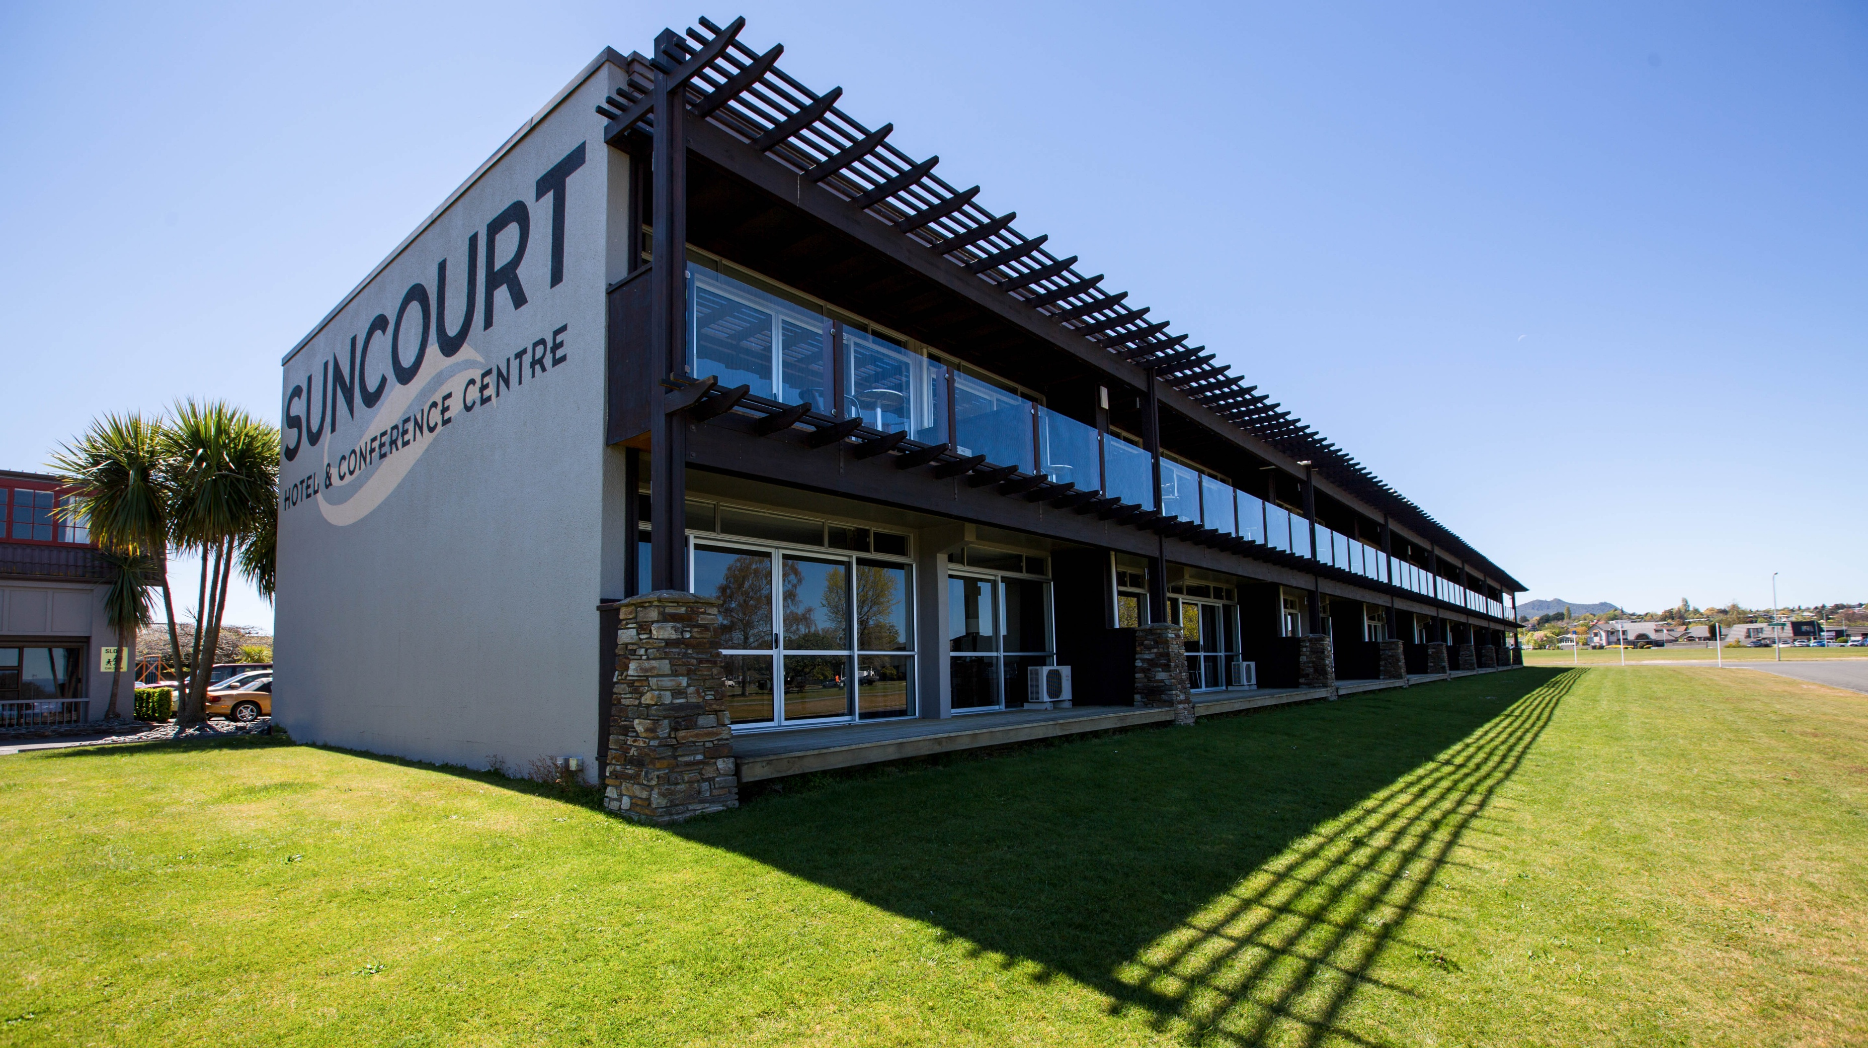
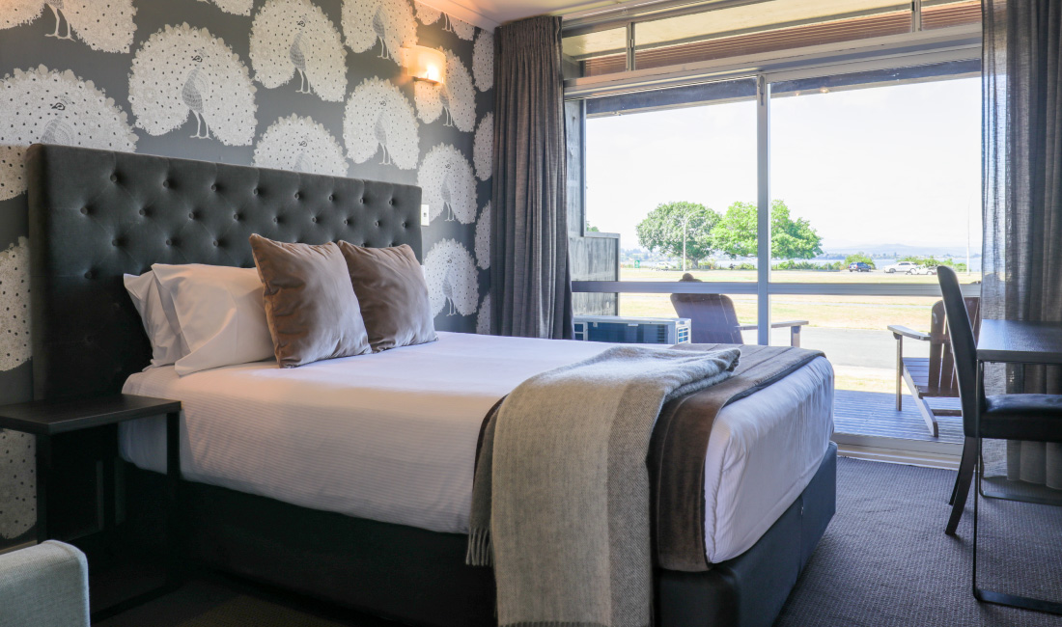


Suncourt
USPs
  Lakefront location
  Lake views from rooms and restaurant
  Closest accommodation to town (2 min walk)
  Caters for FITs, Groups and MICE
  Onsite restaurant (all day dining)
52 rooms:
including 39 available for Trade:
13 x standard Twin Studio (1Q+ 1KS – max 3 pax)
10 x Premium Lakeview Studio (1Q – max 2 pax)
12 x Premium Deluxe Lakeview Studio (1K – max 2 pax)
4 x Premium Lakeview Family room (1Q + 2KS – max 4 pax)
Additional information:
Onsite dining: Lionel’s
Outdoor swimming pool
Conference spaces
Complimentary on-site and coach parking
Contact details:
Trade: Lyndon Hayter
lyndon@suncourt.co.nz
Res.: reception@suncourt.co.nz +64 7 378 8265

