Slide 1
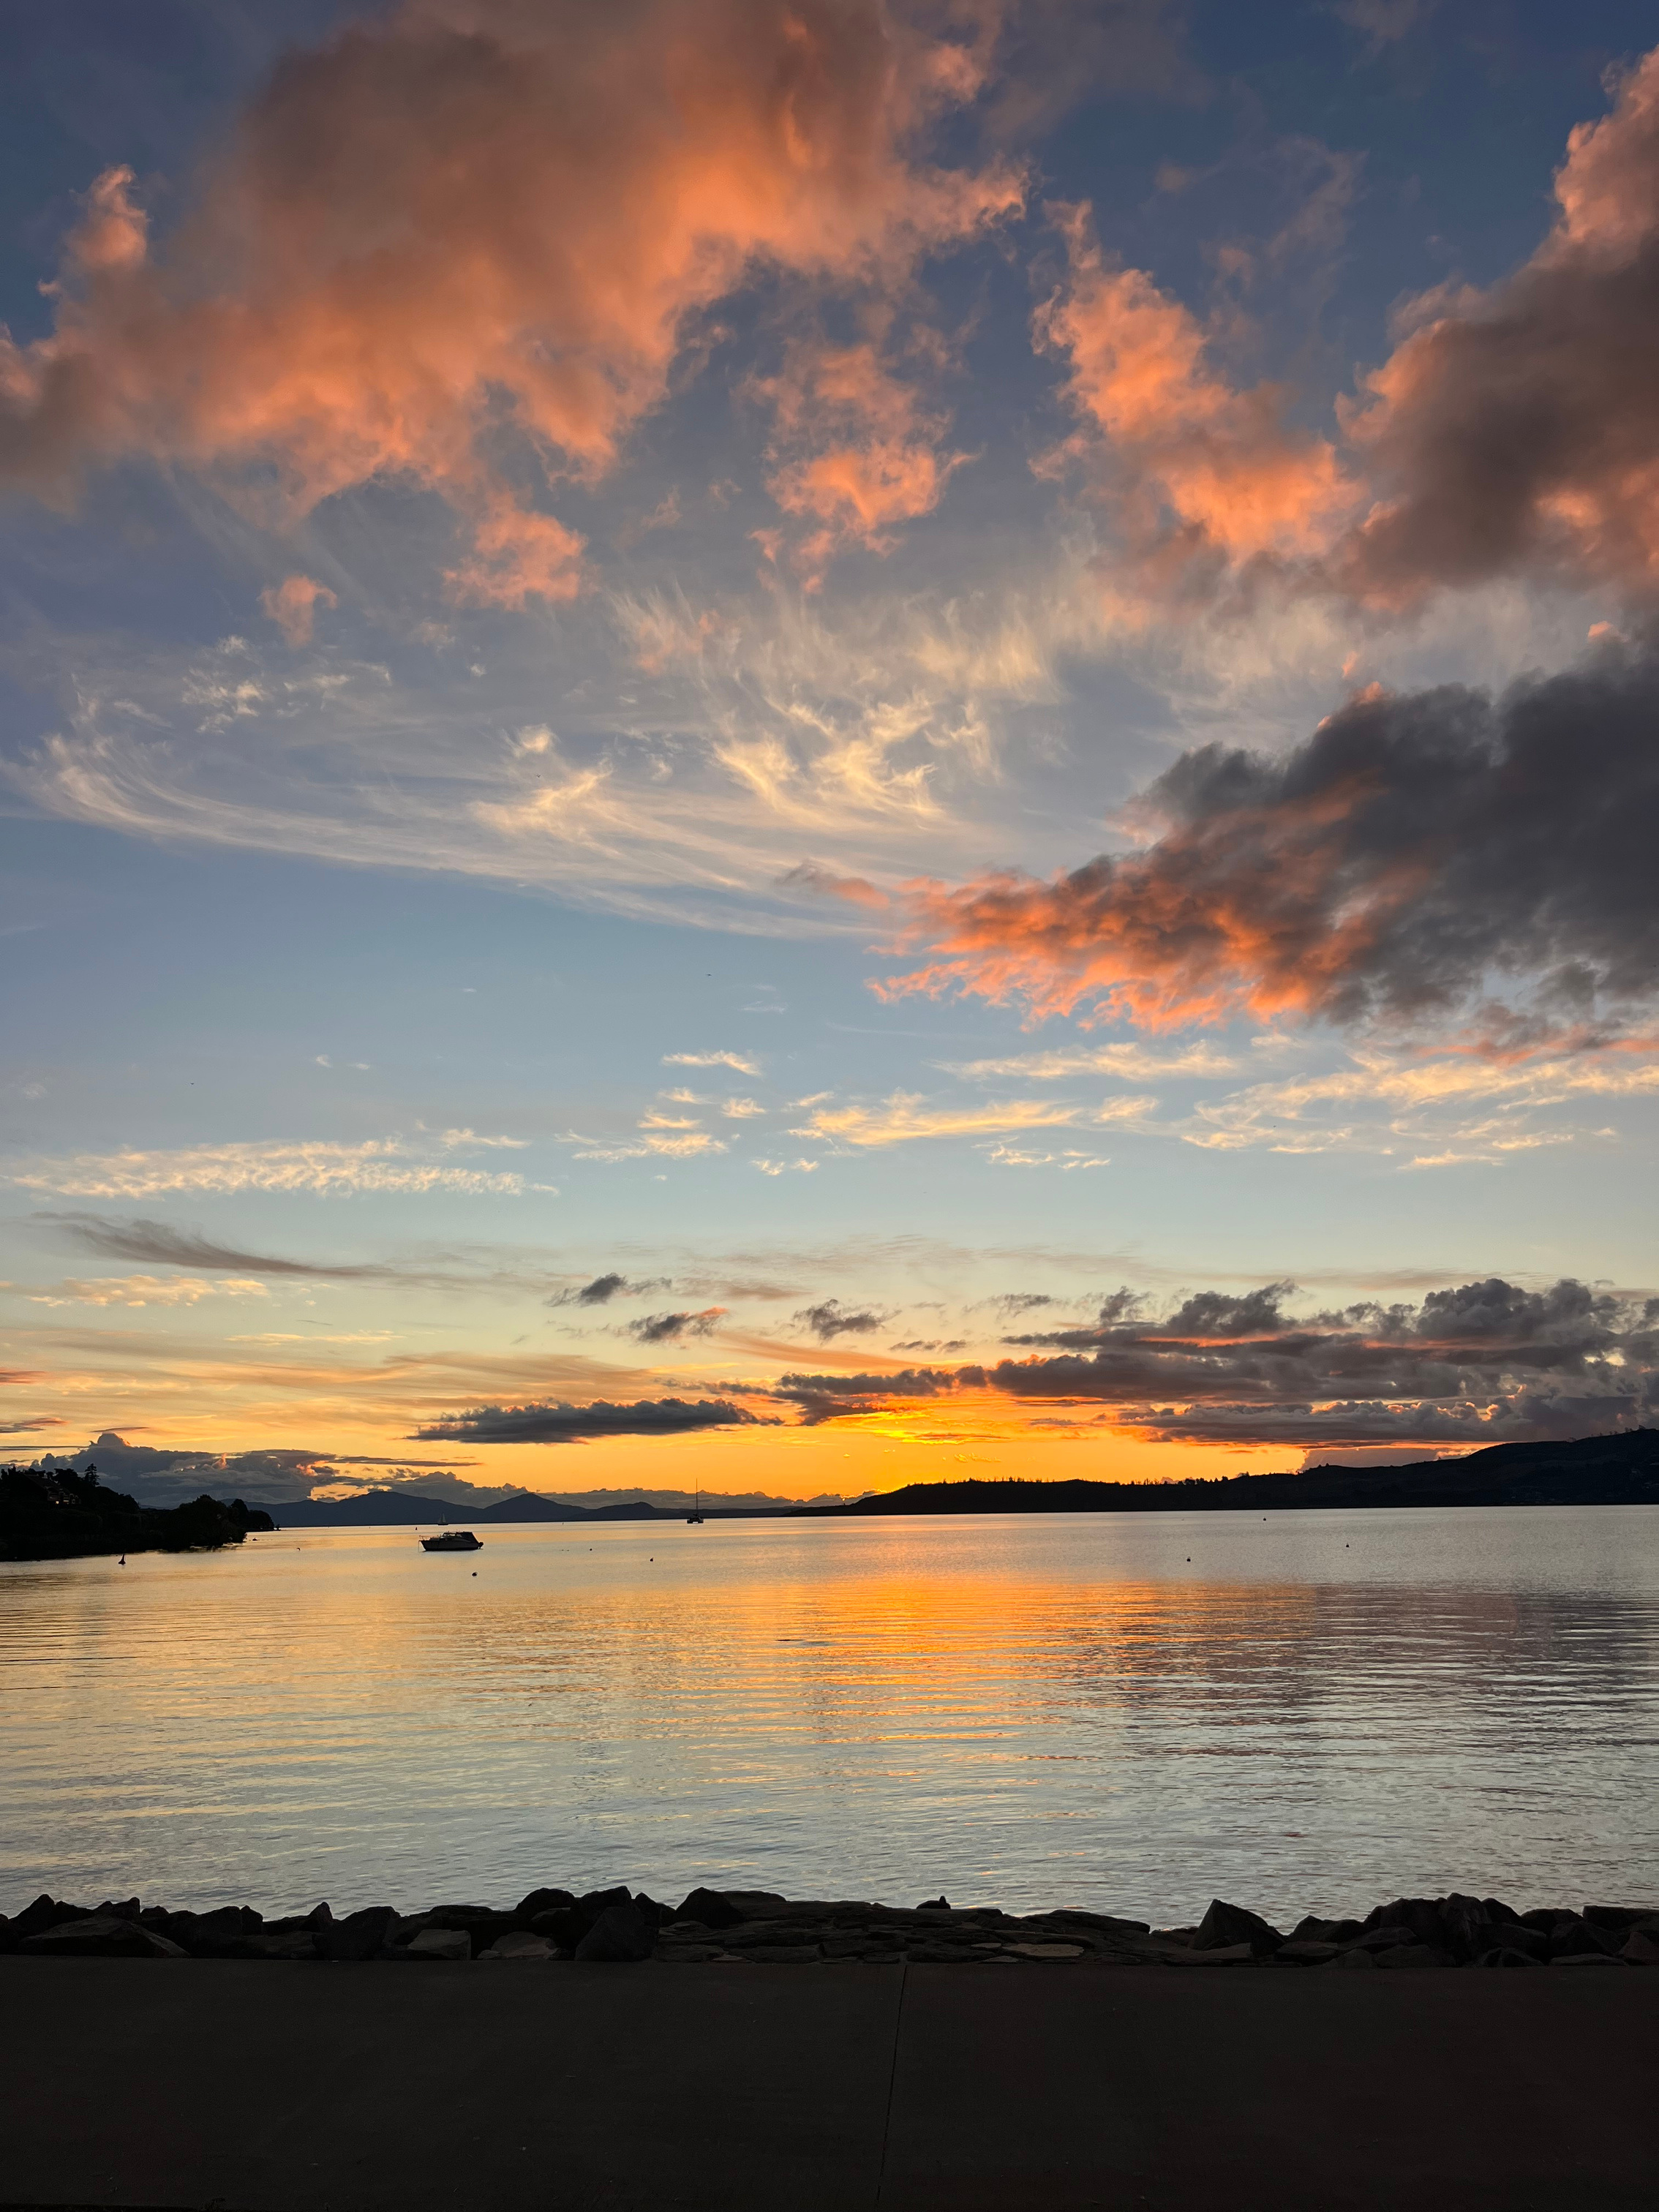
MILLENNIUM HOTEL
&
RESORT MANUELS TAUPŌ
Discover a hidden gem with unique local soul
WWW.MILLENNIUMHOTELS.COM

Slide 2
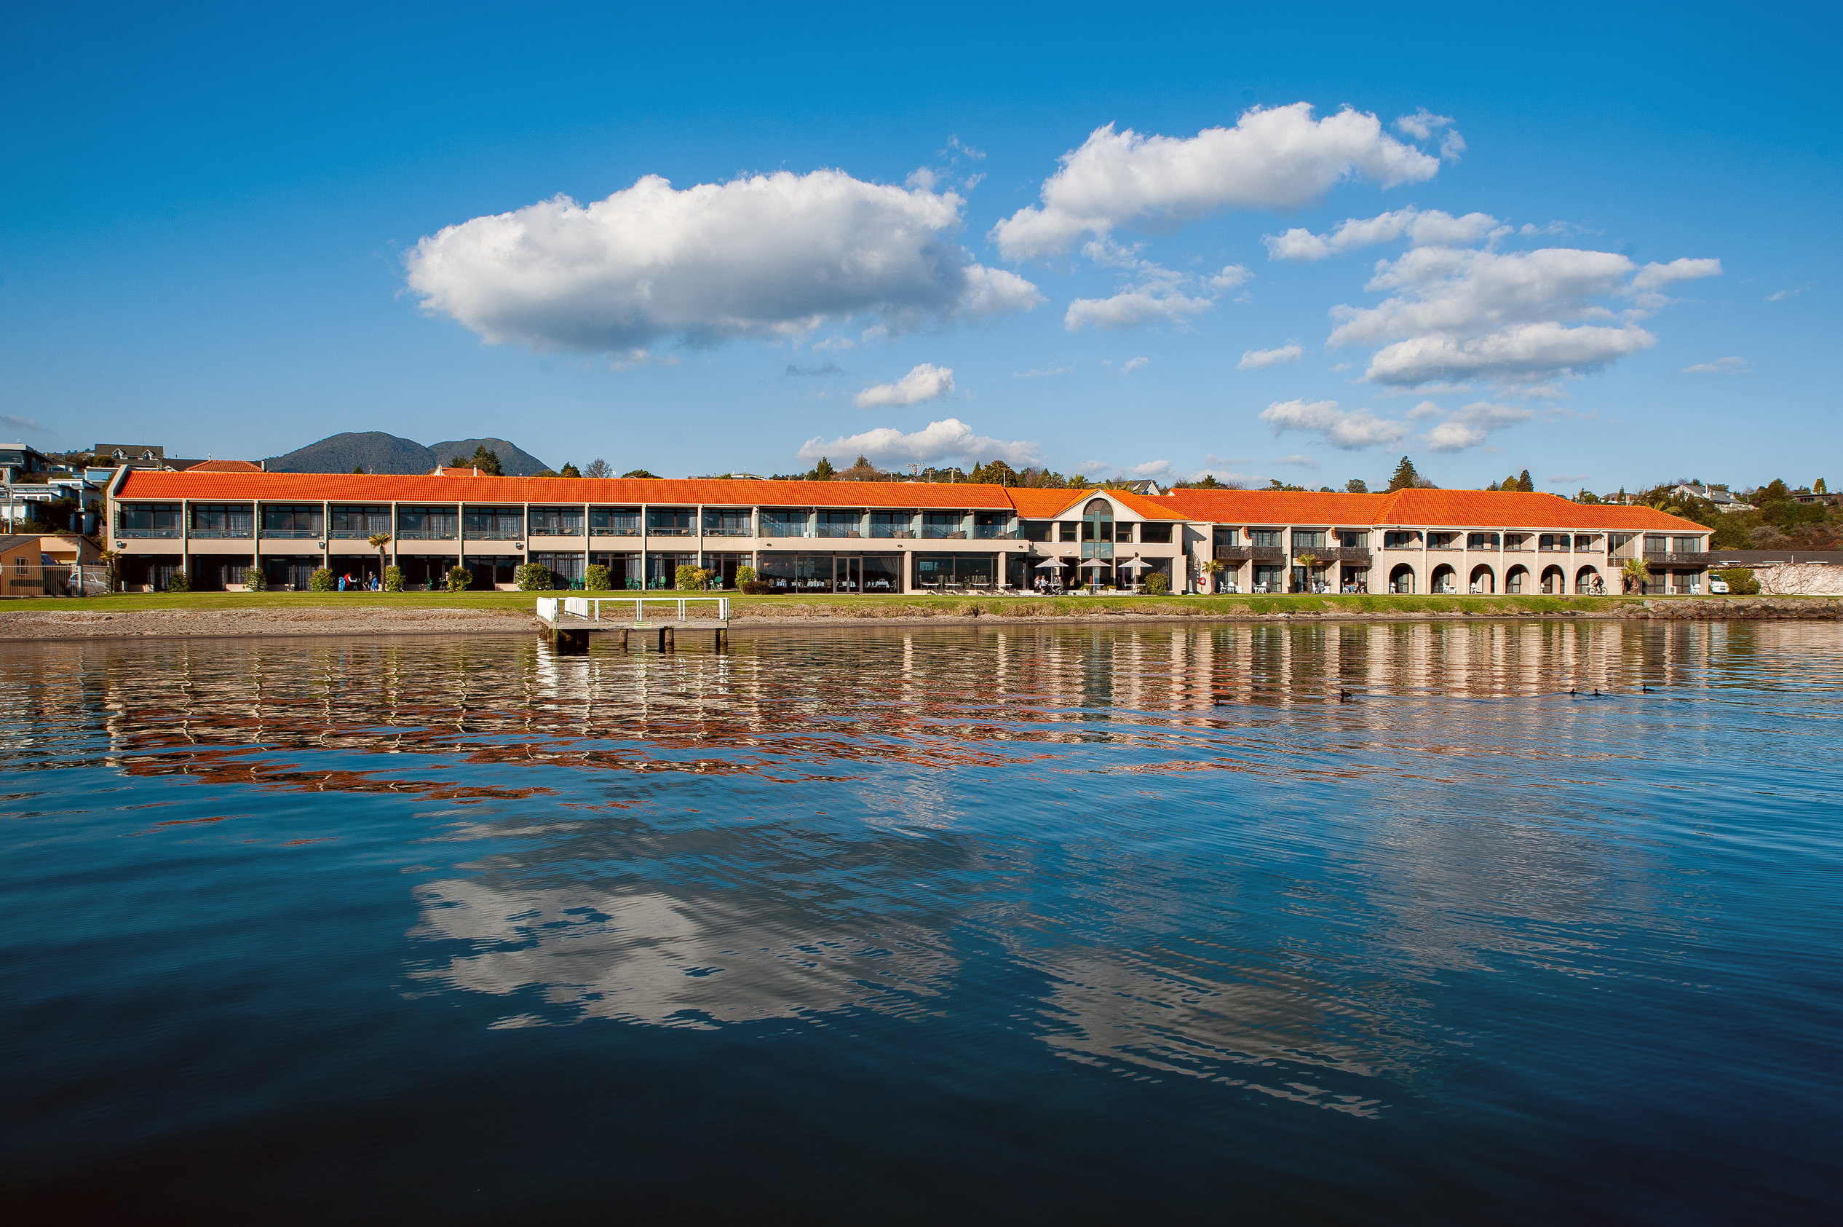

The Millennium Hotel and Resort Manuels Taupō enjoys a premium, absolute beachfront position directly on the edge of Lake Taupō, offering some of the most breathtaking water views in New Zealand.

Slide 3
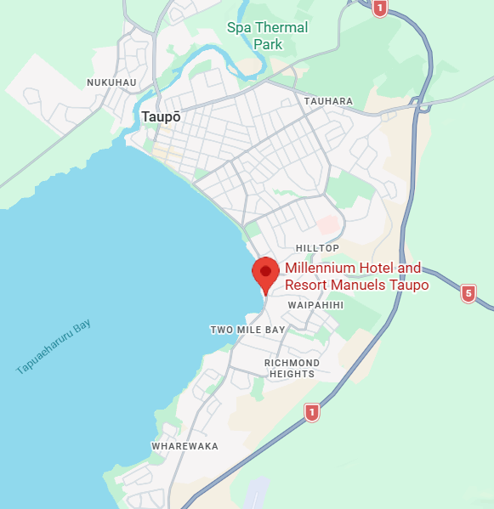
WHERE TO FIND US ?
Contact Us
243 Lake Terrace,
Waipahihi,
Taupō 3330
+64 7 378 5110
Reception@manuels.co.nz
Check-in: 3.00pm - checkout: 10.00am

Slide 4
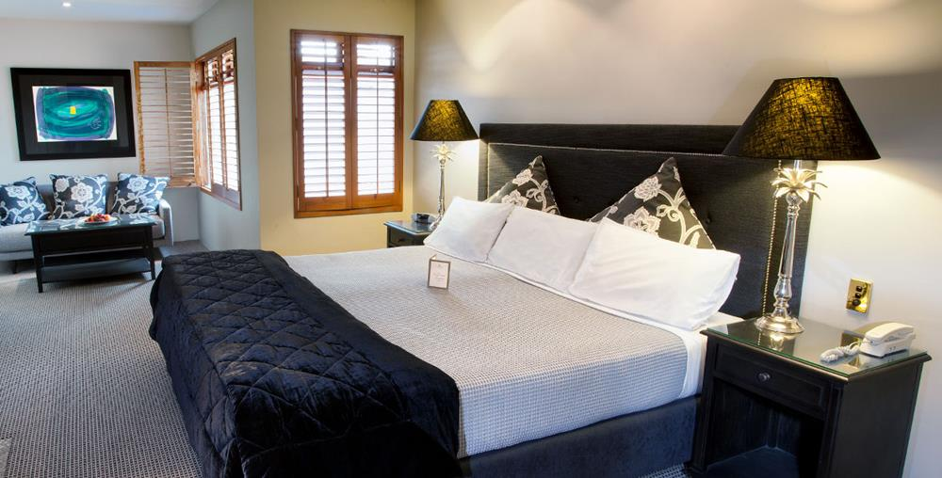
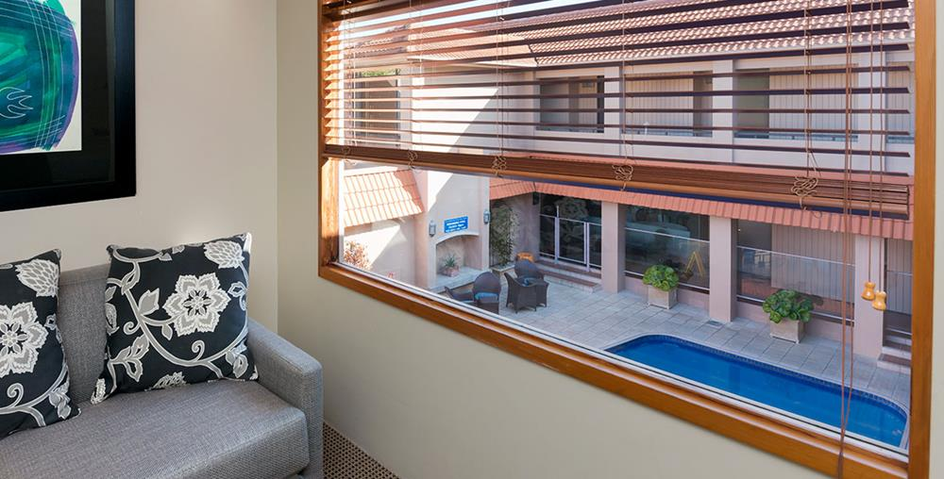
ACCOMMODATION (51 rooms)
Standard Poolroom View
5 rooms
Room size: 22 sqm
Bedding configuration: 1x California King Bed (Can Split)
Max occupancy: 2 pax

Slide 5
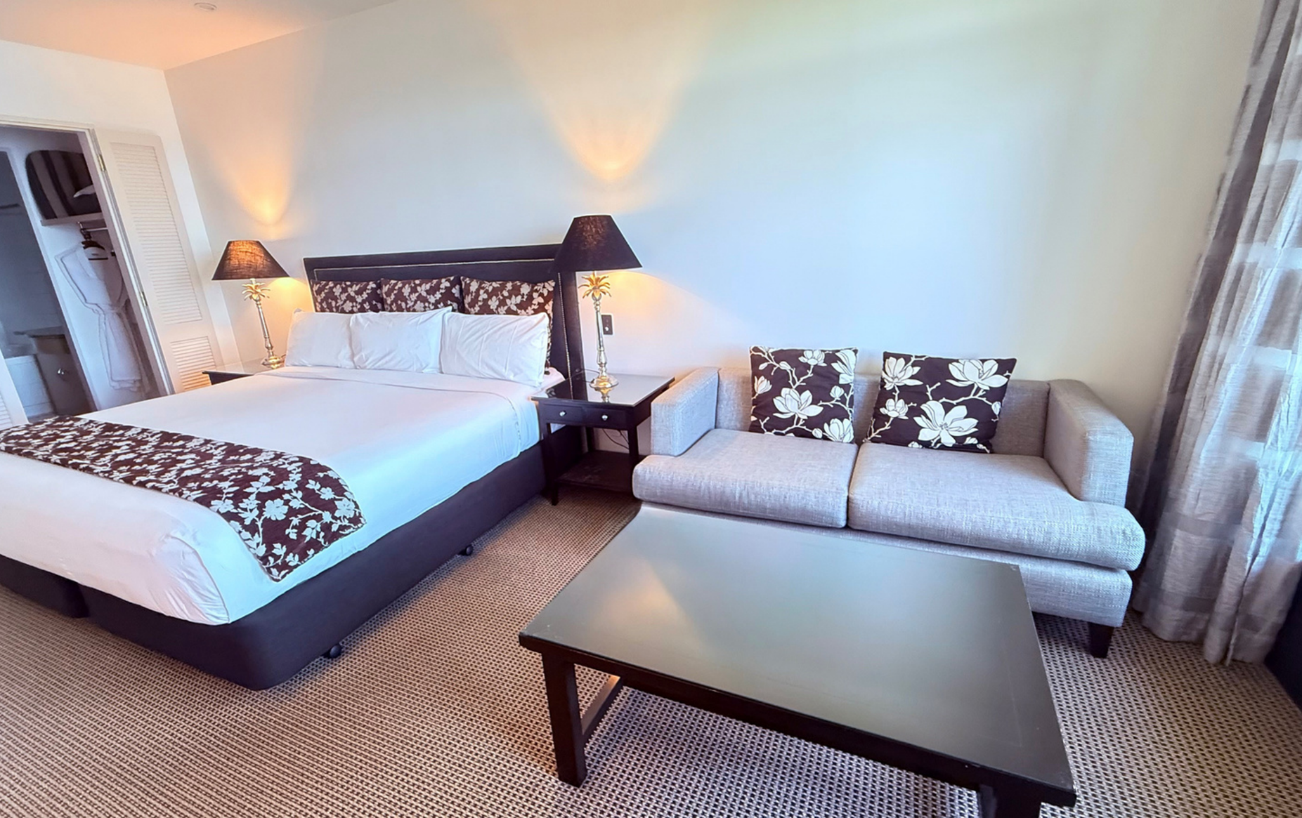
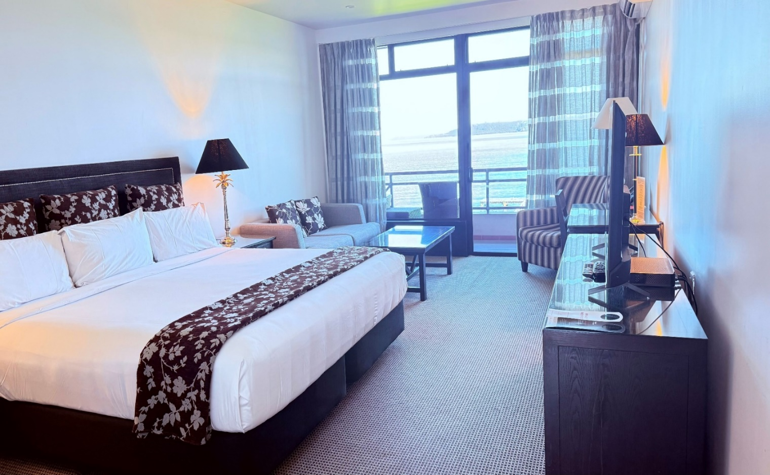
ACCOMMODATION (51 rooms)
Lakeview rooms
6x Junior King Suite – California King bed
6x Superior Plus – California King Bed
6x Junior Queen Suites – Queen Bed
12x Standard Queen – Queen Bed
Room size: 22 sqm
Bedding configuration: 1x bed
Max occupancy: 2 pax

Slide 6
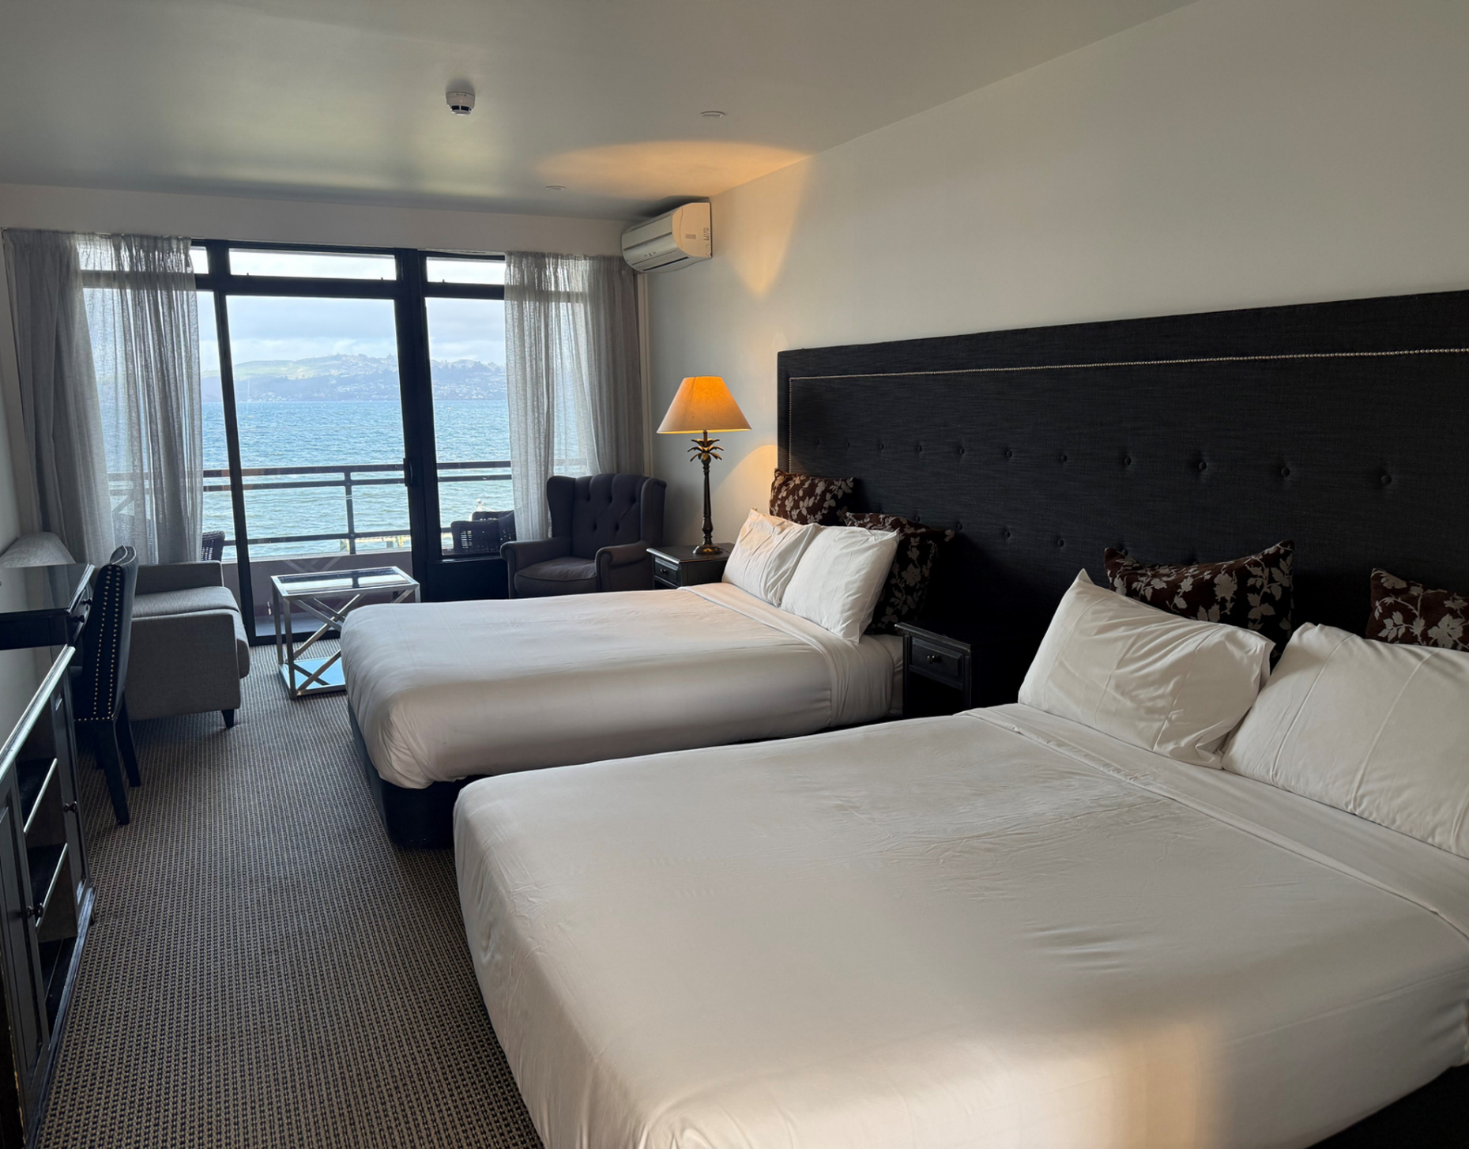
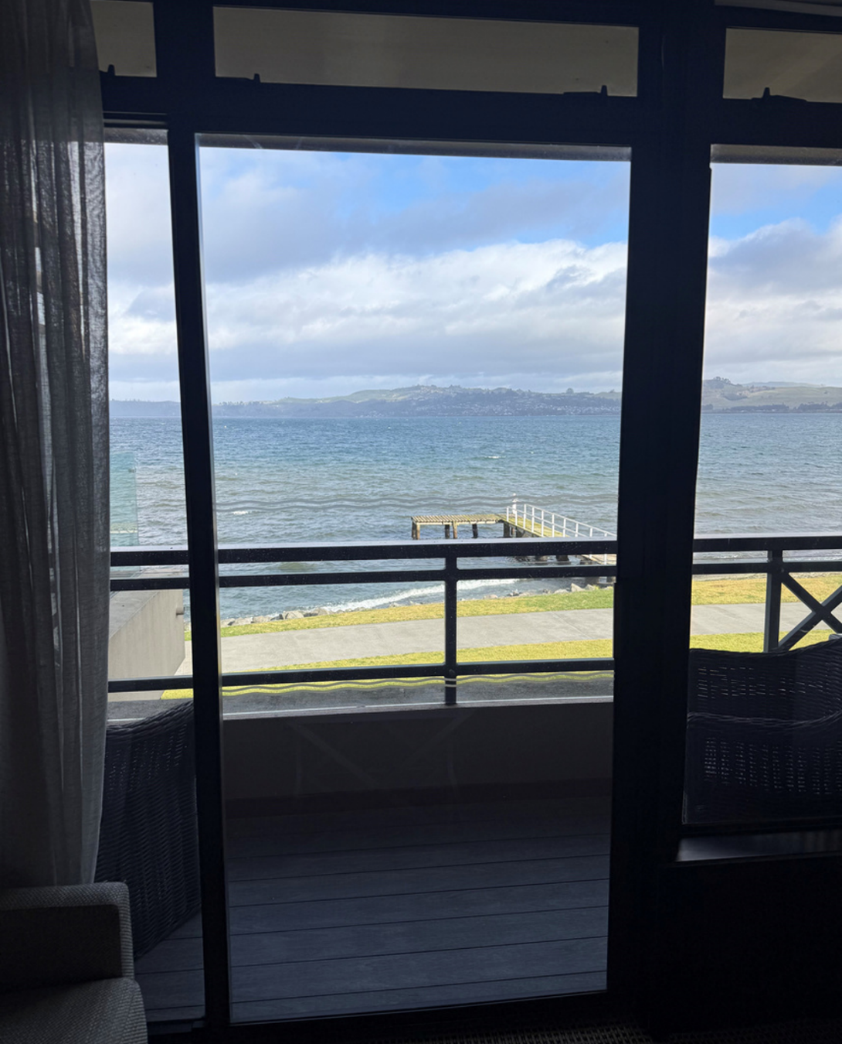
ACCOMMODATION (51 rooms)
Superior Twin Lakeview room
12 rooms
Room size: 29 sqm
Bedding configuration: 2 Double Beds
Max occupancy: 4 pax

Slide 7
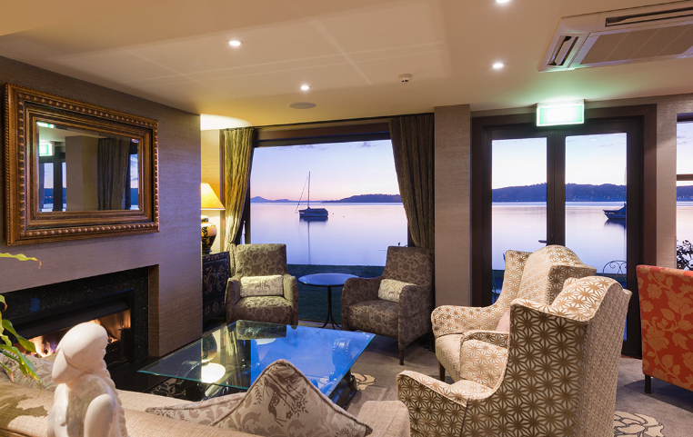
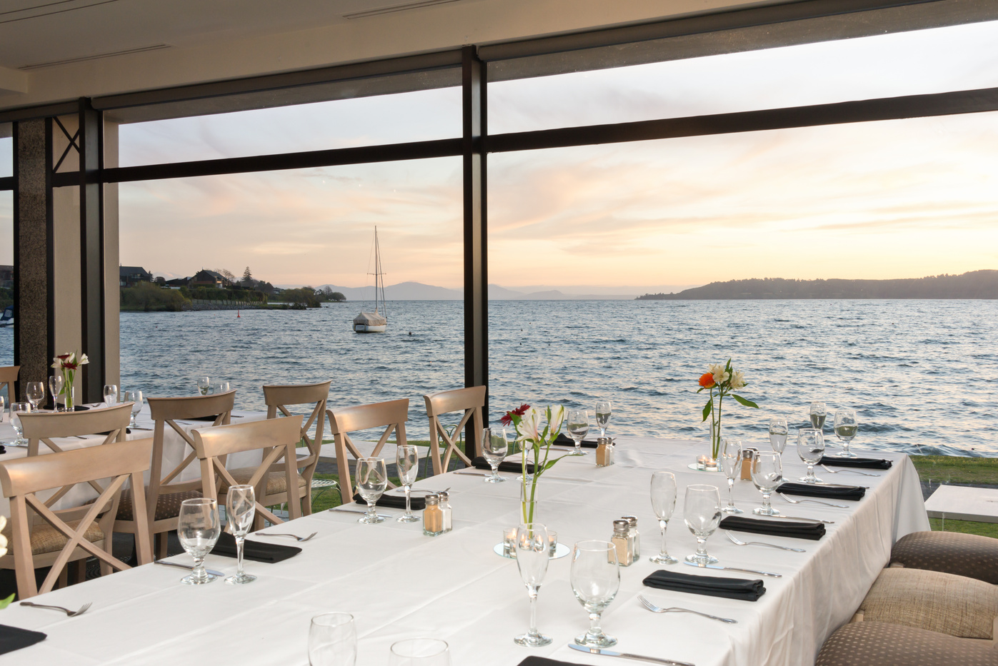
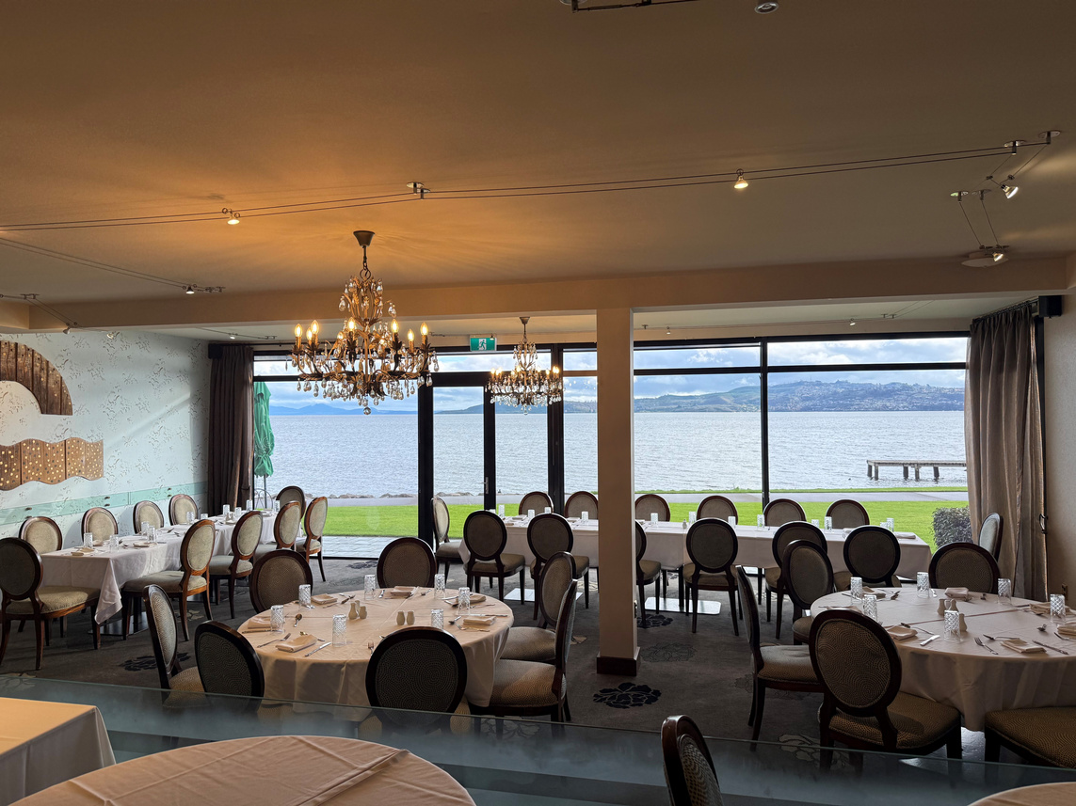
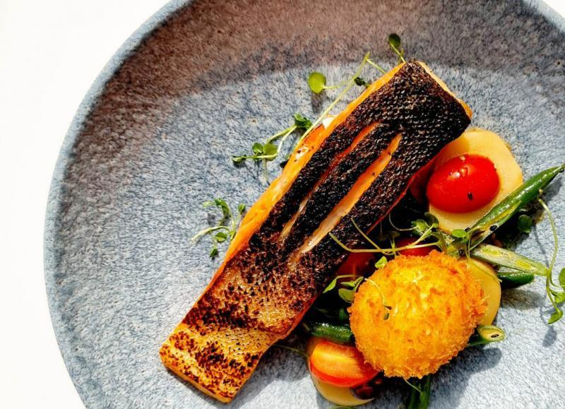
DINING
4 possibilities
2 Restaurants: 1x Private dining/Group Dining
1 Bar: Lakefront Bar
Lounge
Room Service

Slide 8
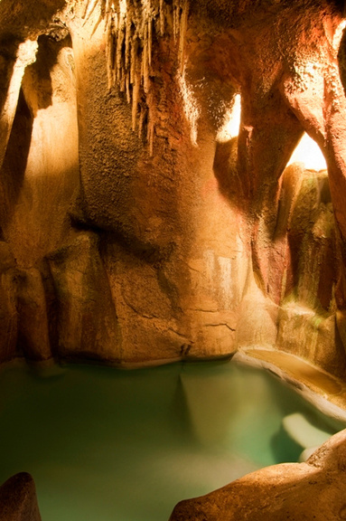
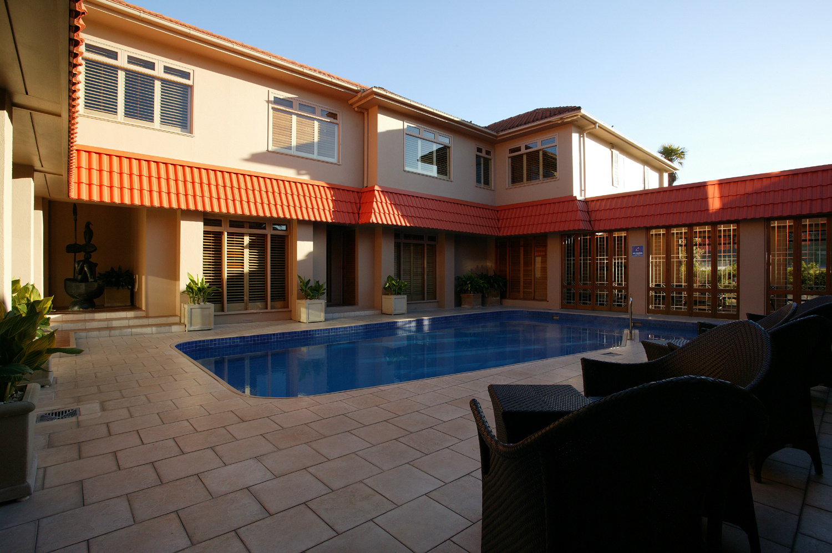
FACILITIES
Wi-Fi Complimentary
Unique Features
Air Conditioning
Porterage (on request)
Guests can enjoy a refreshing, year-round swim in the outdoor pool before stepping into the resort's unique, subterranean-style grotto. This intimate hot tub is artfully carved like an indoor cave, complete with whimsical stalactites, creating a surreal, atmospheric environment to unwind after a day exploring the region's geothermal highlights.
Dry Cleaning and Laundry
Restaurant and Bar
Meetings and Events Facilities
Grotto
Lounge
Pool
Gym
Tennis Court
On-Site Parking
Thermal Heated pool

Slide 9
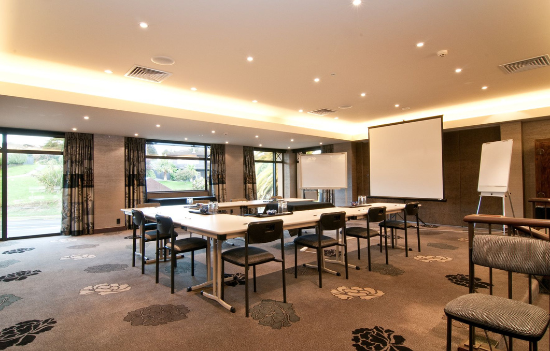
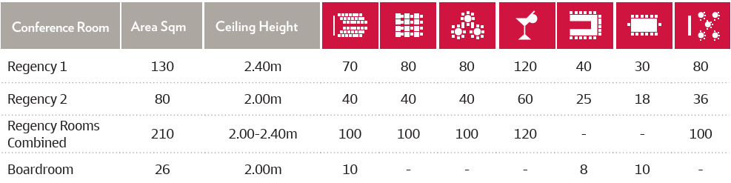
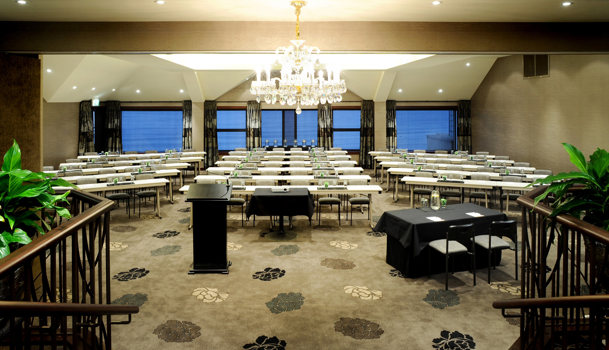
CONFERENCES
3 Meeting rooms
Elevate…
… your next event at Millennium Hotel and Resort Manuels Taupō, where business meets the shore of Lake Taupō. We offer versatile spaces for any scale, from an intimate small private meeting room to large conferencing rooms. Every event is fully supported by professional on-site catering and audio-visual equipment against a backdrop of stunning lake views.

Slide 10
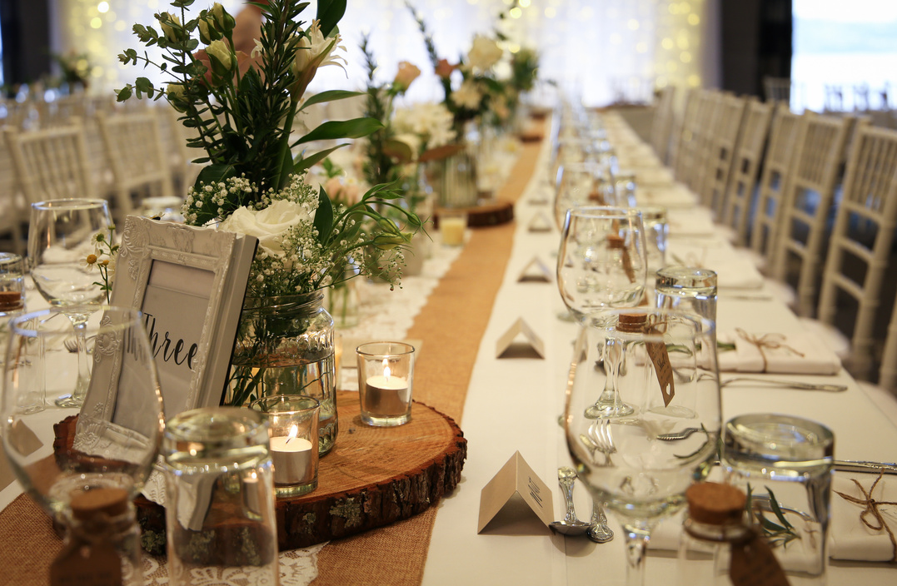
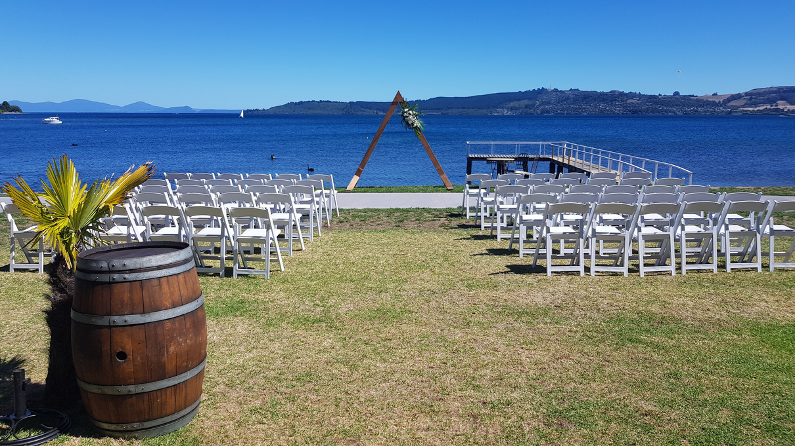
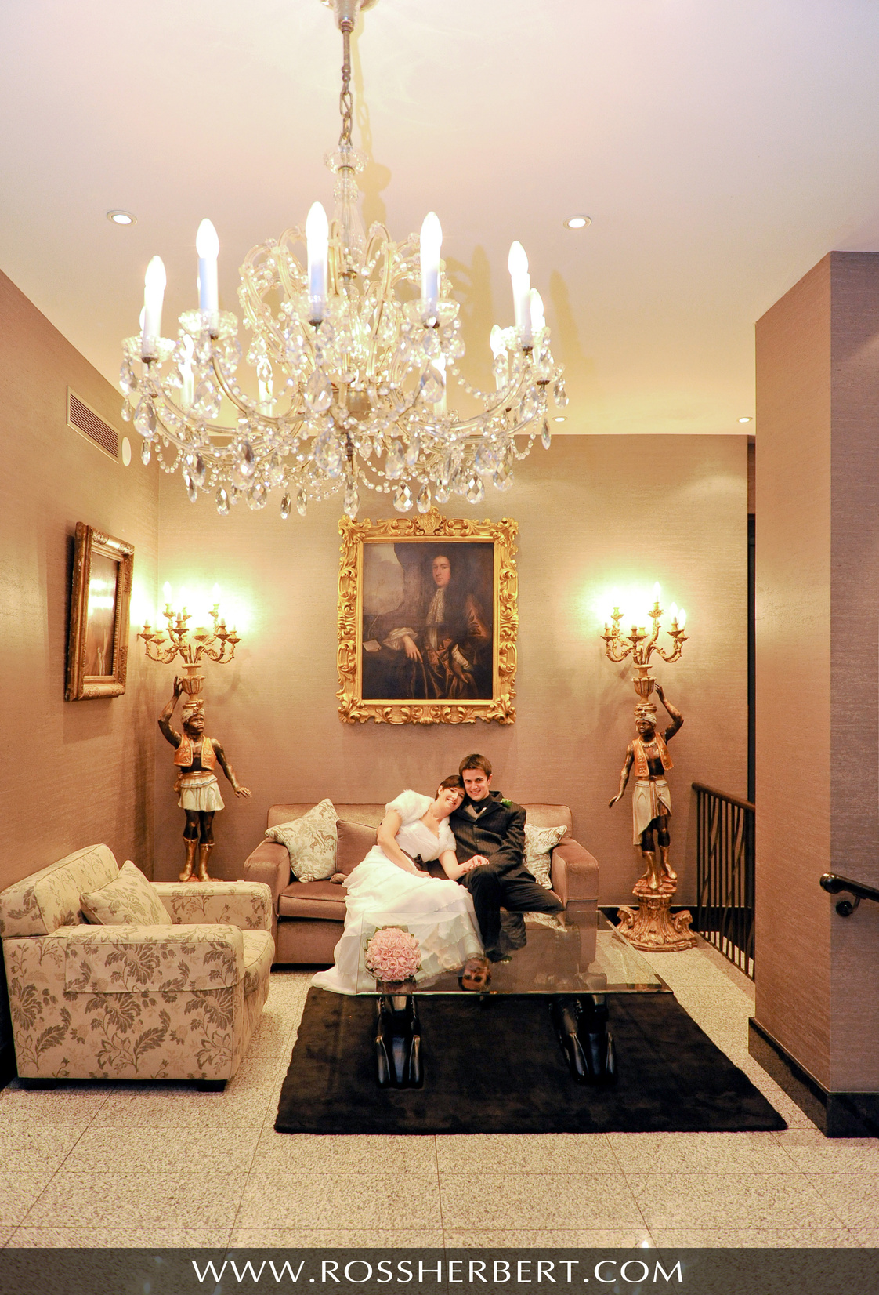
EVENTS
Celebrate…
… your most memorable moments at Millennium Hotel and Resort Manuels Taupō, the ultimate waterfront venue. Whether you are planning a romantic lakeside wedding, a milestone birthday party, or an intimate family celebration, our versatile spaces offer the perfect backdrop with panoramic water and mountain views. Supported by a dedicated events team, tailor-made dining menus, we ensure your special occasion is completely seamless, elegant, and unforgettable.

Slide 11
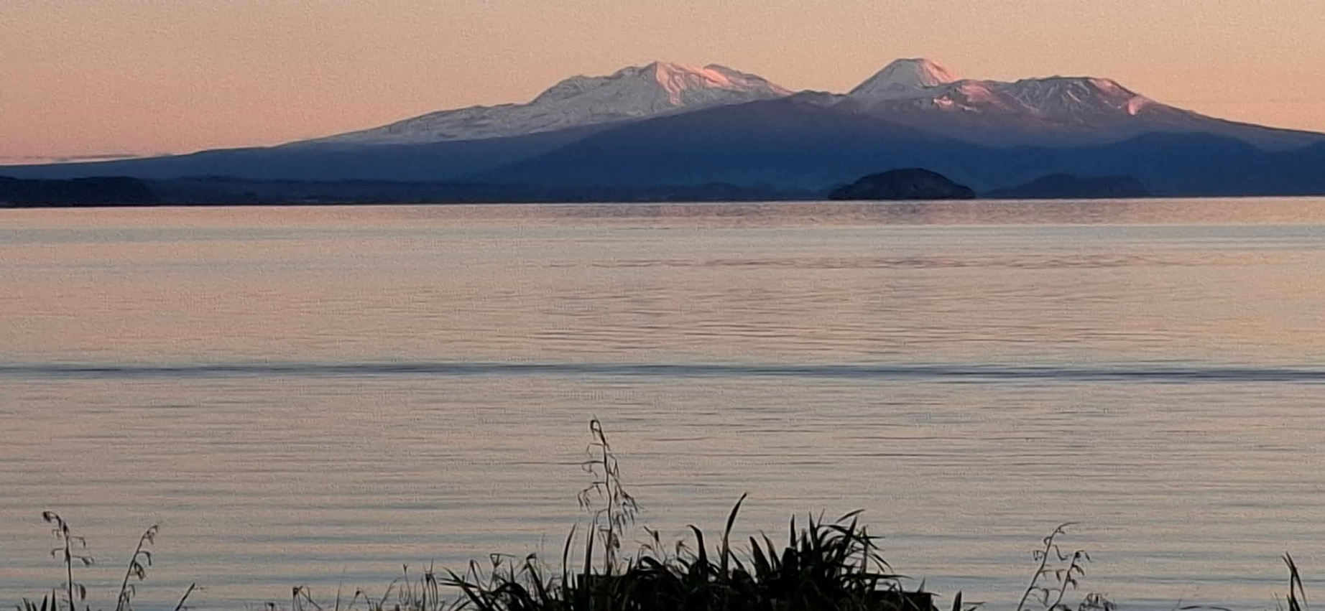
RESERVE YOUR EXCLUSIVE ESCAPE
WEBSITE
WWW.MILLENNIUMHOTELS.COM

