Slide 1

Activity Name
USPs (up to 5)
Working Farm
Views to Ocean and Mountains
Architectural design
Wellness resources
Fine dining
Operational details
Departure times or open hours
Duration of trip
Number of vessels and max nb of pax per vessel
Transportation / shuttle included
Additional information:
Private charters available on request
Cafe
Gift shop
Donation from each fare to the Encounter Foundation which supports a range of environmental initiatives.
Pictures to go on this side of the slide.
Up to 4 photos max
Contact details:
Trade: First name + last name
email address
Res.: email address
+64 phone number
Qualmark logo to go here
(remove if not applicable)
operator logo to go here
(remove if not applicable)

Slide 2
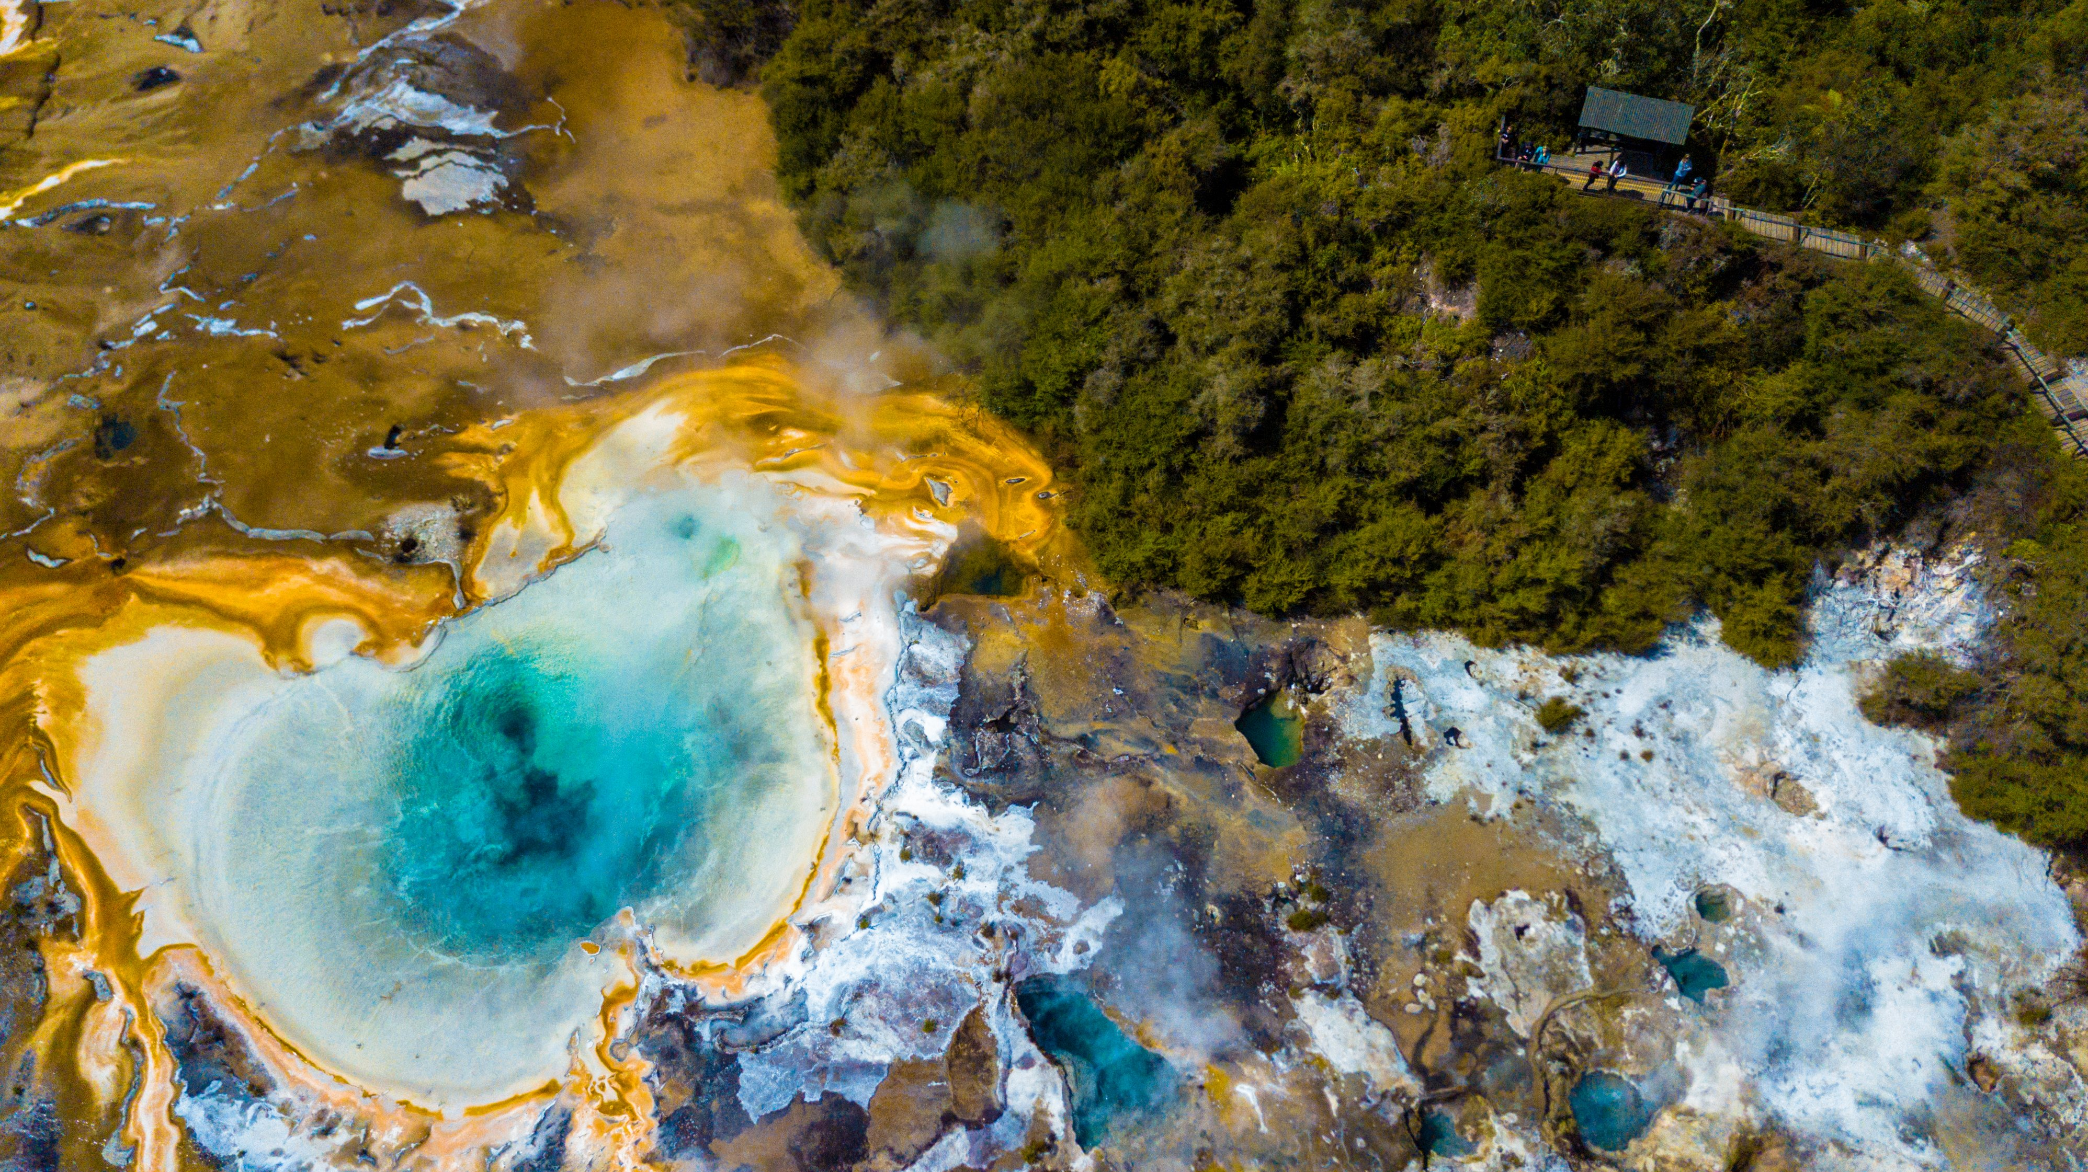
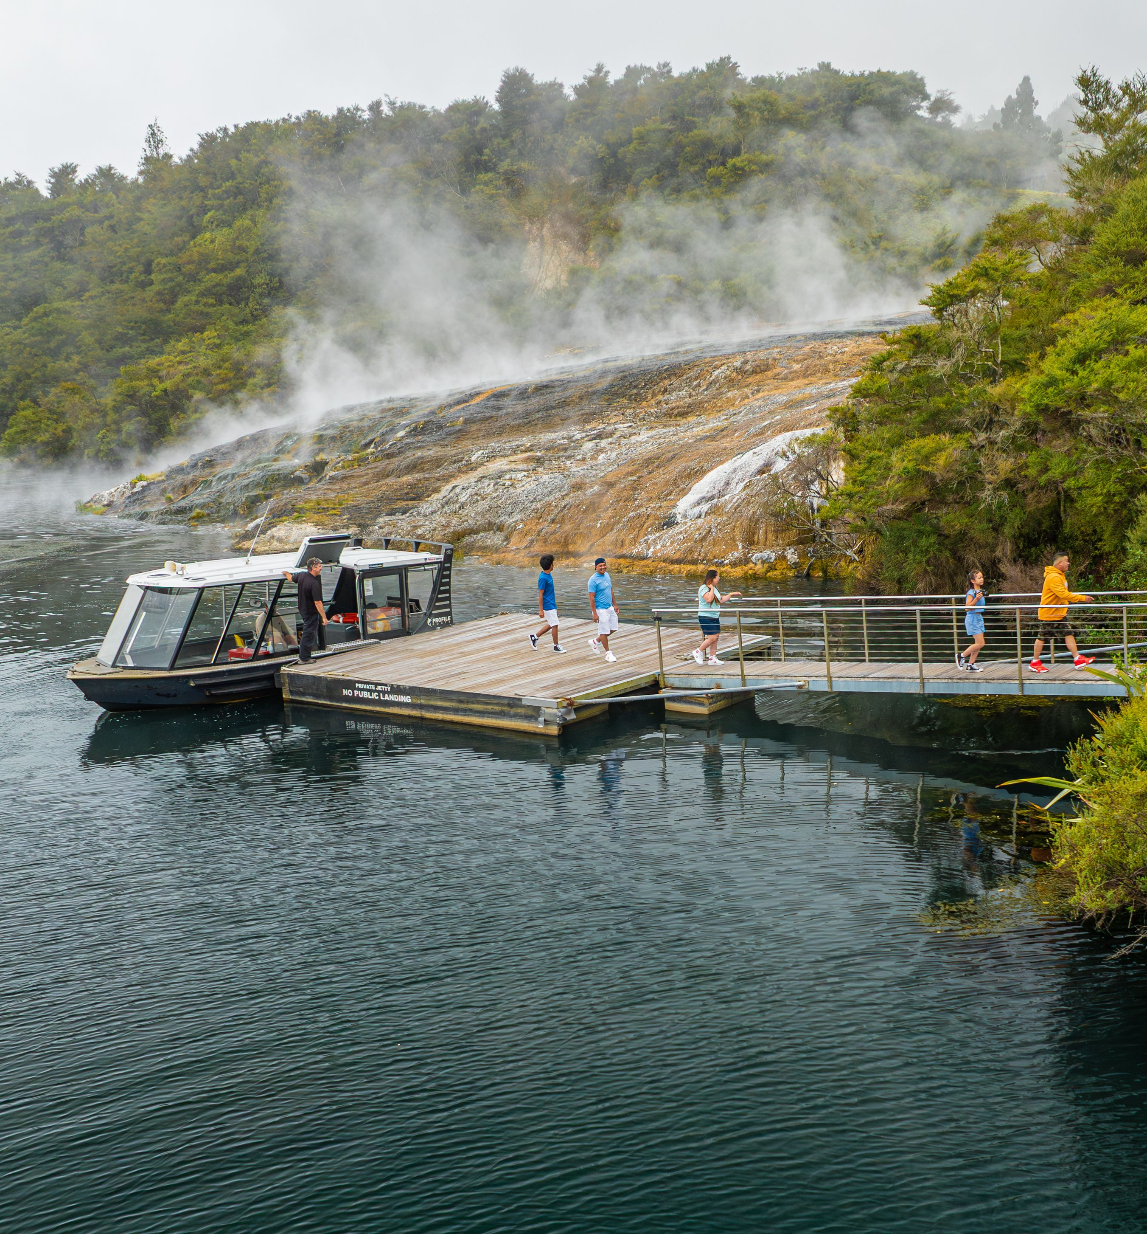
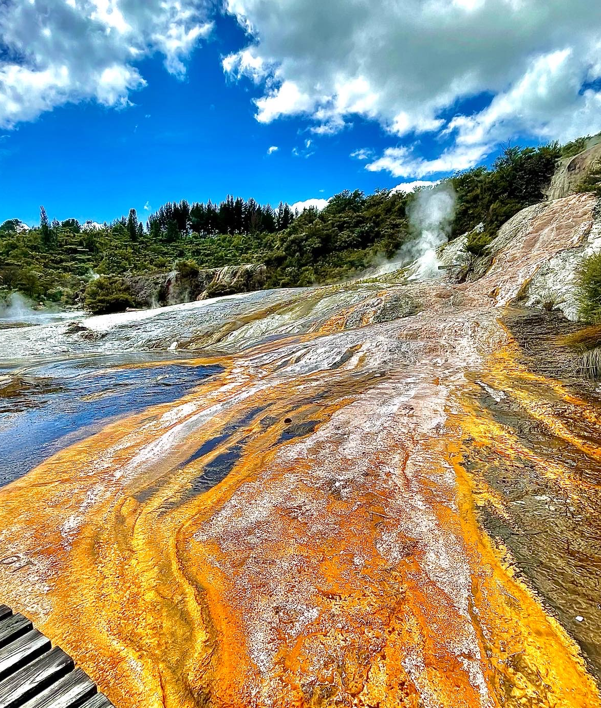


Orakei Korako
USPs:
“Arguably the best thermal area in New Zealand” – Lonely Planet
Geothermal activity up close.
Nothing artificial - Everything you see is natural and alive.
NZ’s largest geyser field (23 Geysers)
Alkaline geothermal activity = different colours and no smell!
No crowds
Operational details
Open from 8:00 to 17:00 (last boat leaves at 16:00)
Self guided walk – allow 2 hrs (but no set duration)
Approx 2.5km
Journey starts with a short cruise across lake Ohakuri
Medium difficulty (stairs to climb)
Additional information:
Cafe
Gift shop
Ferry is the first marine vessel in the world to use a hydrogen on demand unit.
Safety briefing in 12 languages
Contact details:
Trade: Nikolos Gibson
nik@orakeikorako.co.nz
Res.: admin@orakeikorako.co.nz
+64 7 378 3131

