Slide 1

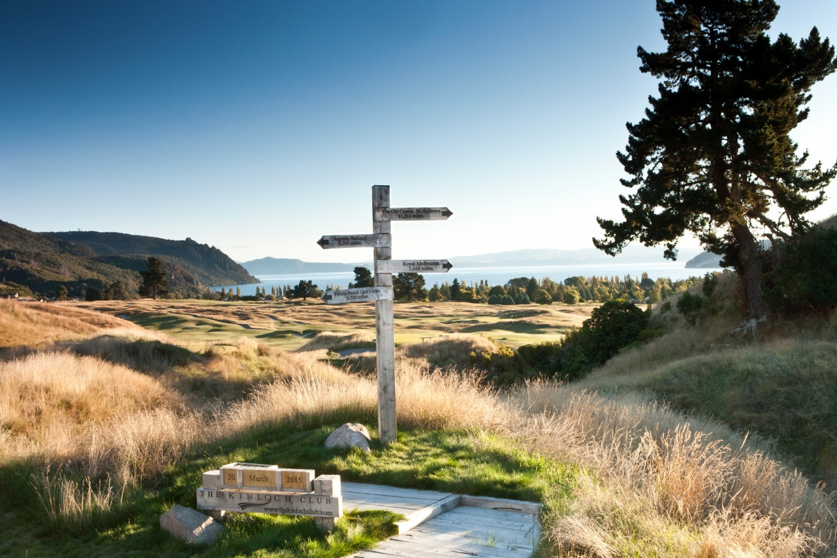
UPON COMPLETION OF
THE KINLOCH COURSE JACK NICKLAUS WAS ASKED TO NAME ITS ‘SIGNATURE HOLE’.
HE REPLIED “THERE ISN’T ONE, THERE ARE 18 SIGNATURE HOLES
HERE”.

Slide 2
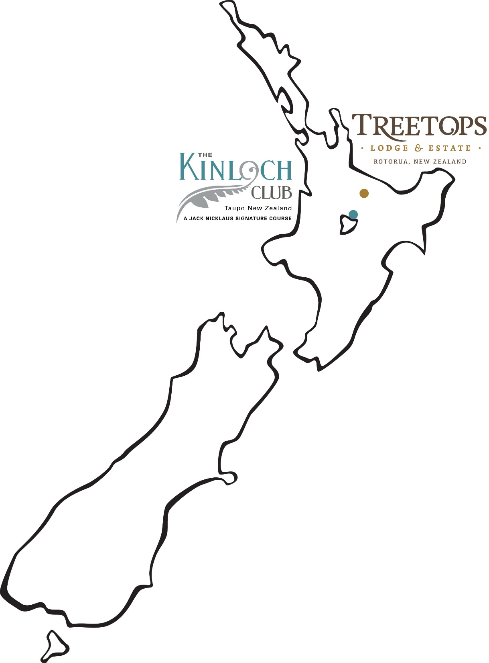
Notes:
Located outside Rotorua, on the North Island, this is the Maori heartland and trout fishing capital of the world It is a 30 minute flight OR 2.5 hour drive from Auckland International Airport. Treetops sister lodge, opened in January this year is the newest luxury lodge to open in New Zealand and boasts New Zealand's only Jack Nicklaus Sig
nature Golf Course. It is built on the shores of Lake Taupo just a one hour drive from Treetops Lodge
ONLY 2.5 HOUR DRIVE OR 30 MINUTE FLIGHT FROM AUCKLAND INTERNATIONAL AIRPORT

Slide 3
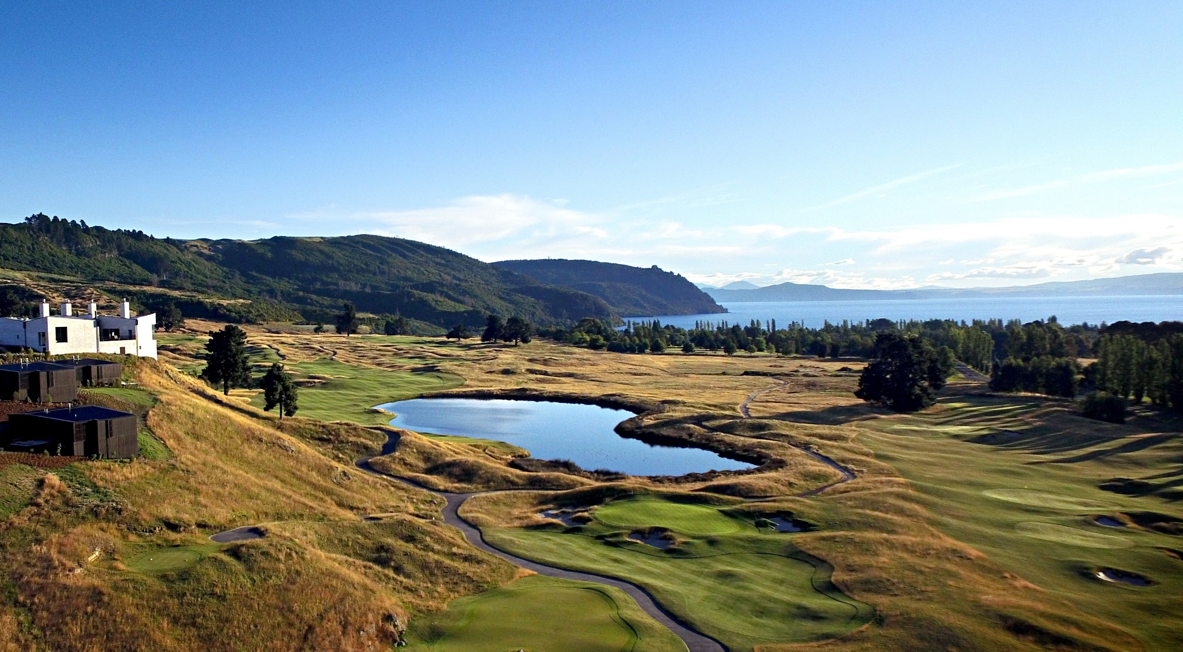

Slide 4
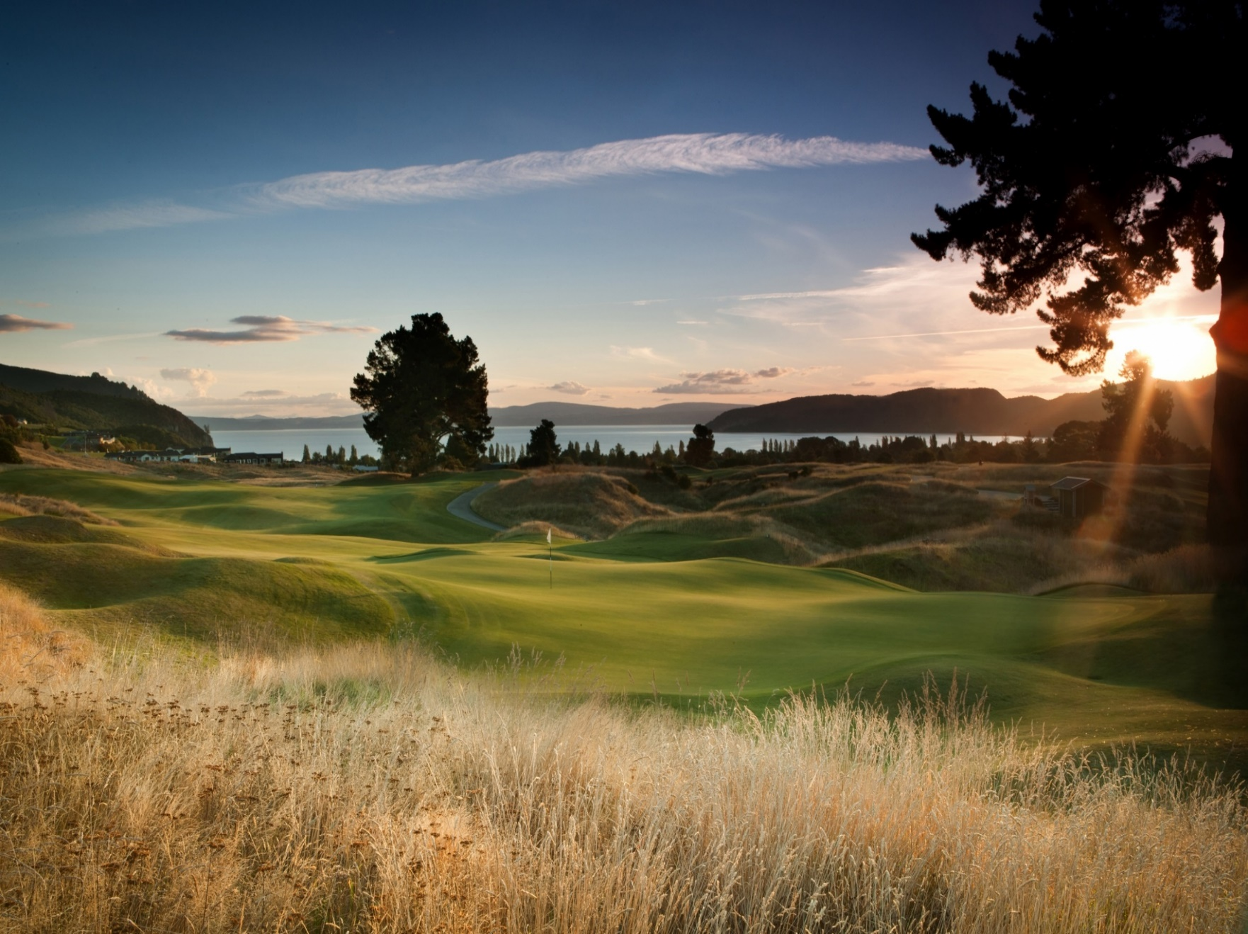

Slide 5
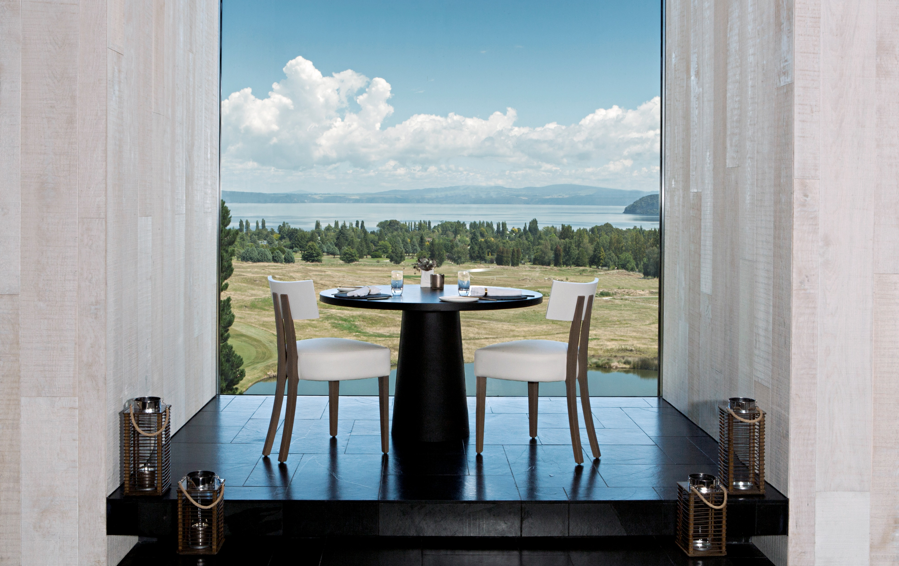
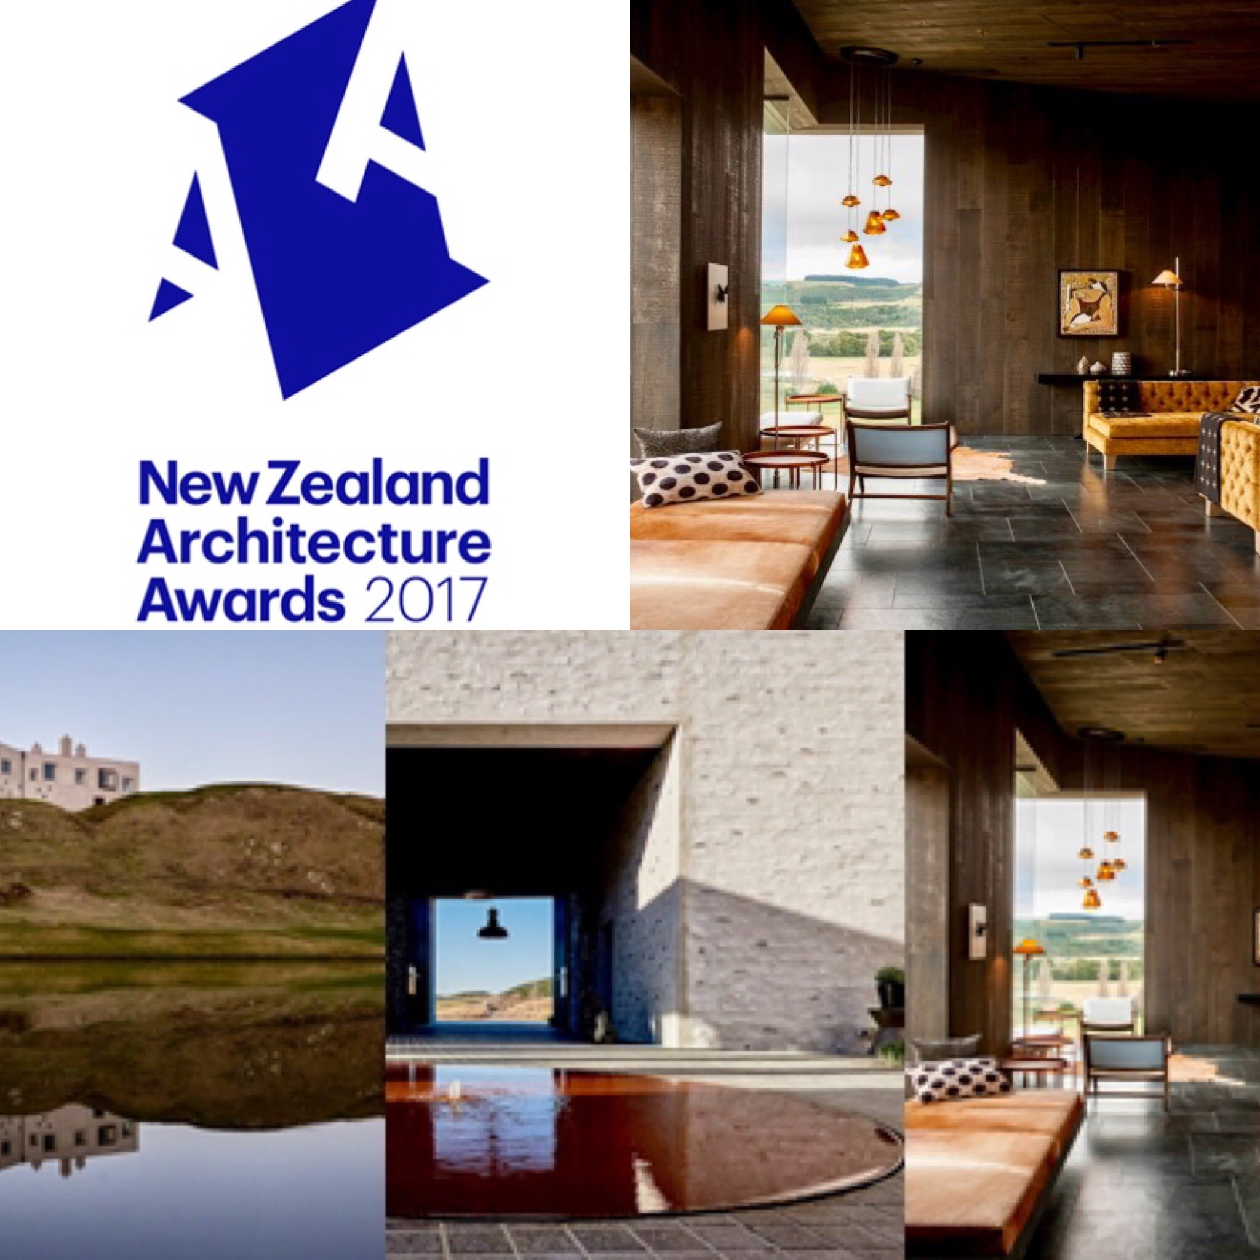

Slide 6
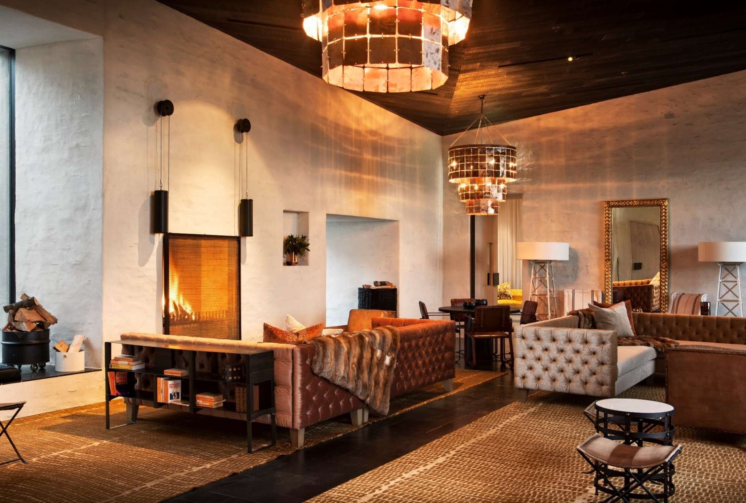

Slide 7
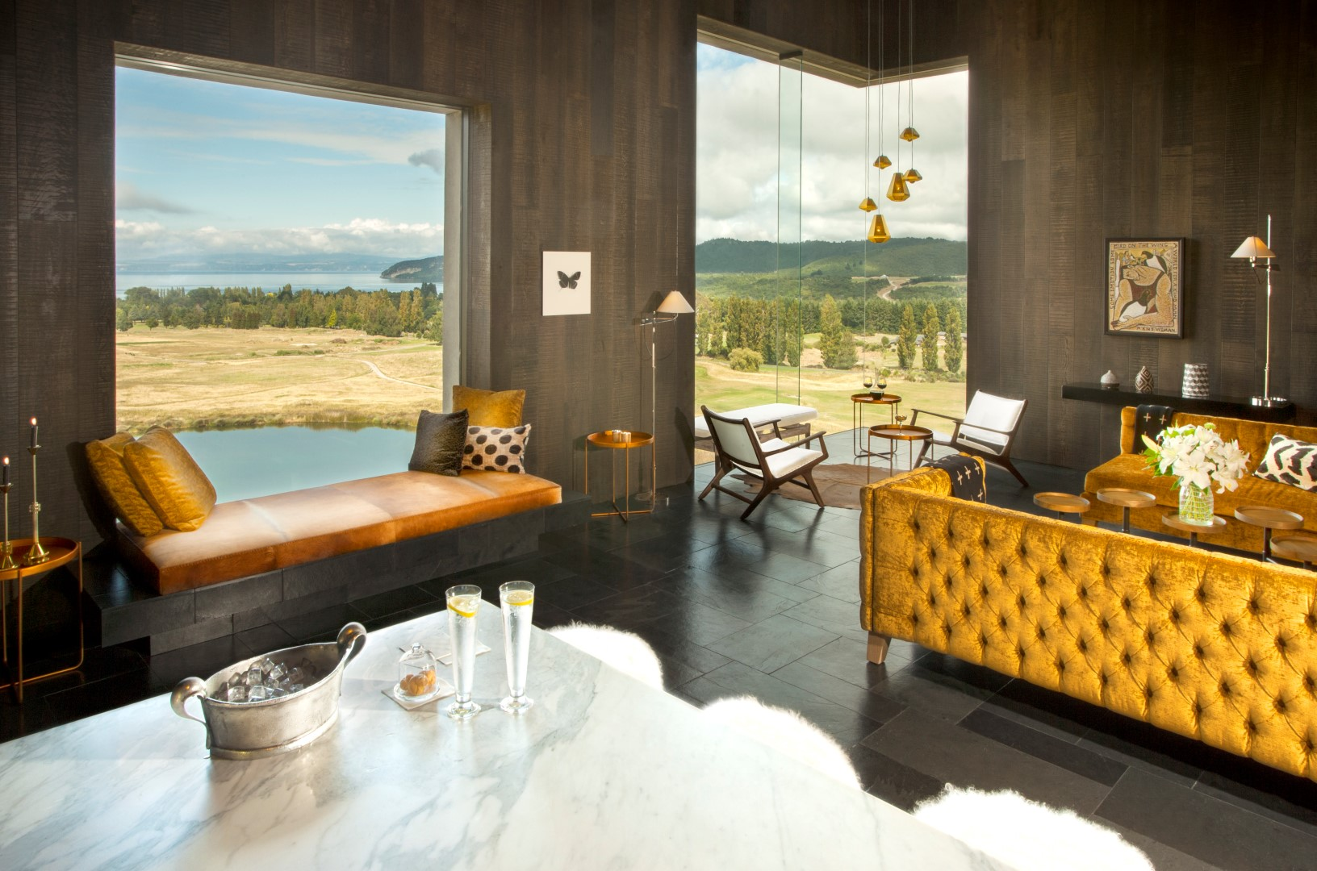


Slide 8
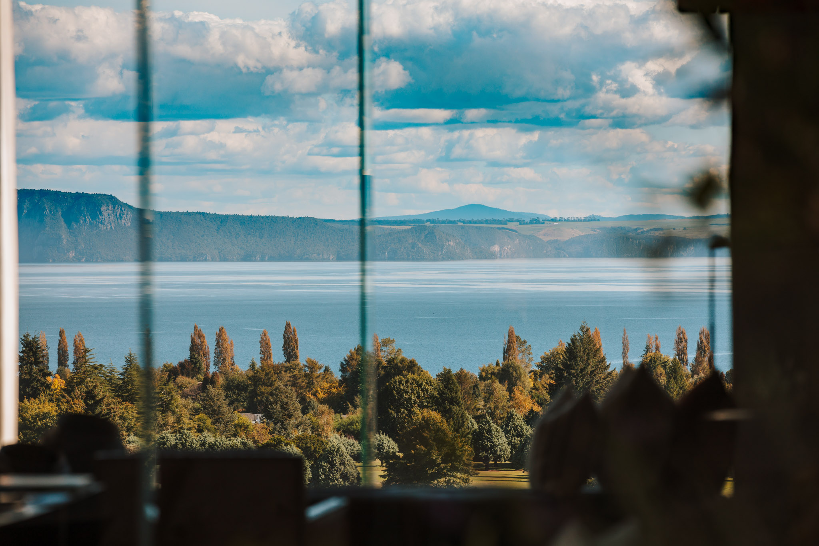
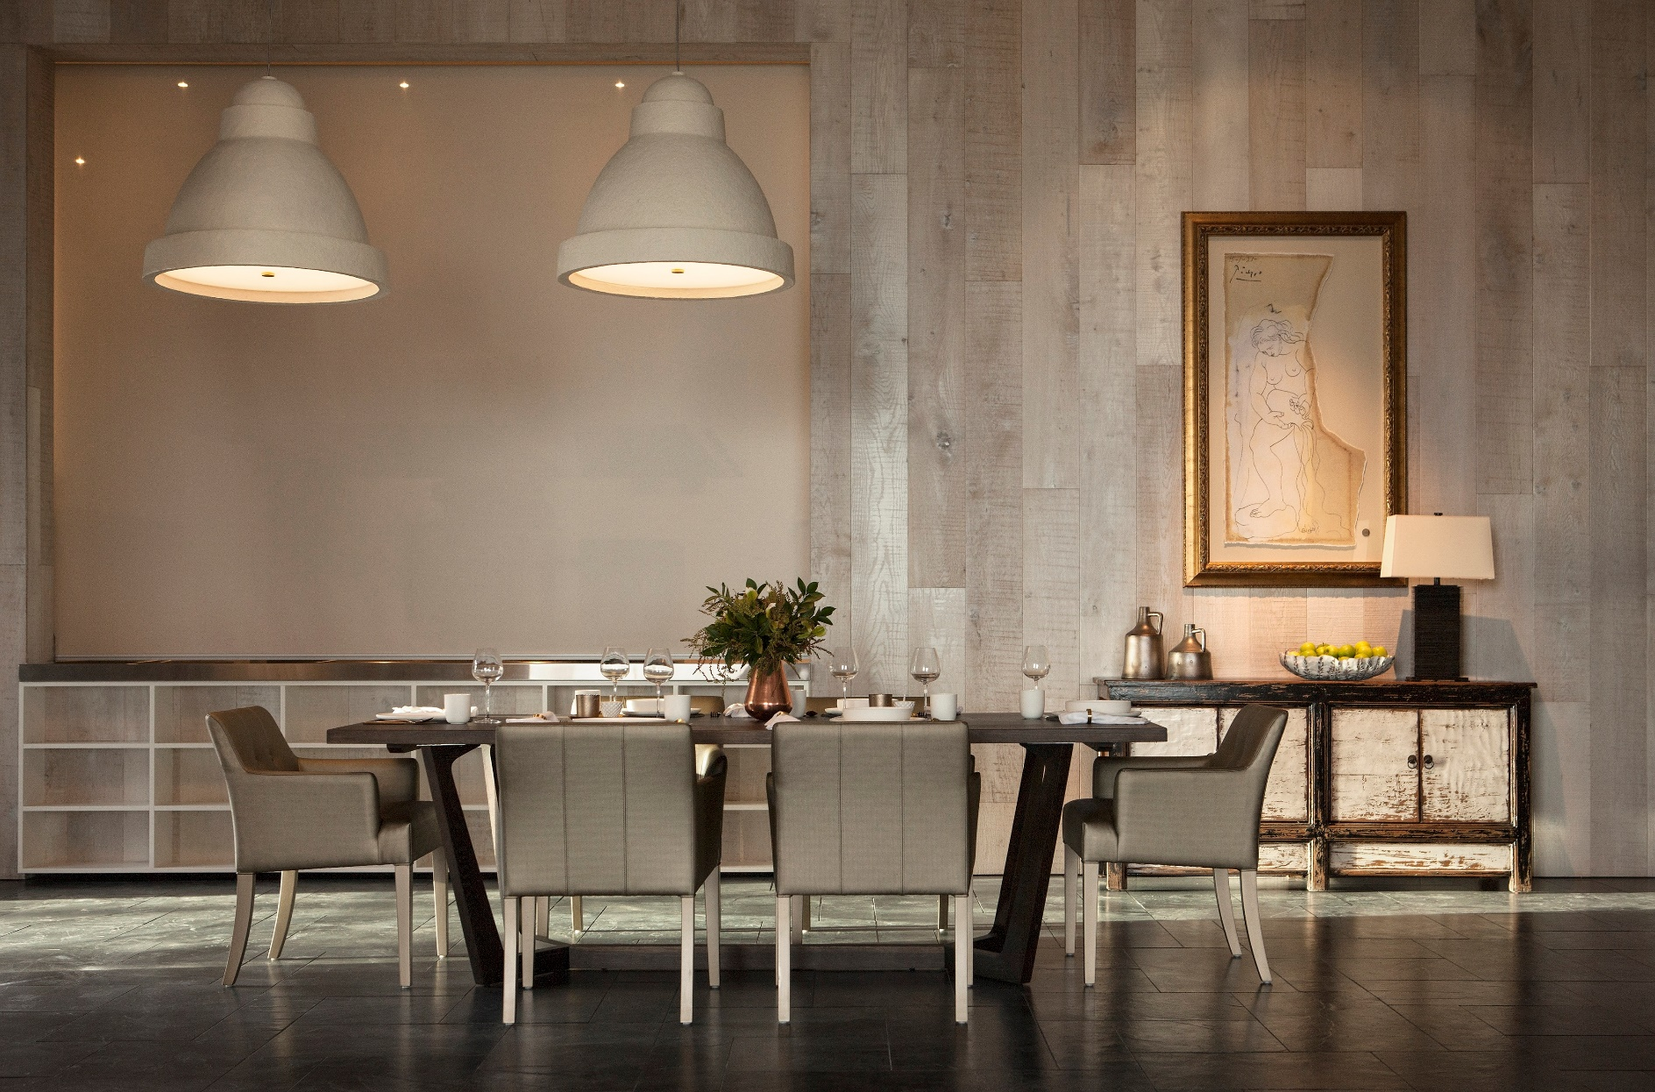


Slide 9
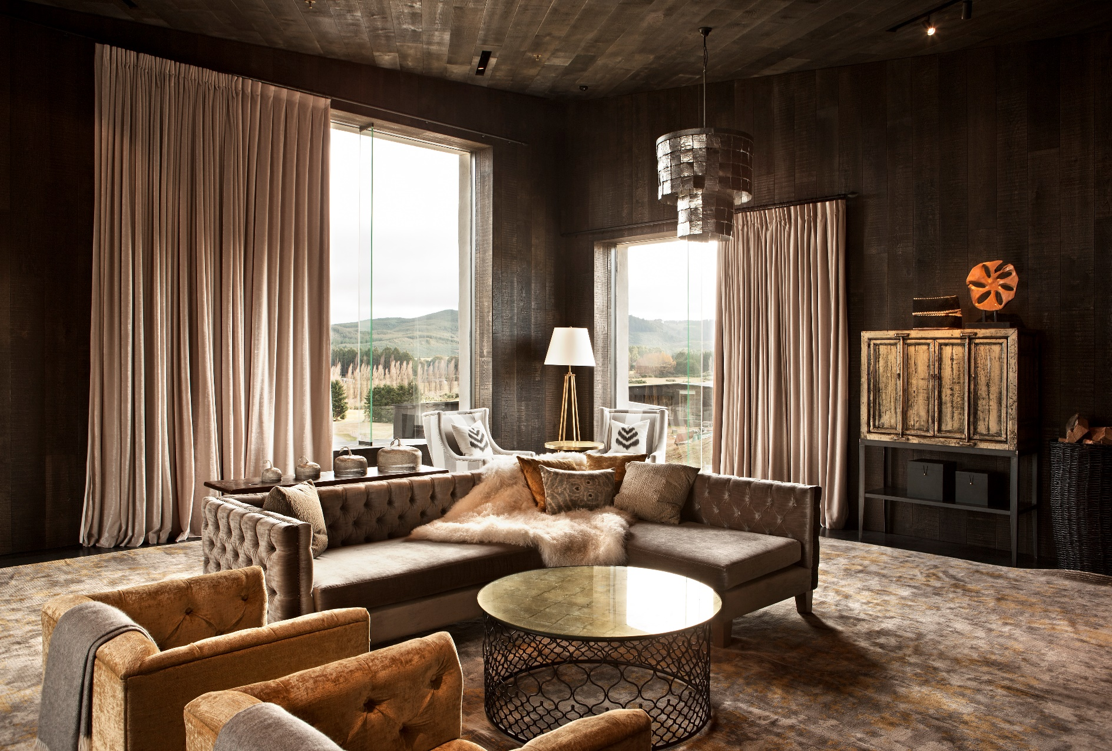

Slide 10
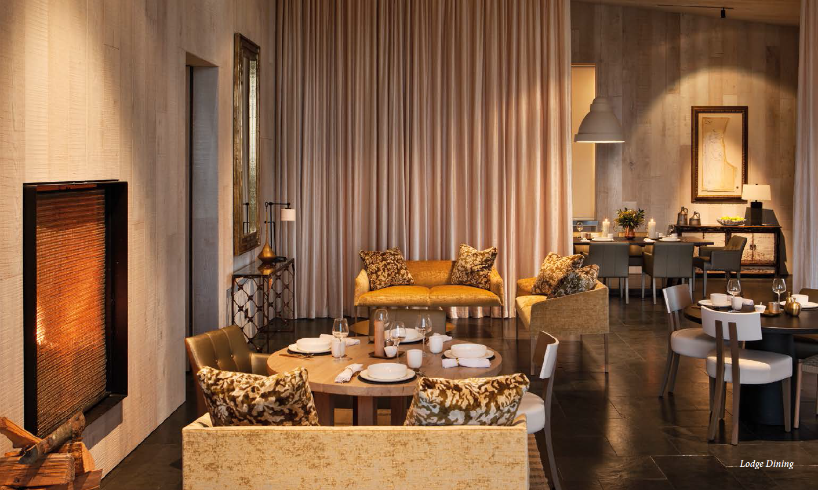

Slide 11
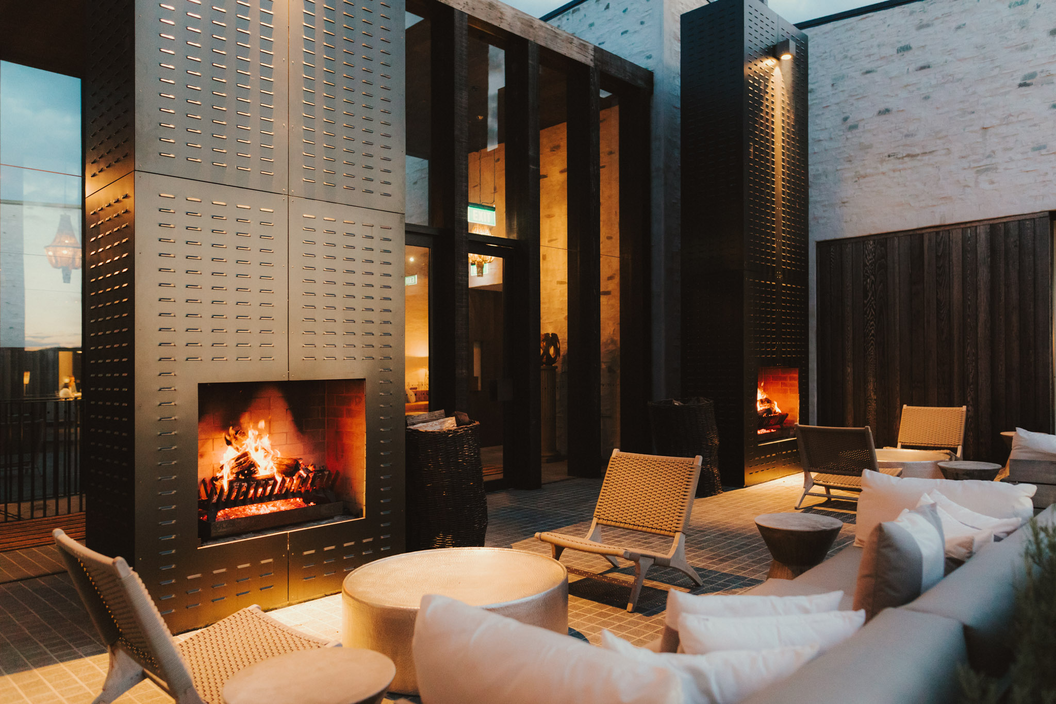

Slide 12
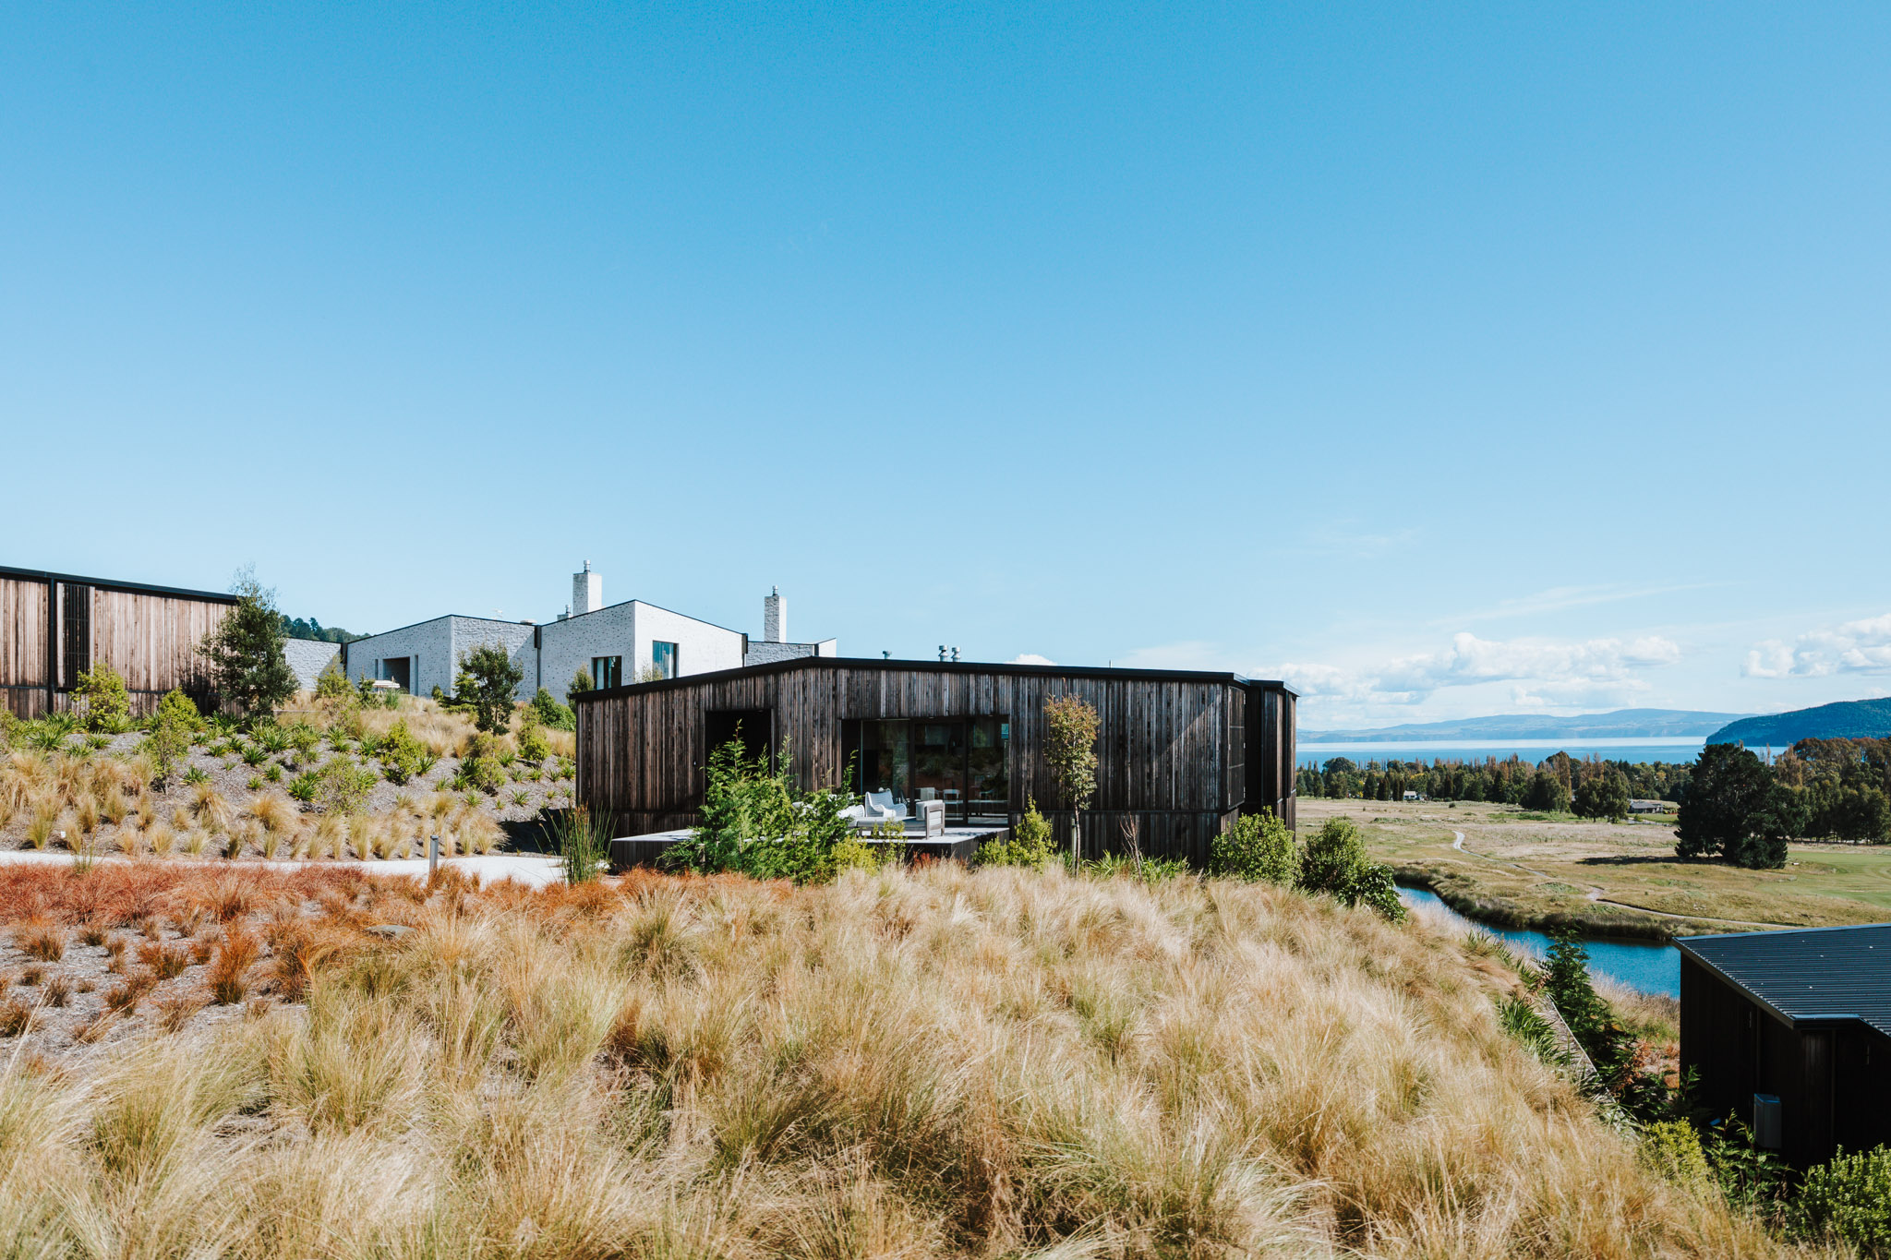

Slide 13
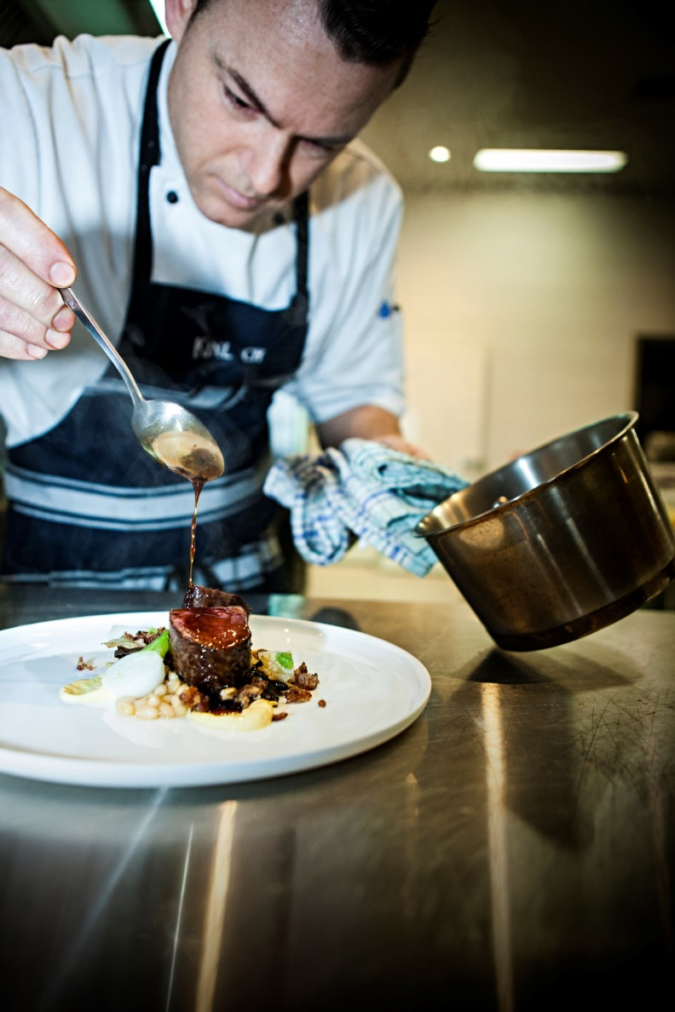
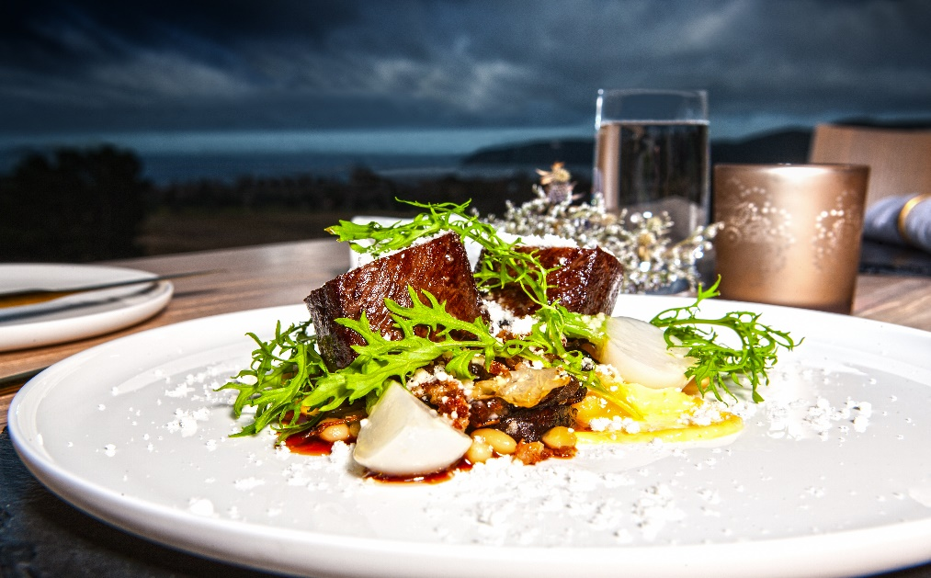
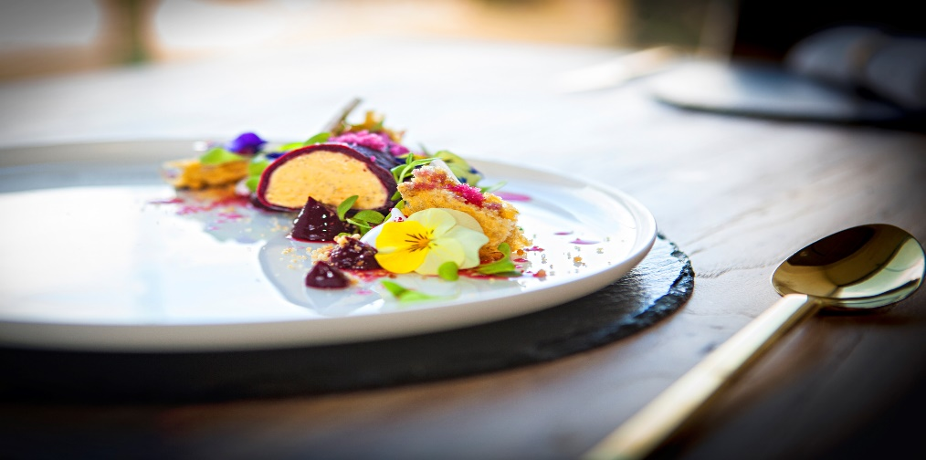

Slide 14
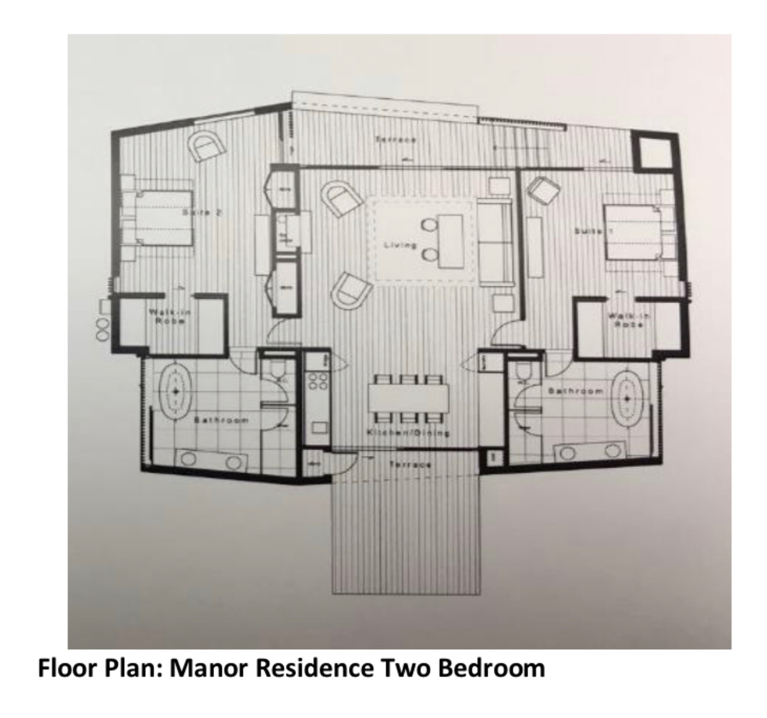

Slide 15
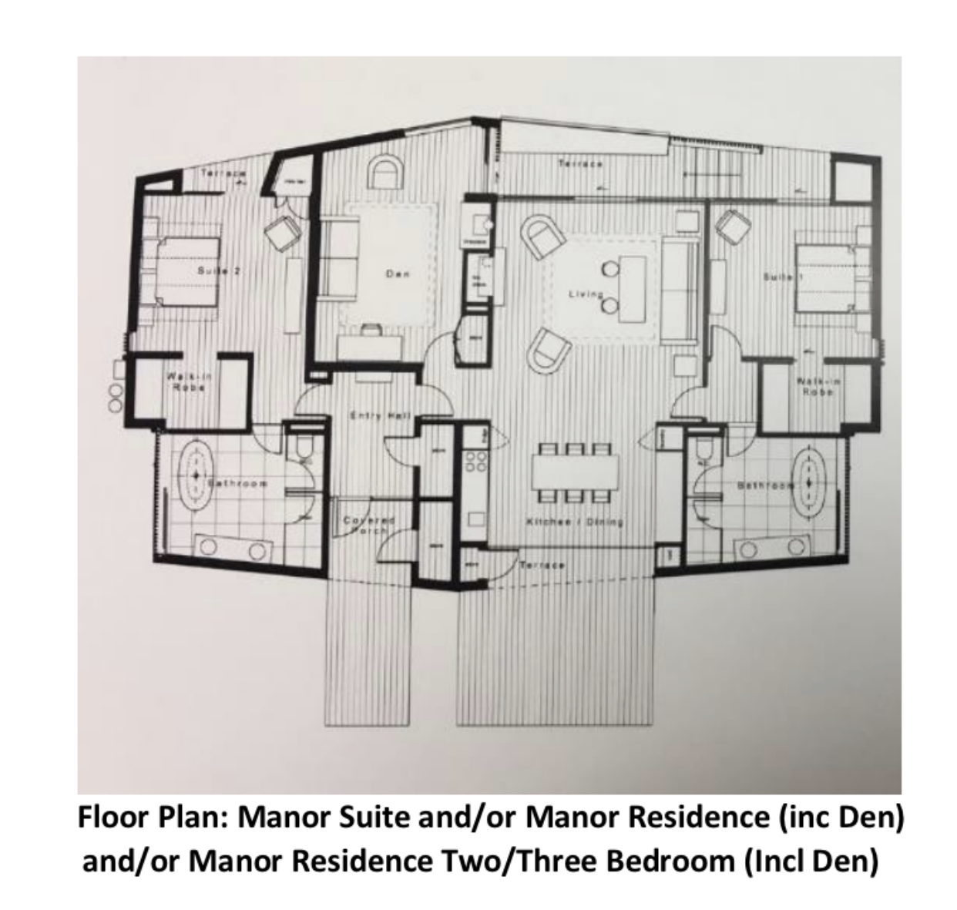

Slide 16
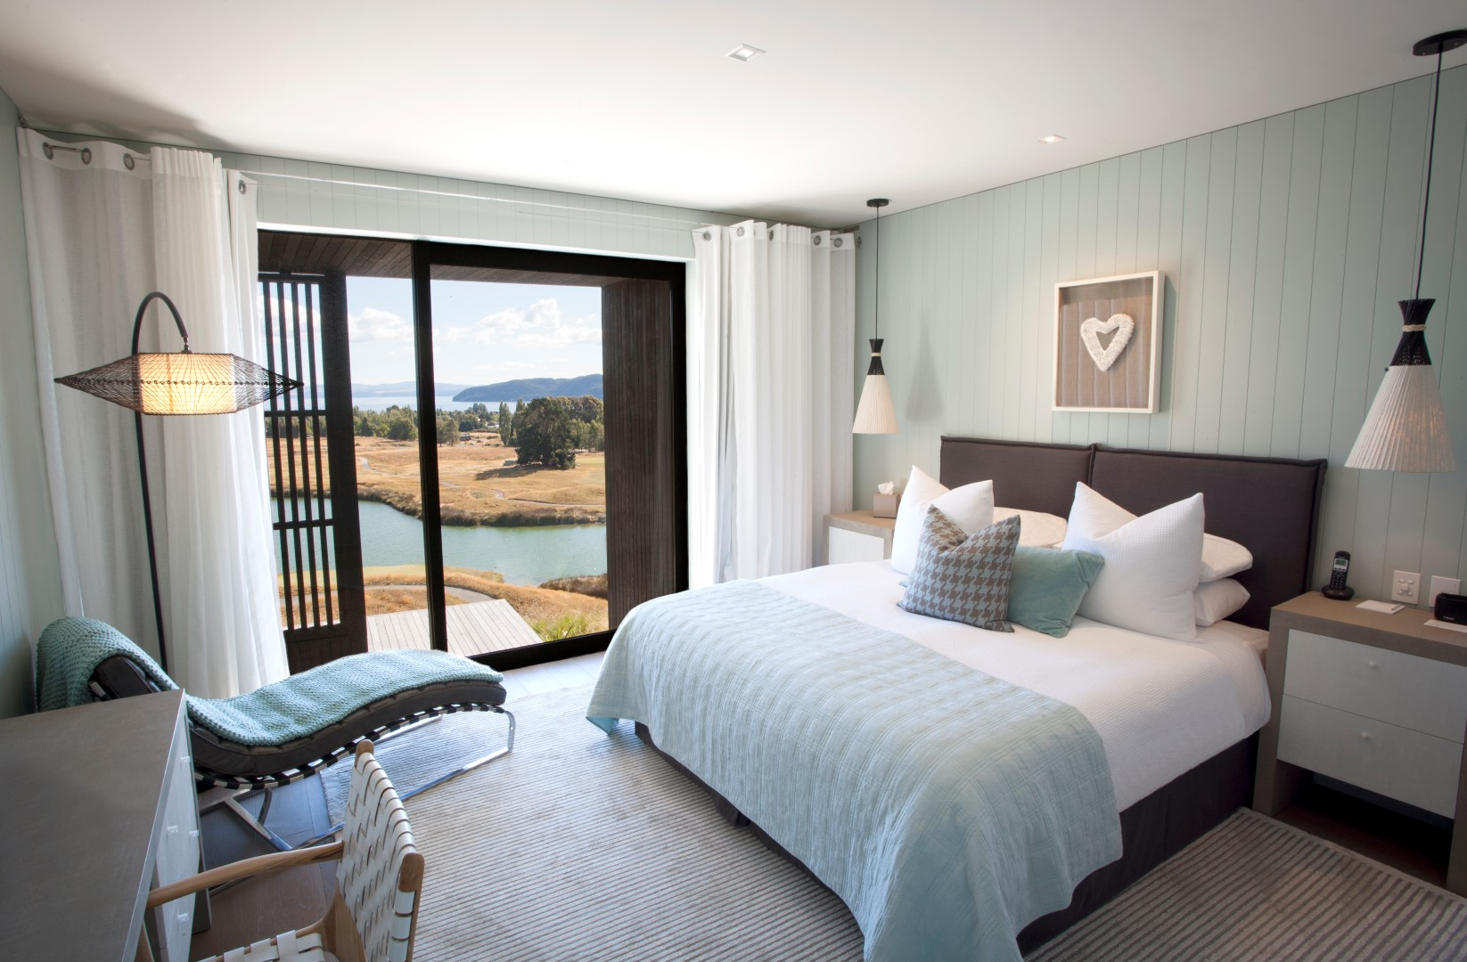

Slide 17
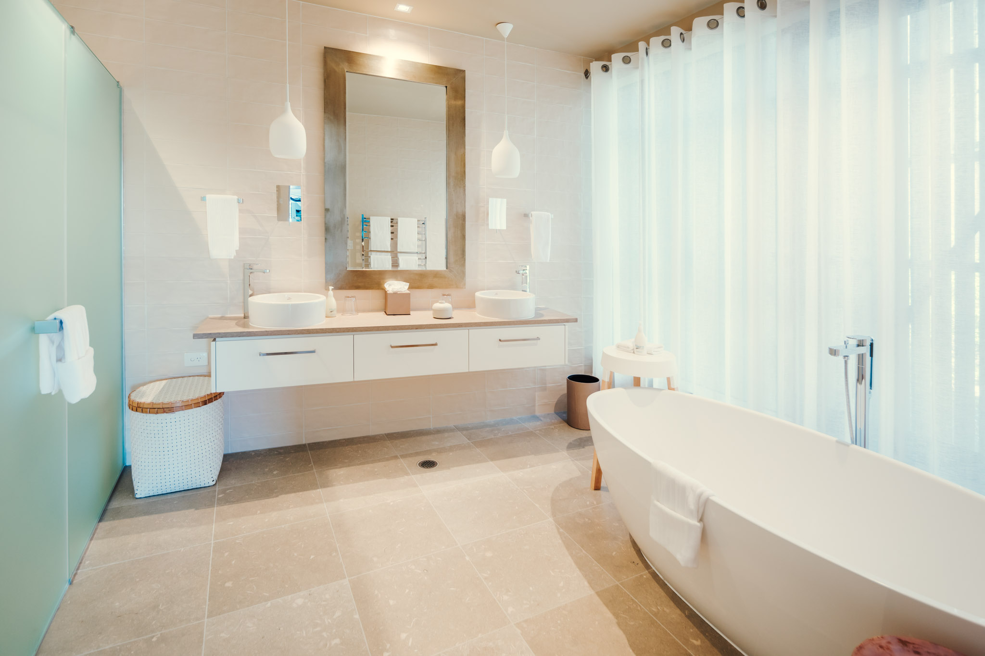

Slide 18
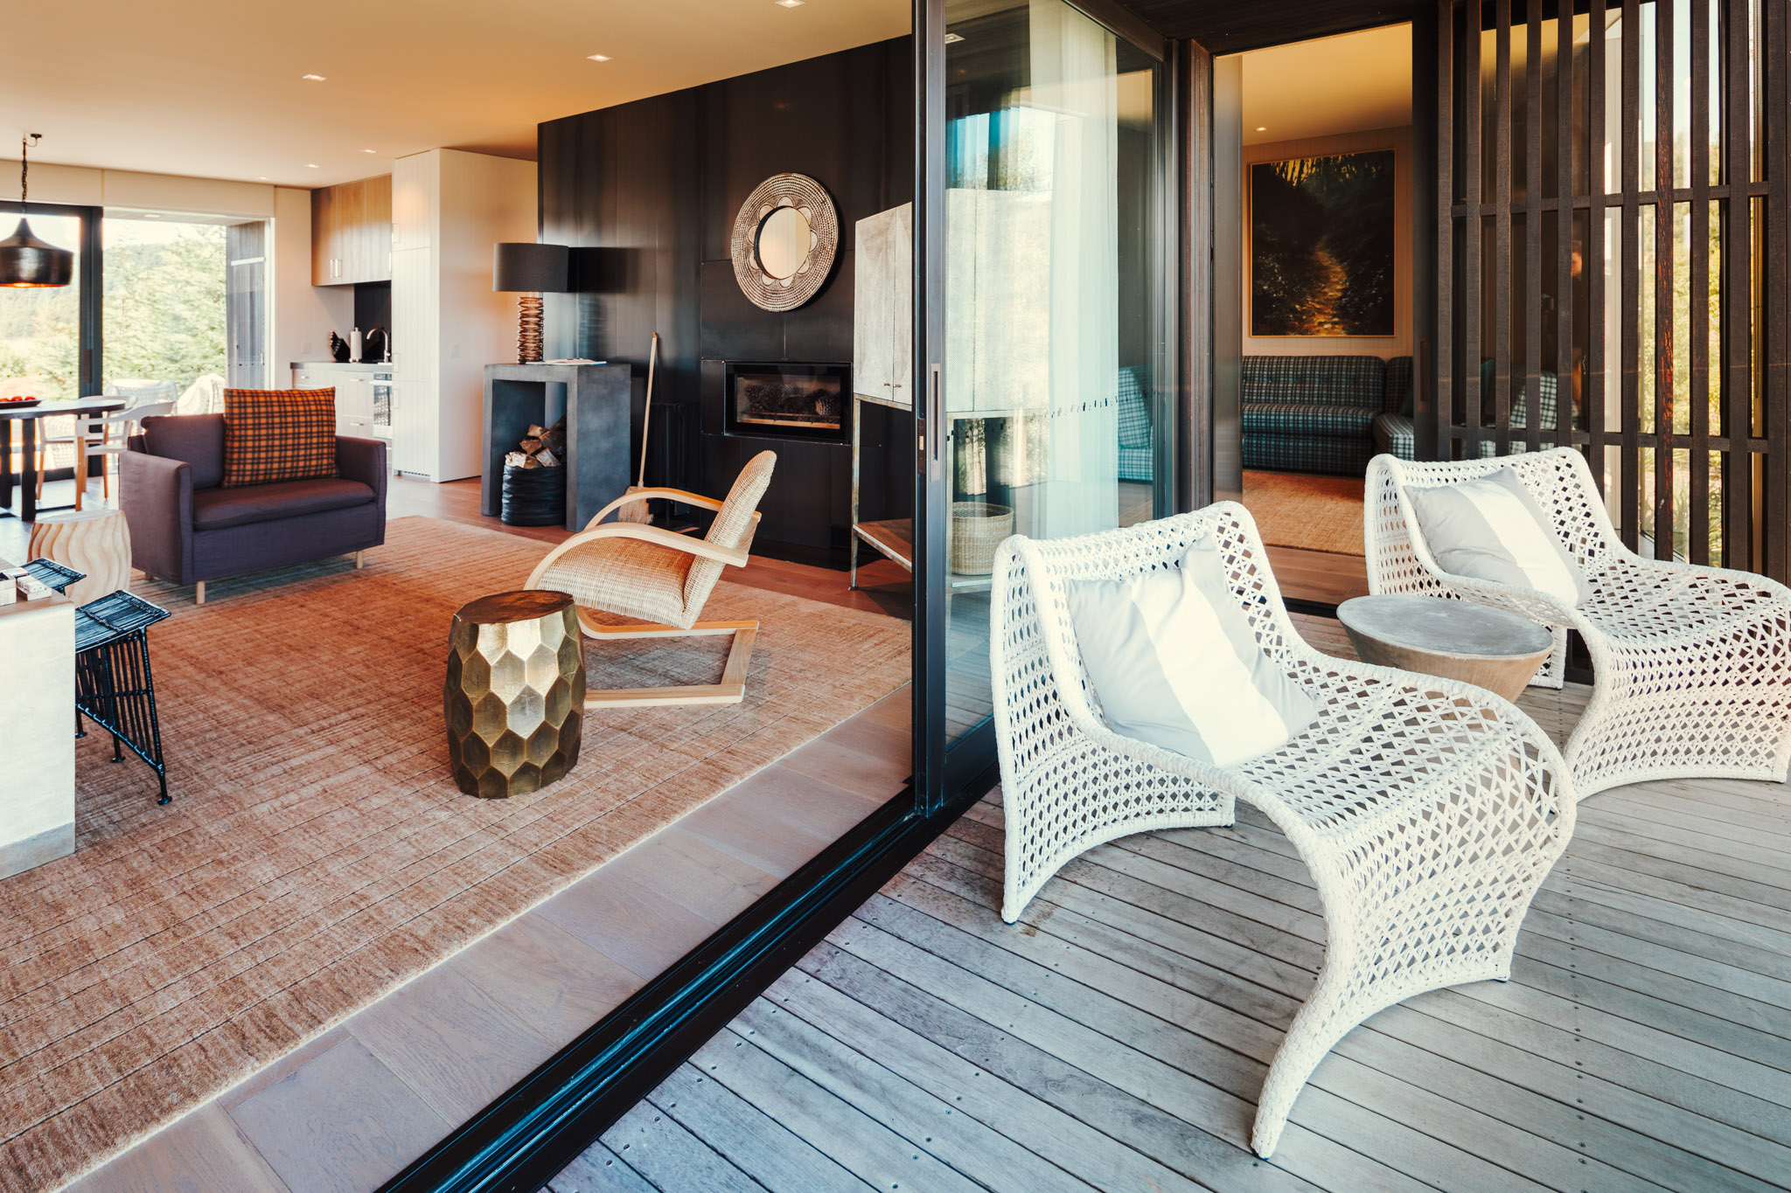

Slide 19
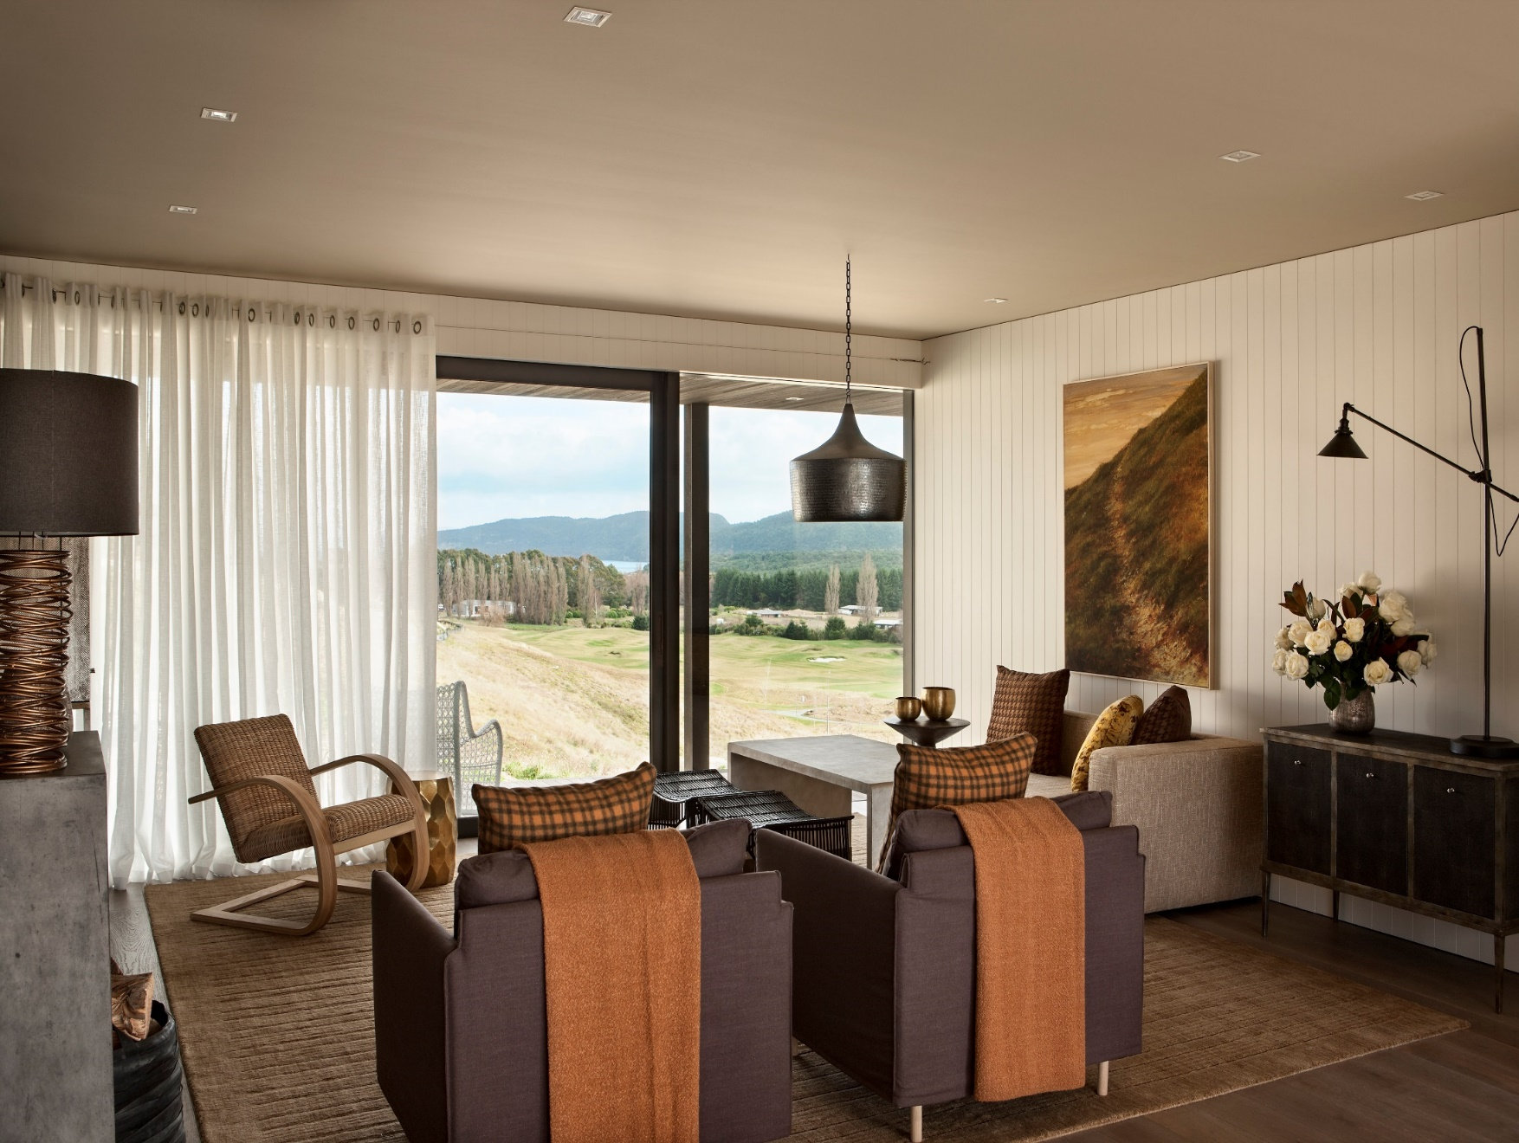
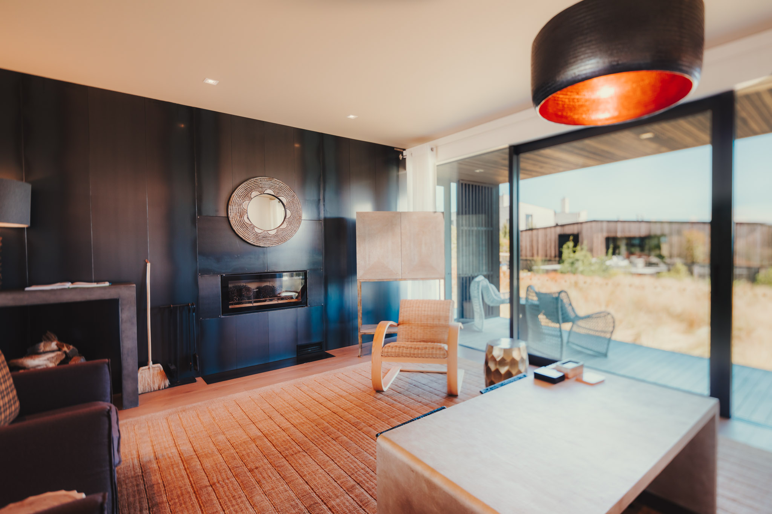

Slide 20
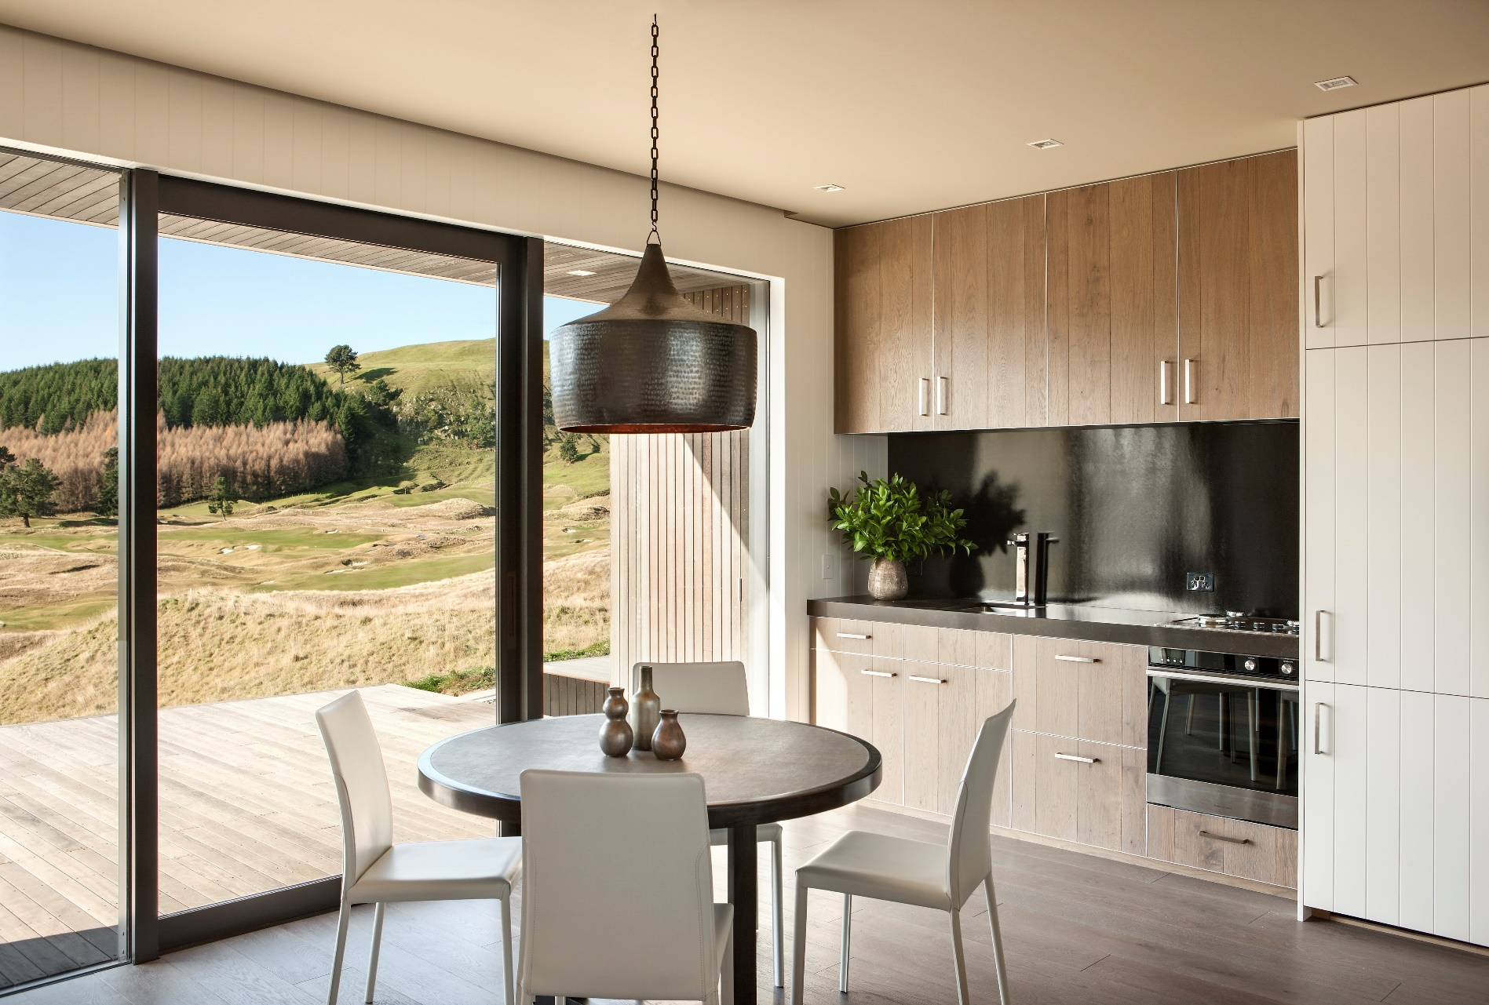

Slide 21
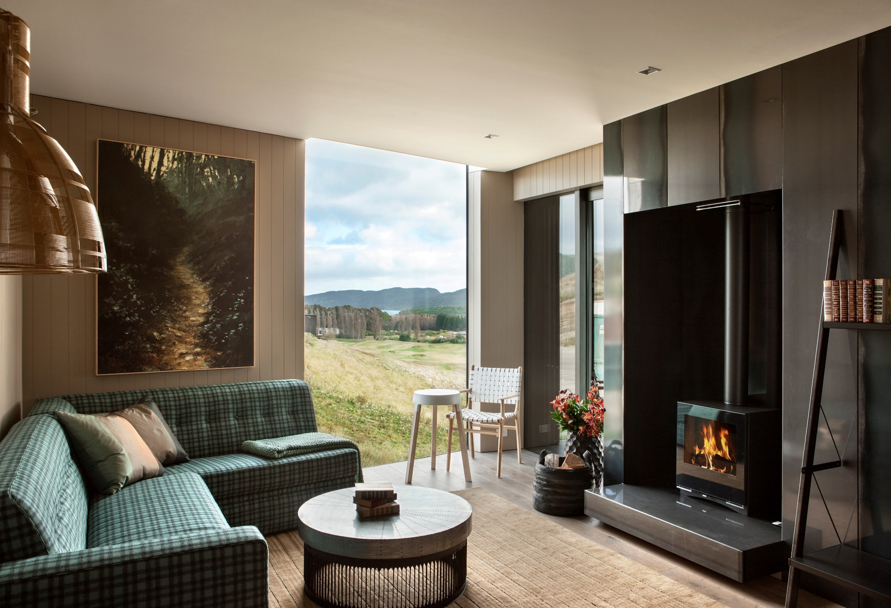

Slide 22
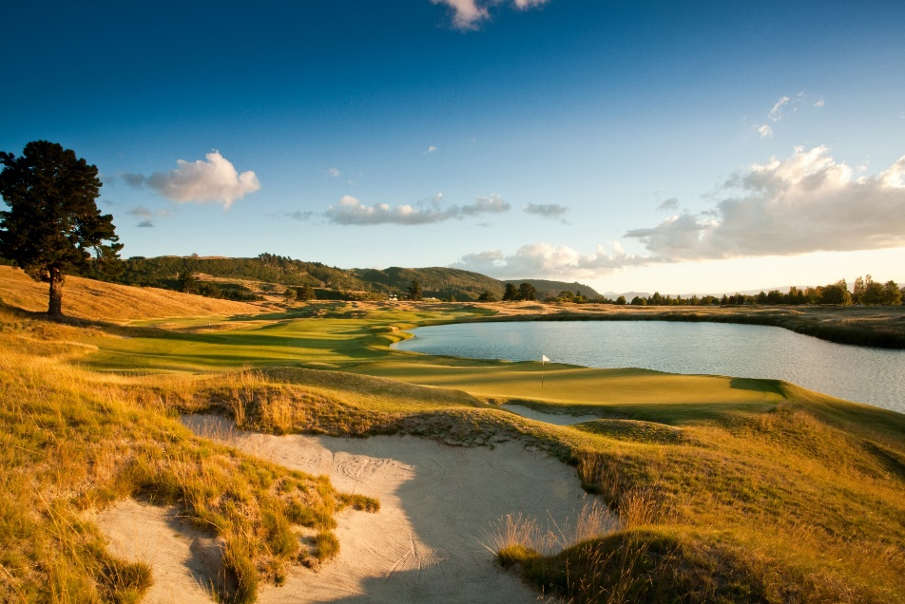
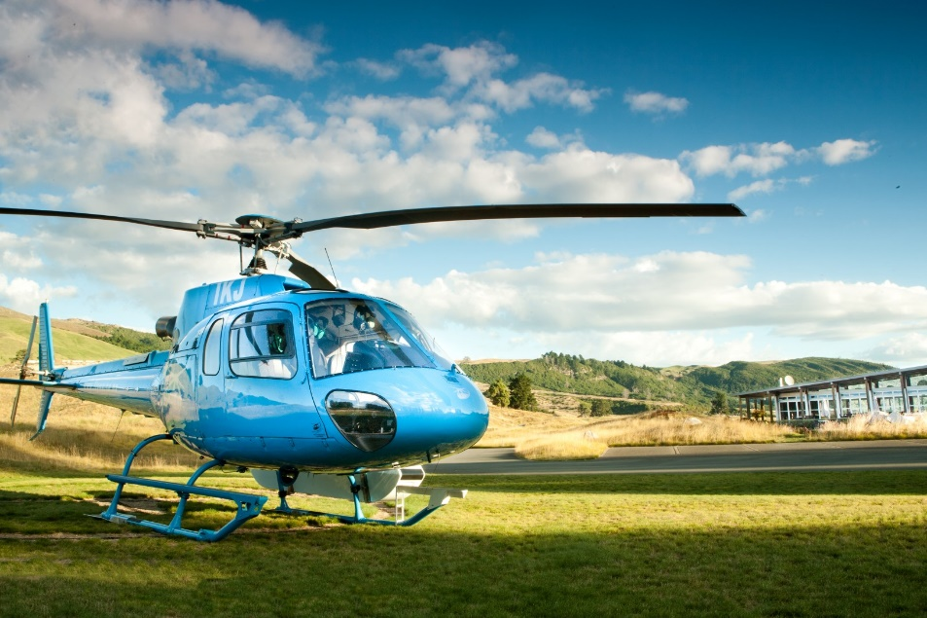
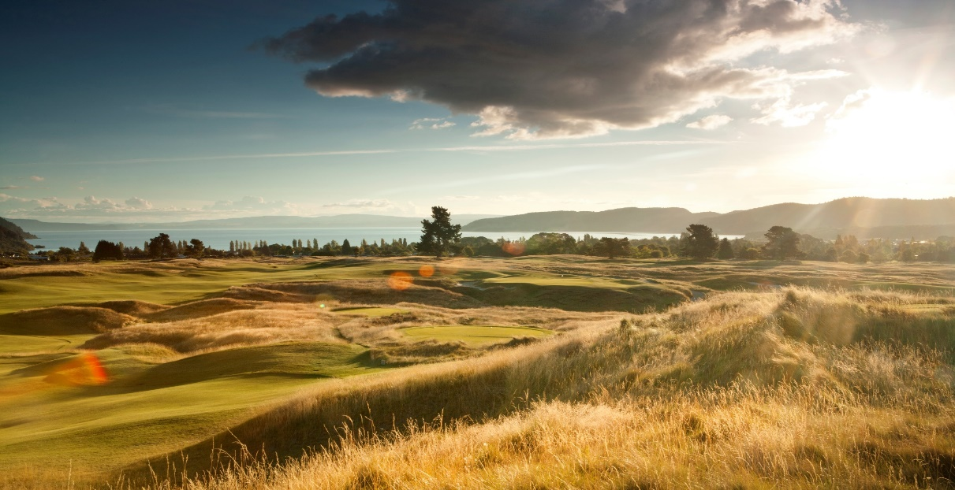
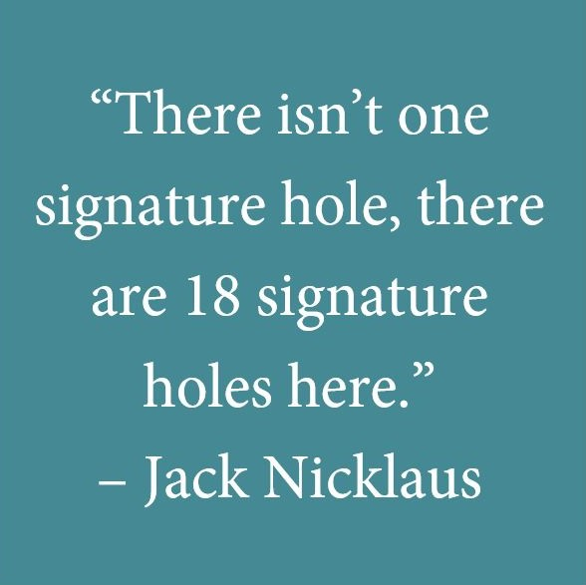

Slide 23
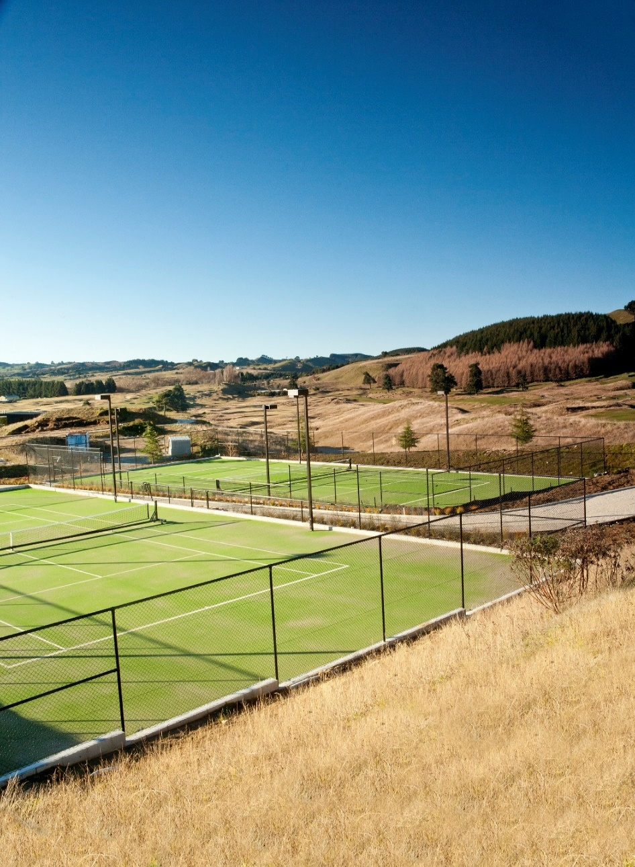
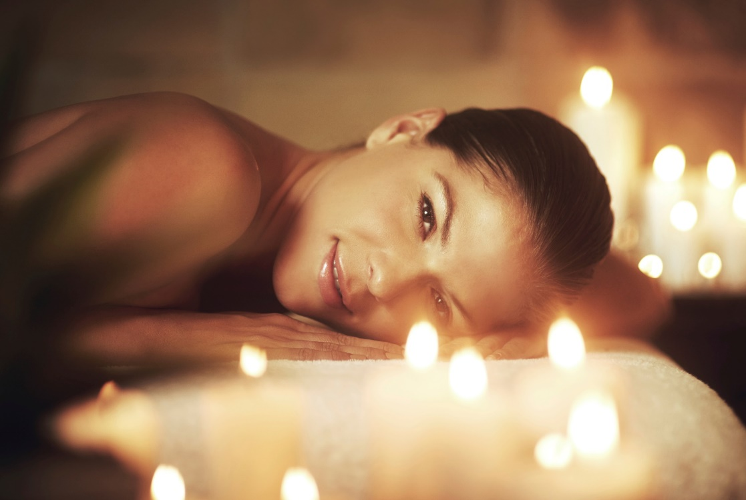

Slide 24
