Slide 2
Agenda
National Overview
Regional Summary
National Tourism Strategy
Next Big Strategic Review
Things to Consider
Group Discussion

Slide 3
Domestic visitors deliver 60% of nights and spend
Domestic
18 Bn
↑2.2%
International
12 Bn
↑4.6%
Source: Accommodation Survey, MRTE’s YE June19
Notes:
Commercial guest nights reached a new high in the year ending June 2019, up 1.3 per cent to 40.4 million nights spent in hotels, motels, backpackers, and holiday parks. The long term trend shows strong overall growth in the sector, with a 10 year compound annual growth rate of 2.45 percent.
Reflecting the global trend of a softening in the international travel market, domestic guest nights have grown strongly, while international guest nights in commercial accommodation have dropped slightly over the year. Compared with the June 2018 year, domestic guest nights rose 3.9 per cent, while international guest nights fell 2.1 per cent.

Slide 4
Top 6 markets - YoY Growth
Germany -0.8%
Softening economy, shift to savings
China -8.5%
2019 soft; long term outlook positive
Total All Markets: 3.89M
+0.0%
UK -1.5%
Brexit
USA +8.6%
Strong value opportunity as demand and air connectivity continue to grow including QF/AA jv
Japan -1.1%
Rugby World Cup opportunity
Australia +3.0%
Positive momentum
Source: IVA – Statistics NZ
Holiday visitor arrivals
YE July 2019
Notes:
The number of international visitor arrivals to New Zealand increased by 2.7 per cent to 3.89 million, for the year ending June 2019. While this is a softening in growth, the long term trend remains positive, with a 10 year compound annual growth rate of 4.9 per cent

Slide 5
International visitors are staying in New Zealand longer
Source: International Travel, Stats NZ
Notes:
3.6 percent annual decline in the number of visitors undertaking short trips of 1-3 days, a 2.9 per cent increase in trips of 4-7 days, and a 5.3 per cent increase in trips of 8-14 days.

Slide 6
Strong Growth in Older Visitor Arrivals
15-34yr
1.21m
↑3.9%
Since 2017
35-54yr
1.19m
↑3%
Since 2017
55-65+yr
1.05m
↑13%
Since 2017
Visitor Arrivals by age
Source: International Travel, Stats NZ
Notes:
Growth in visitor arrivals was skewed towards older age brackets for the year ending June 2019. The 65+ age bracket had annual growth of 10.3 per cent, while visitors aged 55-64 had annual growth of 4.9 per cent.
According to the UN, by 2050, 25% persons living in Europe and Northern America are projected to be aged 65 or over[1]. Similarly, Australia is projected to have 21 per cent of the population to be aged 65 or over by 2050 (compared to 15 per cent in 2017). As this demographic trend becomes more pronounced over time, it is expected the composition of visitors to New Zealand (across a number of key markets) will follow suit.

Slide 7
Regional Summary

Slide 8
Taupō Region outperforming the national figures
Domestic
$465m
↑6.8%
(vs. ↑2.2% NZ)
Visitor Spend
$685m
↑7%
(vs. ↑3.2% NZ)
=
2/3
of all spend
International
$219m
↑11.1%
(vs. ↑4.6% NZ)

Slide 9
Domestic visitors deliver 60+% of all spend
Notes:
Domestic 65% - 80%

Slide 10
USA leading the charge
Germany
$18m | +5.8%
Vs. +9.6% NZ
China
$12m | No change
Vs. -1.1% NZ
ROE
$31m | +14.8%
Vs. +9.6% NZ
USA
$40m | +33%
Vs. +14.3% NZ
UK
$30m | +15%
Vs. +3.6% NZ
AUS
$49m | +8.8%
Vs. +2.1% NZ
Source: MBIE – MRTE’s
YE Jun 2019

Slide 11
Winter flat but shoulder growing at over 10%+

Slide 12
USA and AU delivering over shoulder and winter periods
Notes:
UK also showed good growth in autumn

Slide 13
Things to consider
Seasonal demand but improving
Domestic visitors - key driver of year round visitation
USA, UK and AU showing good growth
Outbound travel never been cheaper
Access - key to increasing arrivals
Product diversity
Limited bookable product of high value
Infrastructure
Importance of Ngati Tuwharetoa/ iwi partnerships
Capability of industry
Community engagement and support of tourism
Sustainability

Slide 14
Sustainable growth that benefits all
New Zealanders
Visitor Experience
Environment
Economic
Community
Manaakitanga | Kaitiakitanga Whanaungatanga
Visitor Experience
Environment
Economy
Community
Regional growth
Iwi and Industry Partnerships
Embed sustainability
Manage our destinations
Grow and shape demand
Embracing Tikanga Maori
Living Tiaki
Engaging the Community
Industry Carbon Use
Invest in infrastructure and amenities
Foster domestic tourism
Invest in data and research
Destination Management though the 5 A’s
Awareness
Access
Attractions/Activities
Amenities and Services
Ability
More visitors
Grow Expenditure
Industry Engagement
Community Support
Sustainability
Team culture
We believe in positively changing lives and our community, through sharing our love of this place
We believe in, and trust our team
We are innovative and courageous
We win through strong vibrant partnerships
We love our place
EXTEND
Year round destination
DIVERSIFY
Markets and Experiences
INVEST
Partnerships
Product Development
Data and Insights
SUSTAIN
Community and environment Industry Capability
Funding
The next big thing

Slide 15
The Next Big Thing 2016 - 2026
EXTEND
DIVERSIFY
INVEST
SUSTAIN

Slide 16
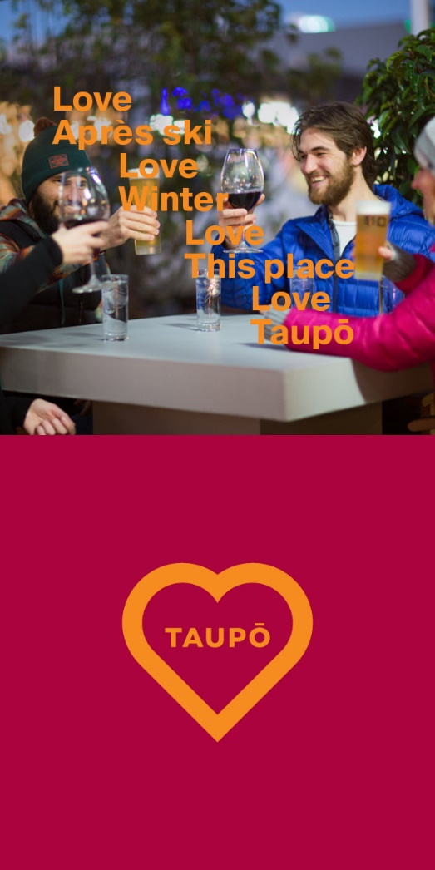
Year round destination
Seasonality
Extend summer across autumn and spring.
Market Taupo as a short break destination.
Winter focus – geothermal, ski, hiking and biking.
C&I Business
Use C&I to fill midweek and shoulder season.
Spread visitation around entire region.
Events
Extend

Slide 17
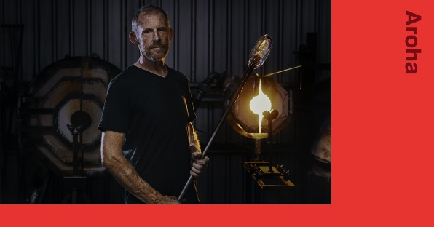
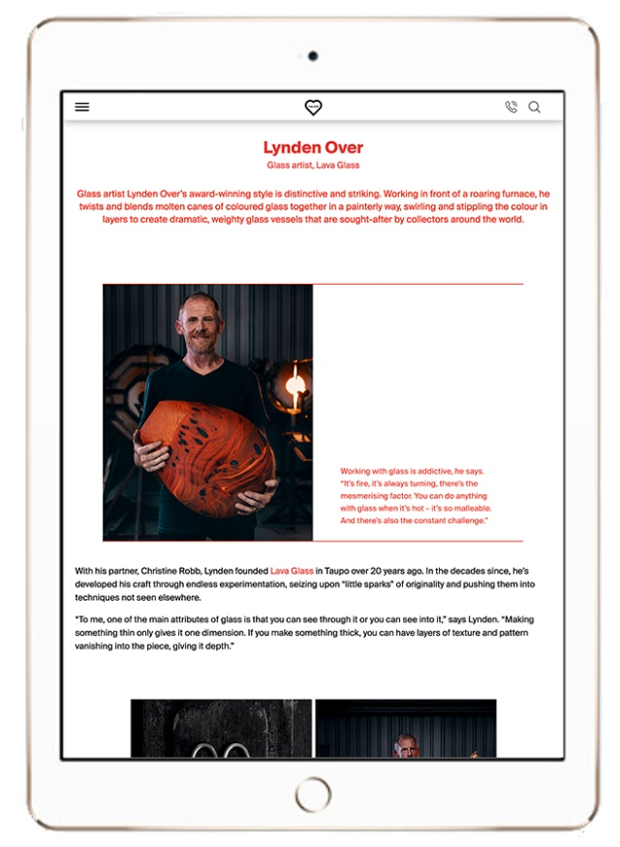
Product, Markets, Messaging
Product
More than an adventure/adrenalin destination
Monetise attractions
Collaborate and package with other products
Target segments - passion groups
Source markets and target segments
Couples, families, boomers
Passion groups – MTB, fishing, hiking, boy’s weekends
Content and Messaging
Telling a broader picture
Diversify

Slide 19
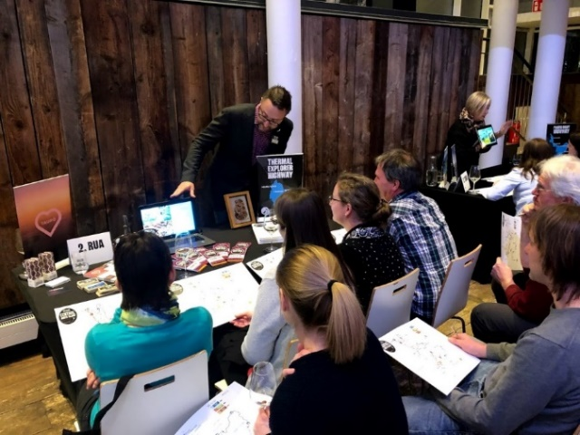
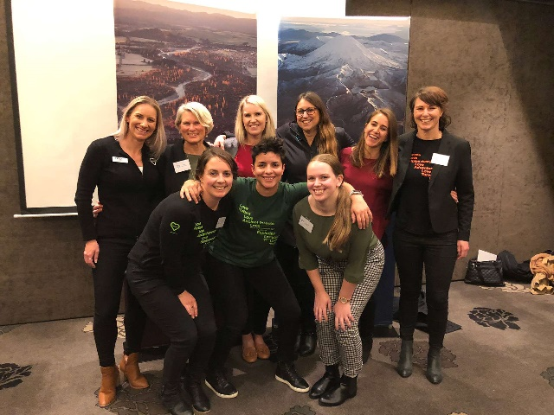
Product, Partnerships, Technology, and Capability
Product Development
New product – suits our source markets
Partnerships
Ngati Tuwharetoa and neighbouring iwi
ITO’s, TNZ, wholesalers
Regional and government agencies
Technology
Res systems – instant confirmation. Online bookability, track and measure
Social channels
Capability
Building knowledge and capability
Training programme
Industry engagement
Invest

Slide 20
A great place to live is a great place to visit
Social
Community engagement and support – social license
We all love our place – its about managing it in a way that benefits our community and protects it for future generations.
Environmental
Carbon neutral
Sustainability Pledge
Tiaki Promise
Economic
Funding
Employment - internships
Sustain

Slide 21
Group Discussion
What does your ideal customer look like?
Notes:
Where do they come from, what age, how are they travelling, who are they travelling with, easy to upsell, respectful of property/asset, return customer, share the word…reviews,

Slide 22
Delivering an Outstanding Visitor Experience
What are 3 things you could do within your business to improve your customer’s experience throughout their entire customer journey?
Notes:
Through the entire journey from Dream, plan – book and follow up.

Slide 23
Sustainability
What are 3 things you can do within your business to reduce your carbon footprint or improve sustainability?
What are 3 ways you can share the Tiaki promise with your guests?
Notes:
Refillnz, source enviro friendly products, measure your waste, get rid of plastic cups, sustainable employment programme,

Slide 24
Social License for Tourism
How can we better share the value of tourism with our community?

Slide 25
Destination Great Lake Taupo
What is the one thing that we can do to better support your business?

Slide 26
What would you do?
If you were DGLT what would be your number one priority or BHAG?

Slide 27
What is your vision for Taupo in 10 – 20 years time?
How will Taupo look, feel and act in the future

Slide 28
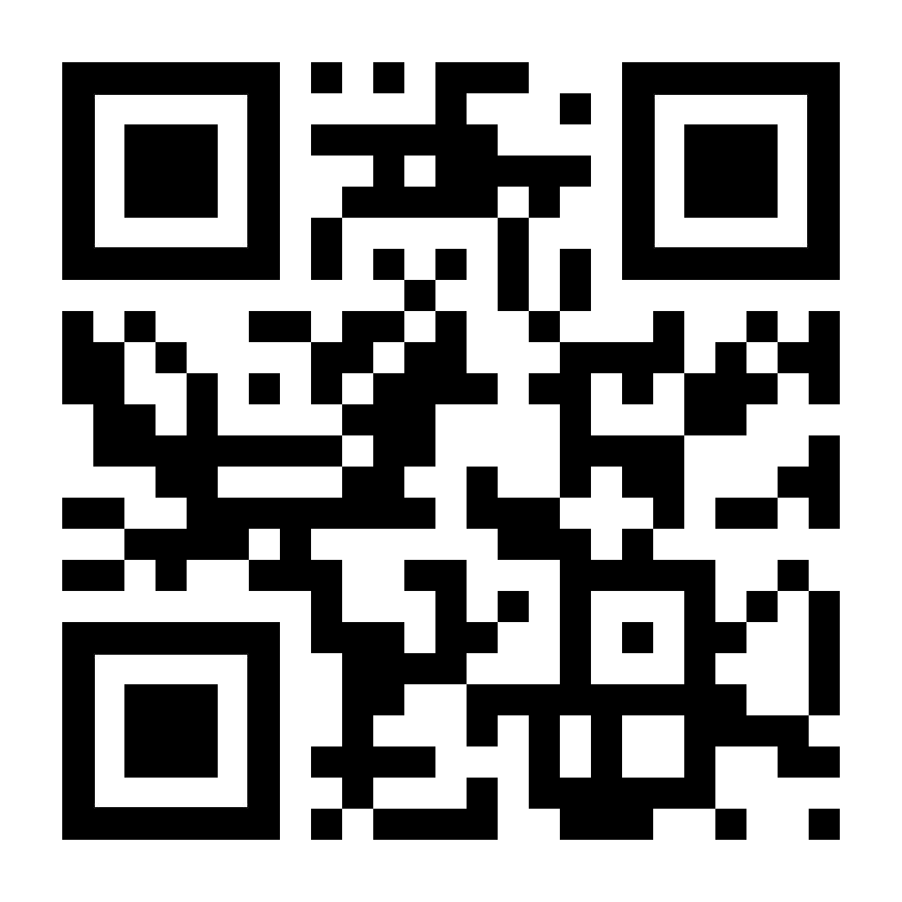
Industry Survey
http://bit.ly/LT_audit

